Slide 1
- COMPANY LOGO GOES HERE -
INSERT COMPANY DETAILS AND LOGO ON THIS SLIDE
DELETE SLIDE IF NOT APPLICABLE

Slide 2

Notes:
- In your welcome, set some ground rules. All phones on silent – check this now. No checking phones during the session
The purpose of this presentation is to introduce the toolkit to you, but not to go through the content in detail. It will be up to you to go back to your teams and dive into the toolkit in detail and use it for yourselves.
Just to clarify, I am not an expert in these issues, I am simply presenting the toolkit as a resource, that should be able to answer the questions you have.

Slide 3

Notes:
The Business Toolkit provides suppliers with practical assistance on how to improve productivity, quality and workforce management: outlining why each issue is important to your business, what you need to do in practice and practical tools to support you as you make improvements, including links to various helpful websites and resources.

Slide 4
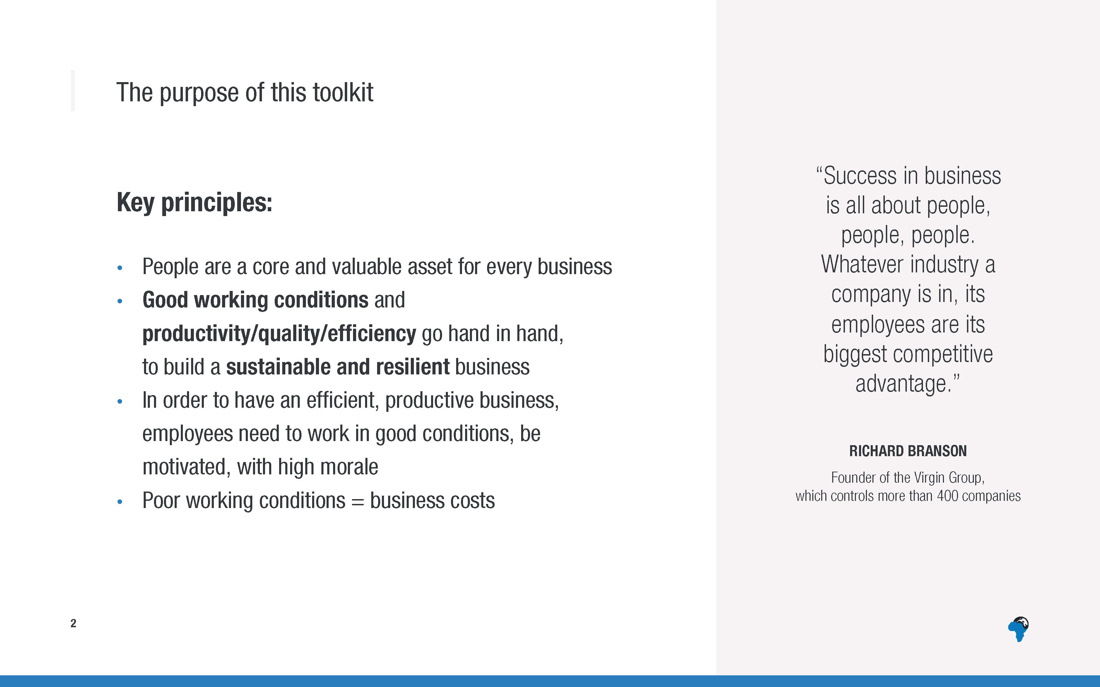
Notes:
Workers who are safe, respected and content are more efficient and productive
Poor health and safety, long hours etc all result in costs for the business – lower productivity and higher worker turnover

Slide 5
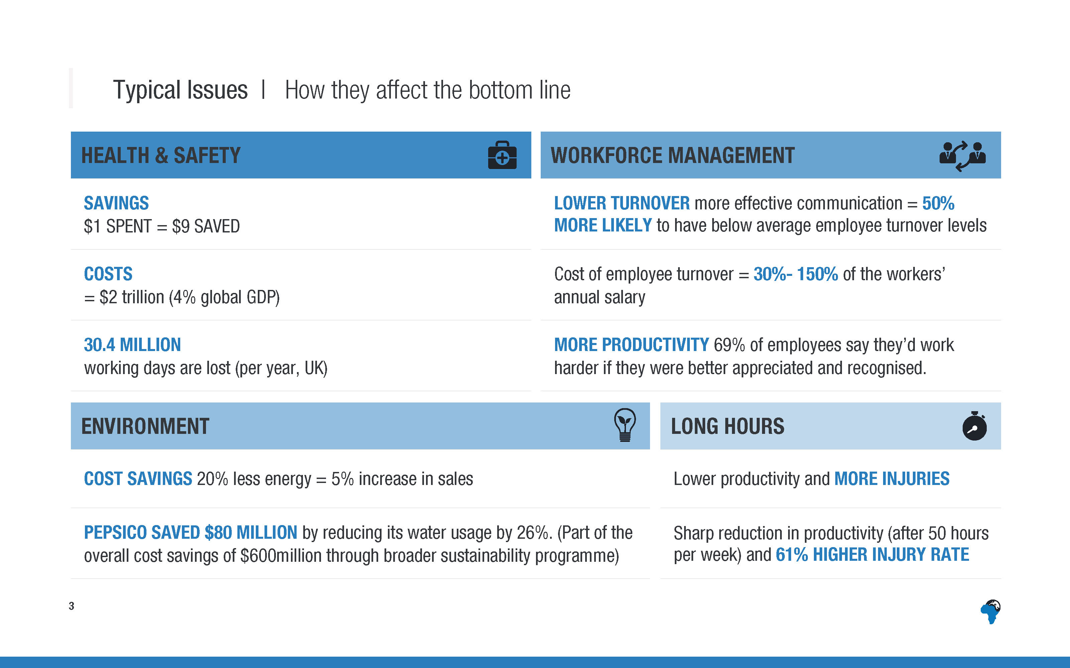
Notes:
[You don’t need to mention all of the stats, in your preparation, read through all of them and highlight the key ones you think are most important to mention to this audience.]
Health and safety
Health and safety improvements can result in a return on investment (ROI) of $9 saved for every $1 spent.
Work-related illness and injury worldwide costs 4% of annual global GDP - $2 trillion.
30.4 million working days are lost due to workplace injury or illness per year, in the UK alone.
Workforce management
Businesses with more effective communication are more than 50% more likely to have employee turnover levels below average
The cost of employee turnover is high, the cost to replace each person that leaves can be equal to 30%-150% of that workers’ annual salary (for entry and mid-level employees).
In a survey, 69% of employees said that they would work harder if they were better appreciated and recognised.
Hours
For each hour people work above 50 hours per week there is a sharp reduction in productivity.
Also, working more than 50 hours a week is associated with a 61% higher injury rate.
Environment
Cost savings : A 20% cut in energy usage represents the same bottom line benefit as a 5% increase in sales.
PepsiCo saved $80million simply by reducing its water usage by 26%. This was part of the overall cost savings of $600million through its broader sustainability program, including energy, packaging and waste reduction.
[NB: If people ask for references, full references are given in the toolkit]

Slide 6
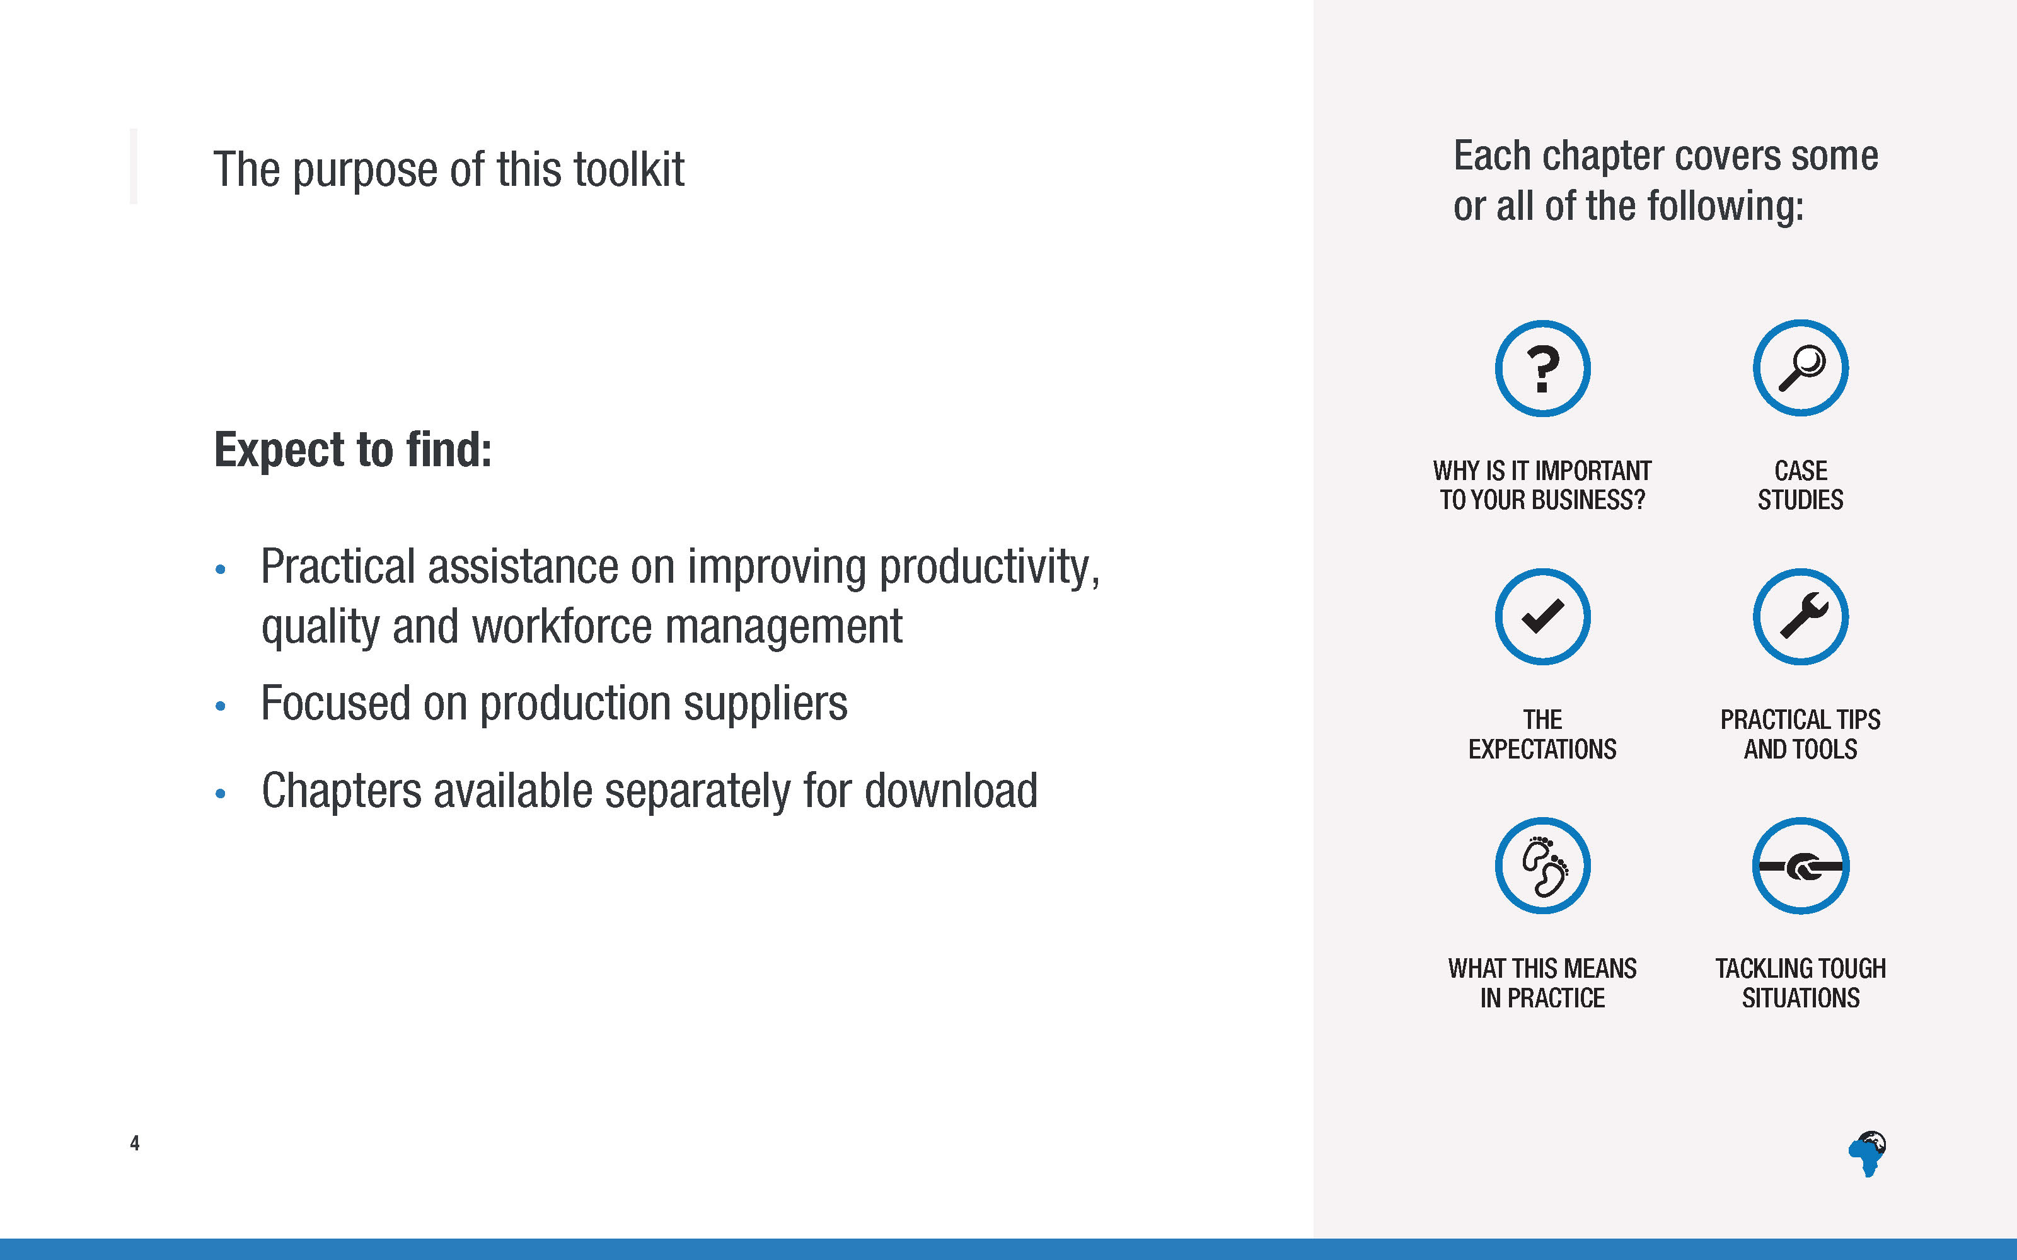

Slide 7
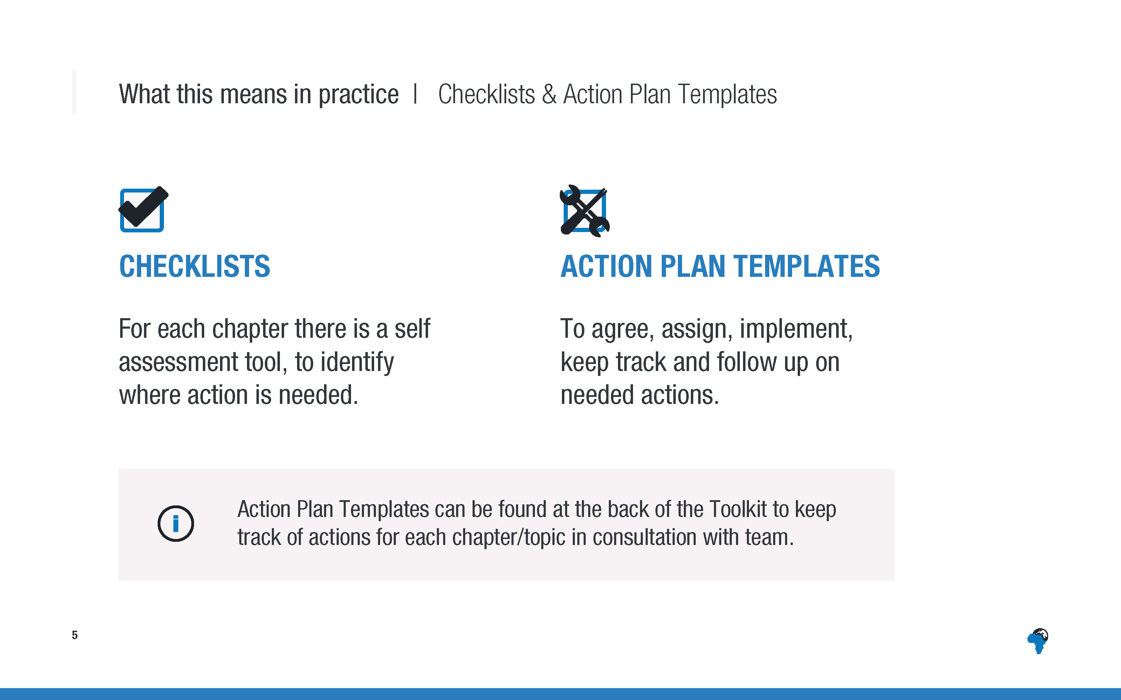
Notes:
This is one of the ways you can make the toolkit really practical and useful to your specific facility/factory.
You can work together with your colleagues and teams to work through the checklists, seeing where things are already in place and where they are not – and also where they are only partially in place and still need work. This will help you to focus your actions/improvements.
Once you’ve completed the checklists as a team, you can then use the action plan templates that are provided at the back of the toolkit to keep track of progress on actions for each topic, working in partnership with your team and those responsible for each action. This helps you to ensure that improvements and actions are seen through and completed.

Slide 8
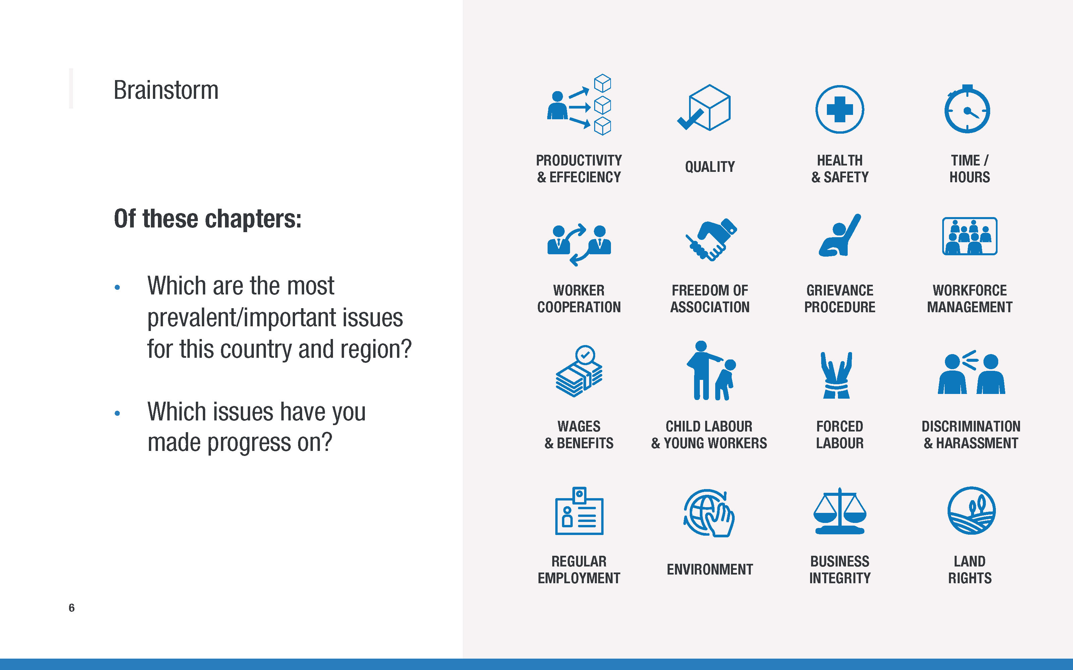
Notes:
You will only have 2-3 minutes to ask this question – not for discussion in groups, just for people to call out their thoughts.
Don’t let the discussion run on for long, unless you have more than an hour for the total training session, in which case you could take a little longer on it.
Their response will also help you to know which slides you can take slightly longer on and which slides you can go through more quickly (for example some countries may not need much mention of Land rights, other countries may need more mention of regular employment or discrimination).
In your own preparation for the session, it would be good to have an idea in your own mind of what you think are the 3-4 issues of highest importance are in the country.

Slide 9
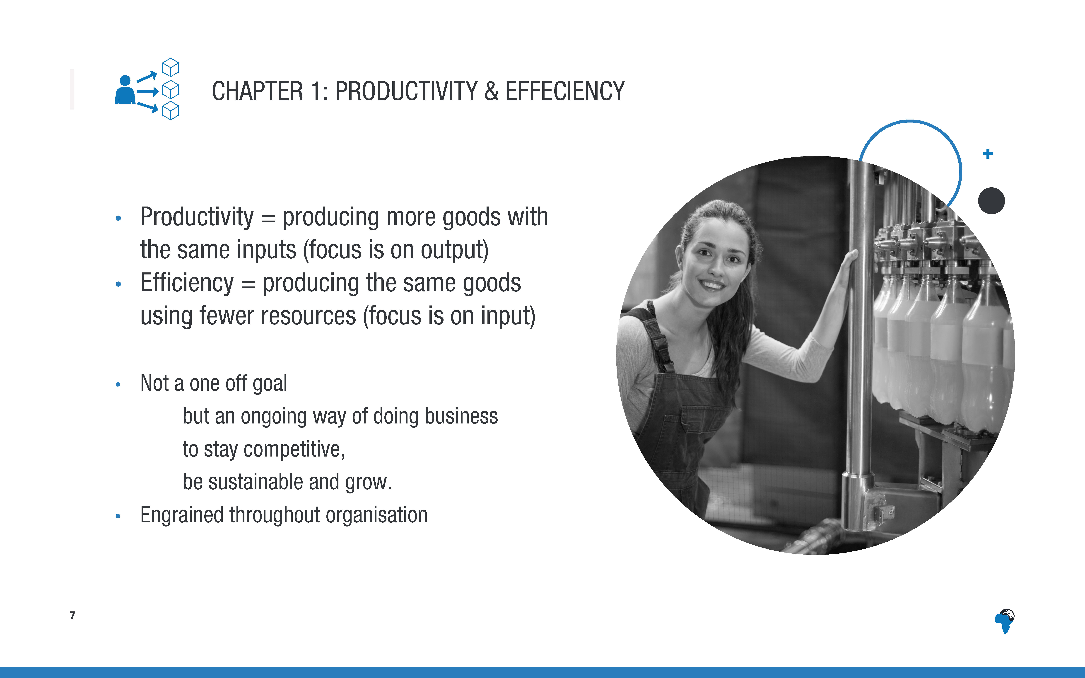

Slide 10
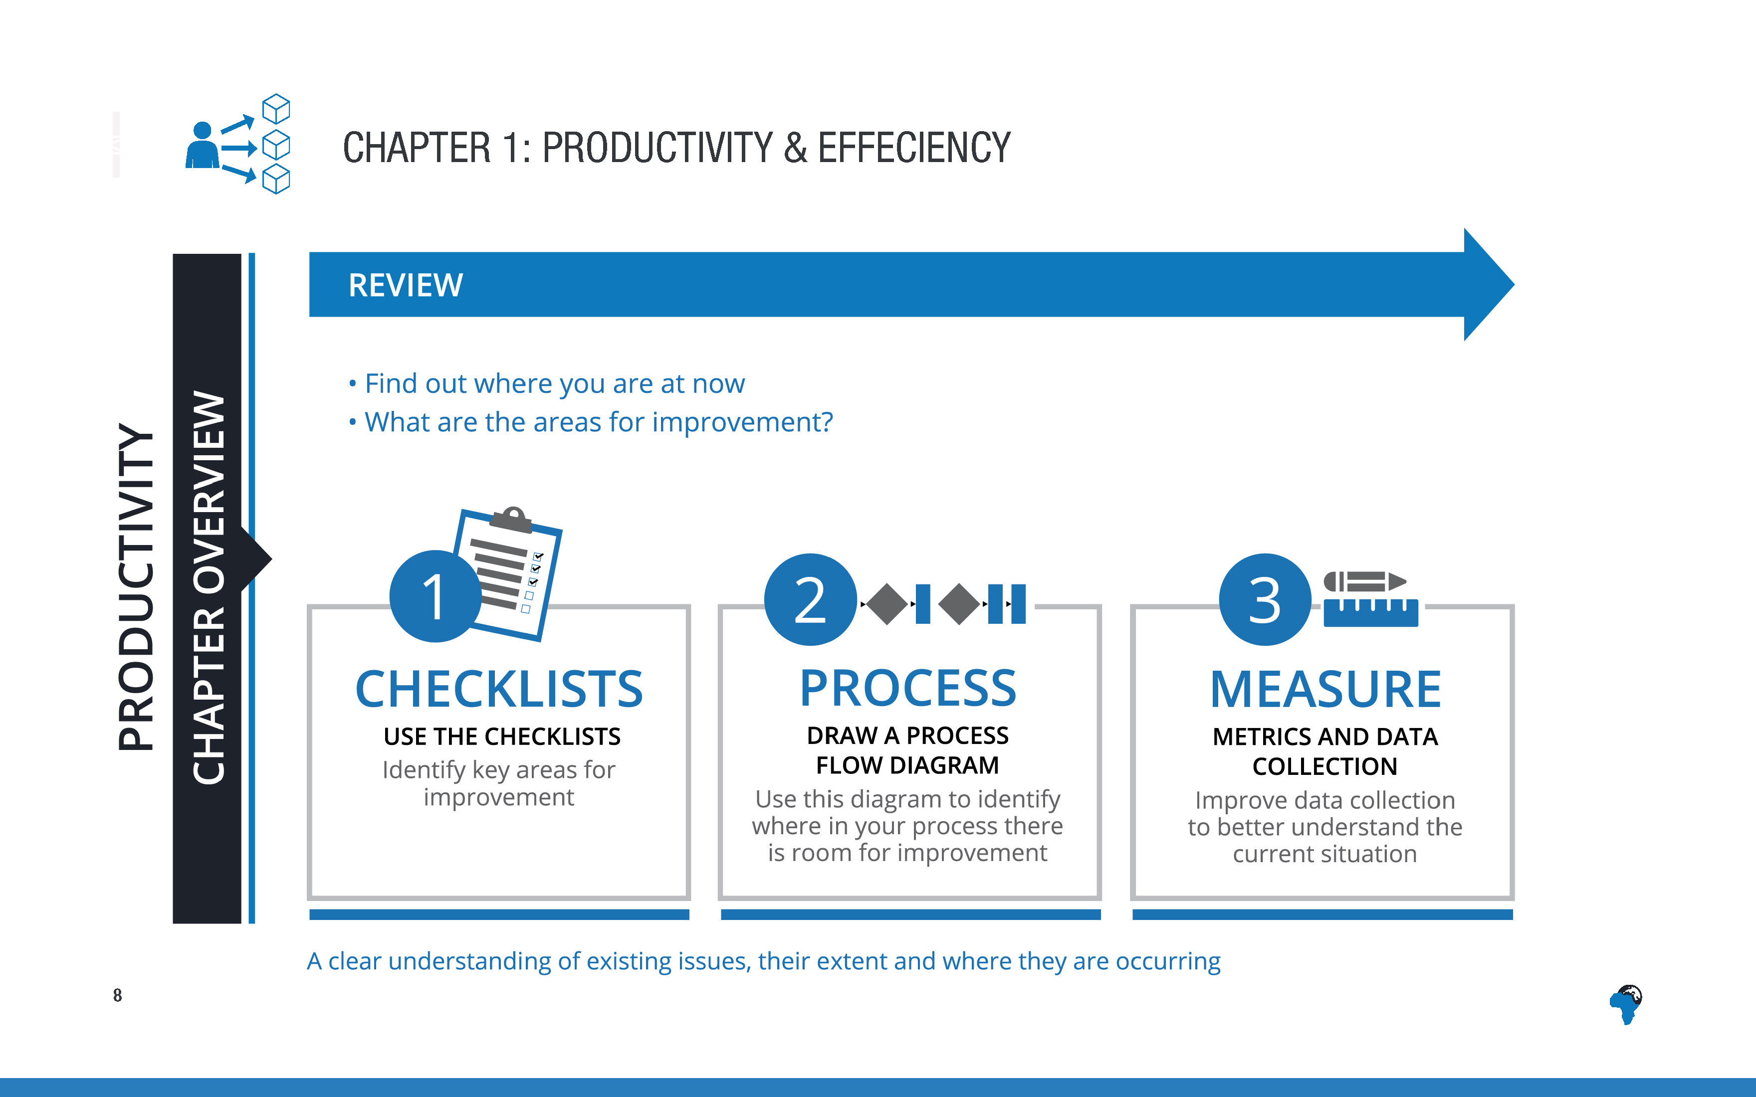
Notes:
This chapter is split into three key stages: Review, Analyse and Improve.
Review includes – checklists to identify areas for improvement, drawing a process flow diagram and improving metrics and data collection
This gives an understanding of the existing issues, their extent and where they are occurring.

Slide 11
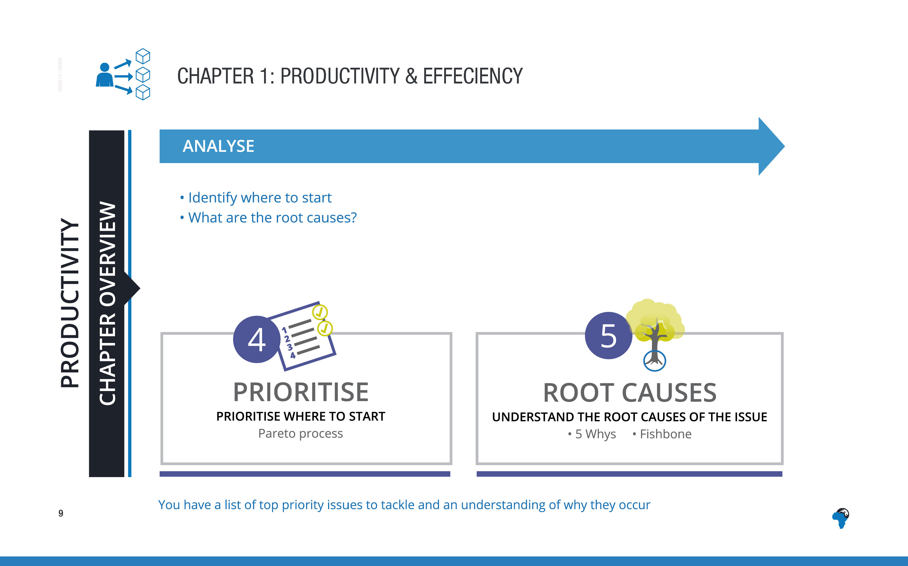
Notes:
The second step is Analyse.
Analyse includes prioritising where to start and understanding the root causes of the issues ie why the problems are occurring

Slide 12
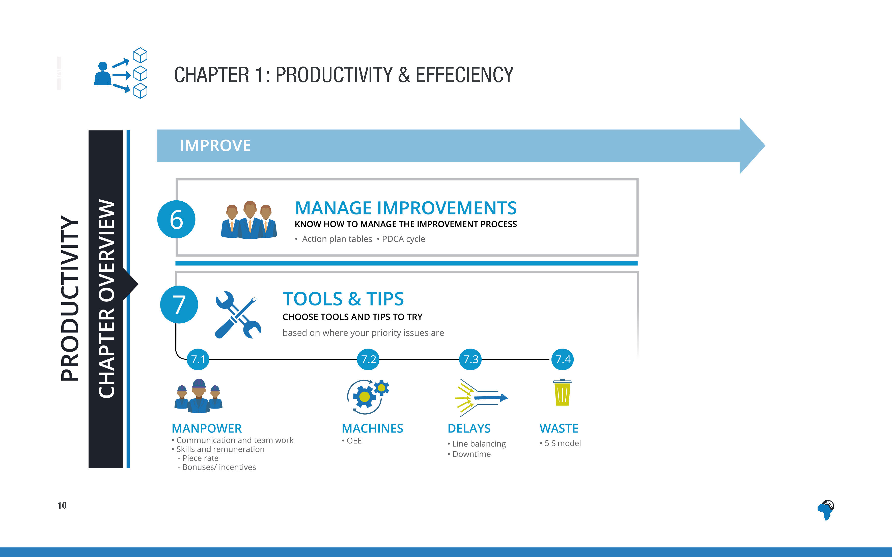
Notes:
The third step is Improve.
Improve includes tools for managing the improvement process and also specific tools and tips to try in different areas, depending on what issues you have identified (eg increasing effectiveness of manpower and machines, and reducing delays and waste)

Slide 13
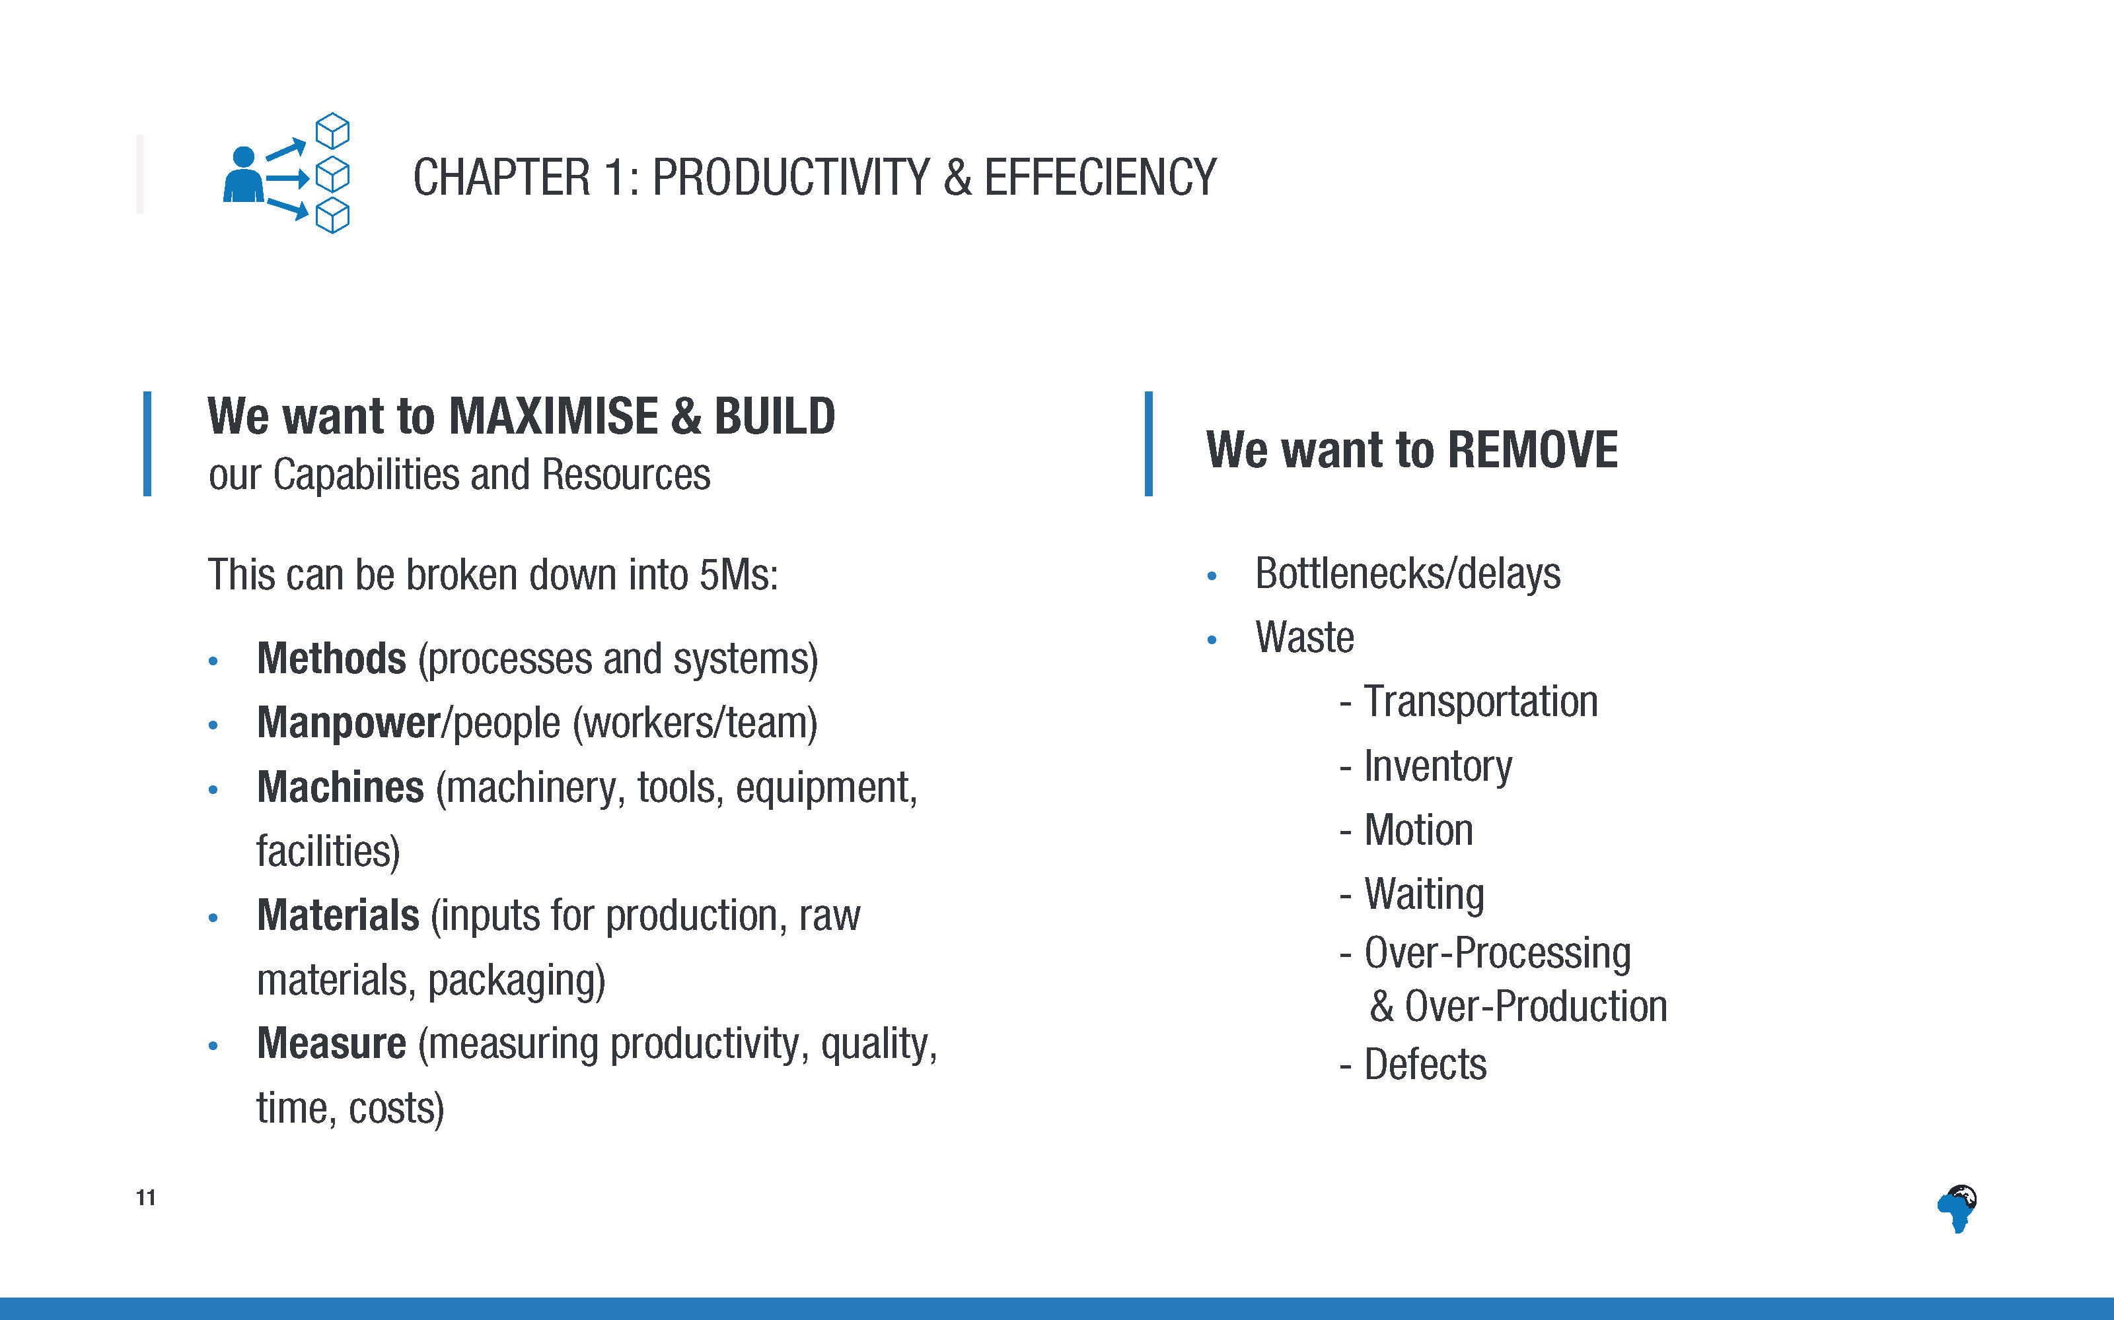
Notes:
[No need to list or explain these in detail – simply mentioning these are the different elements in the productivity section]

Slide 14
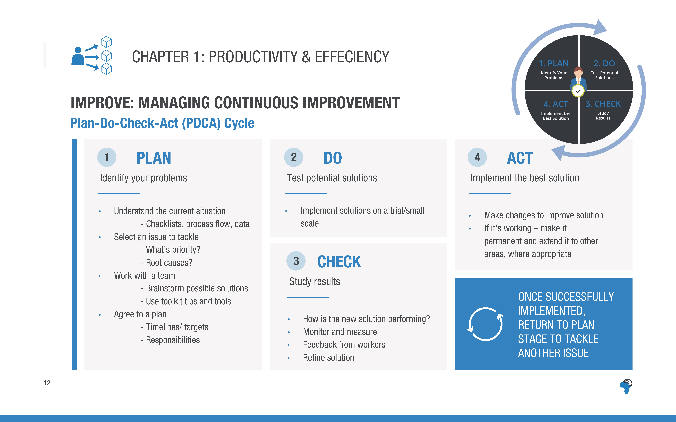
Notes:
Whatever improvement you decide to implement, you can use management expert W Edwards Deming’s ‘Plan-Do-Check-Act (PDCA) cycle’ to guide the process of addressing the root causes you have identified, to improve productivity and efficiency.
[No need to read the detail of this text, just mention the main 4 steps in a few words.]

Slide 15
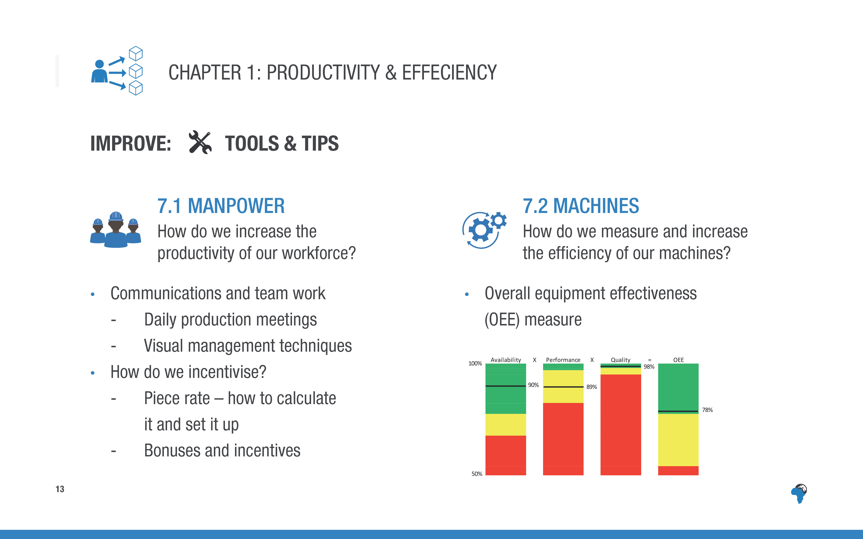
Notes:
There are detailed guidelines and tools for each of these points in the toolkit.
[Just skim through each of these very briefly, mention the key points in headline – just a signpost to what is in the toolkit, not explaining them in any detail.
Encourage them to look in the toolkit when they leave, to find practical tools and tips that will help in their particular situation.]

Slide 16
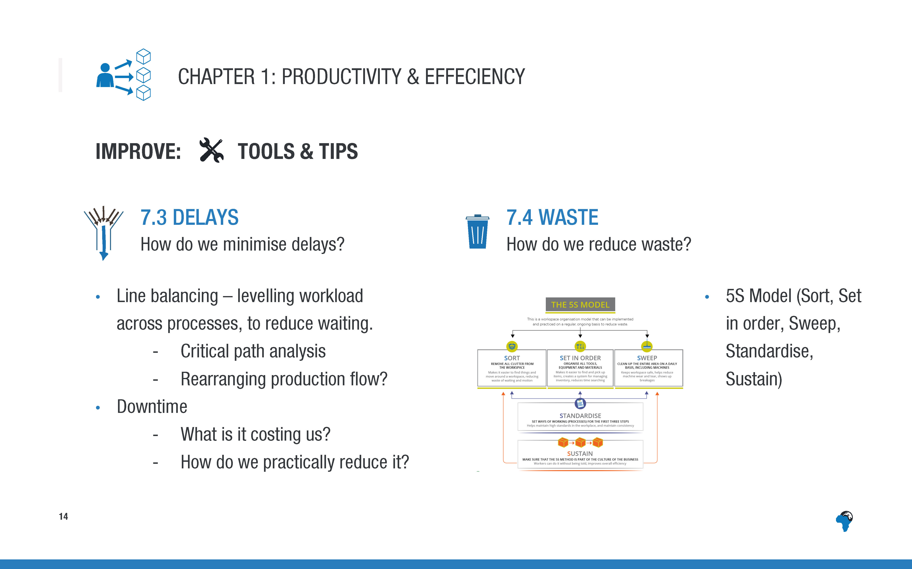
Notes:
There are detailed guidelines and tools for each of these points in the toolkit.
[Just skim through each of these very briefly, mention the key points in headline – just a signpost to what is in the toolkit, not explaining them in any detail.
Encourage them to look in the toolkit when they leave, to find practical tools and tips that will help in their particular situation.]

Slide 17
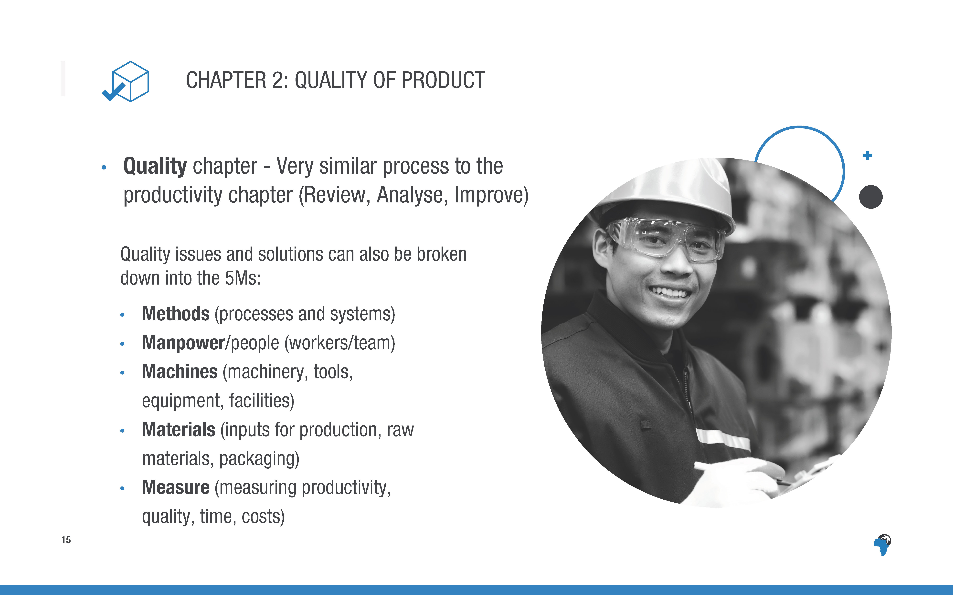
Notes:
[Again, just a summary of the elements of the quality section, no need to list in detail]

Slide 18
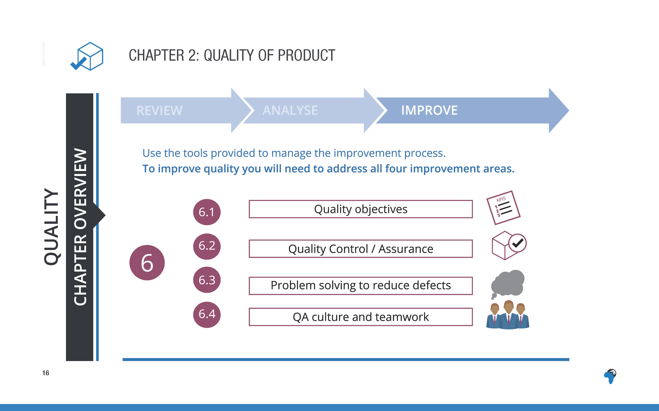
Notes:
The quality section is also broken into the three sections of ‘review, analyse and improve’, as with productivity.
The improve section provides tools for you to use including how to set quality objectives or ‘KPIs’, how to work through solving problems to reduce defects and how to develop a quality assurance culture in your business.

Slide 19
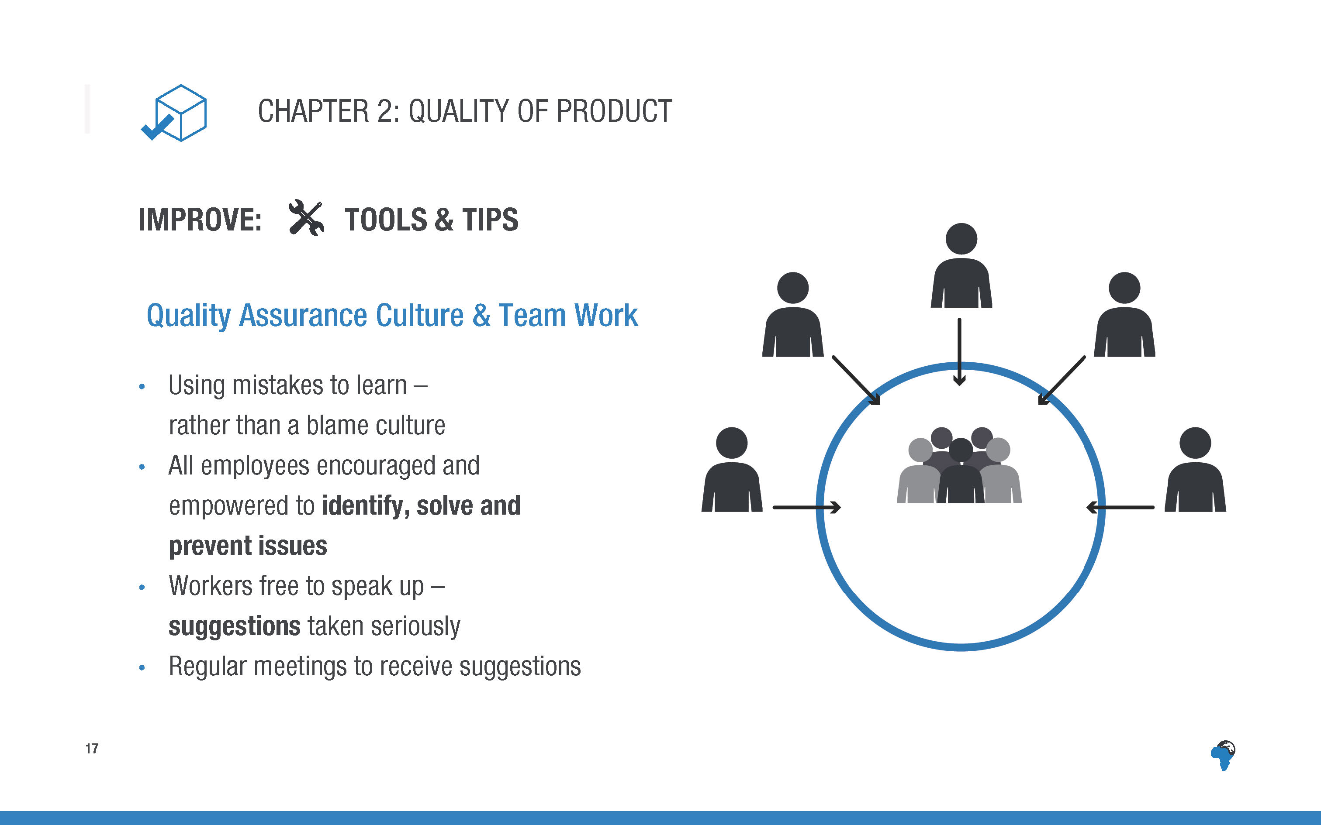
Notes:
[Emphasise this point – culture and team work, speak through the points on the slide.]
[If time (probably only if you have more than an hour for the total training):
Discussion in small groups – What do they think would practically build this kind of culture? What hinders it or holds it back? 3 minutes.]

Slide 20
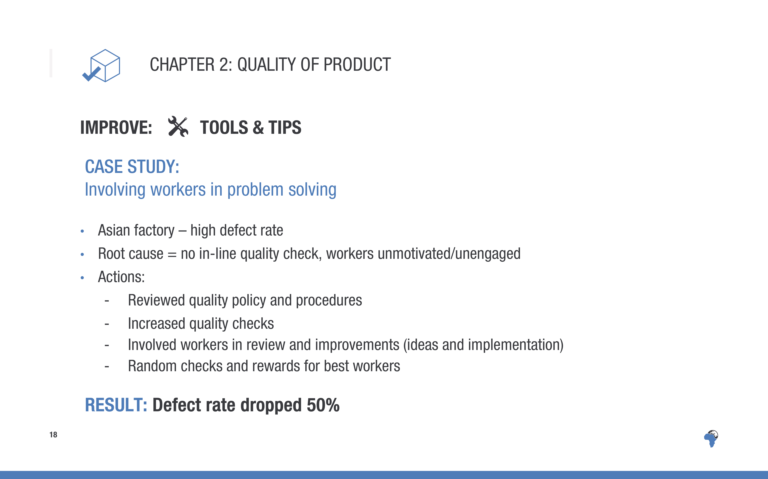
Notes:
An Asian factory had a high defect rate and wanted to reduce it.
After further investigation they found that the root causes included a lack of in-line quality check and that workers were unmotivated and unengaged.
They took a number of actions, including reviewing their quality policies and procedures, increasing quality checks through the process. They involved the workers in the review and improvements, by giving them opportunities to give their ideas and also to be part of the implementation of the improvements. They carried out random quality checks and gave the best performing workers rewards.
The result was that the defect rate dropped by 50%

Slide 21
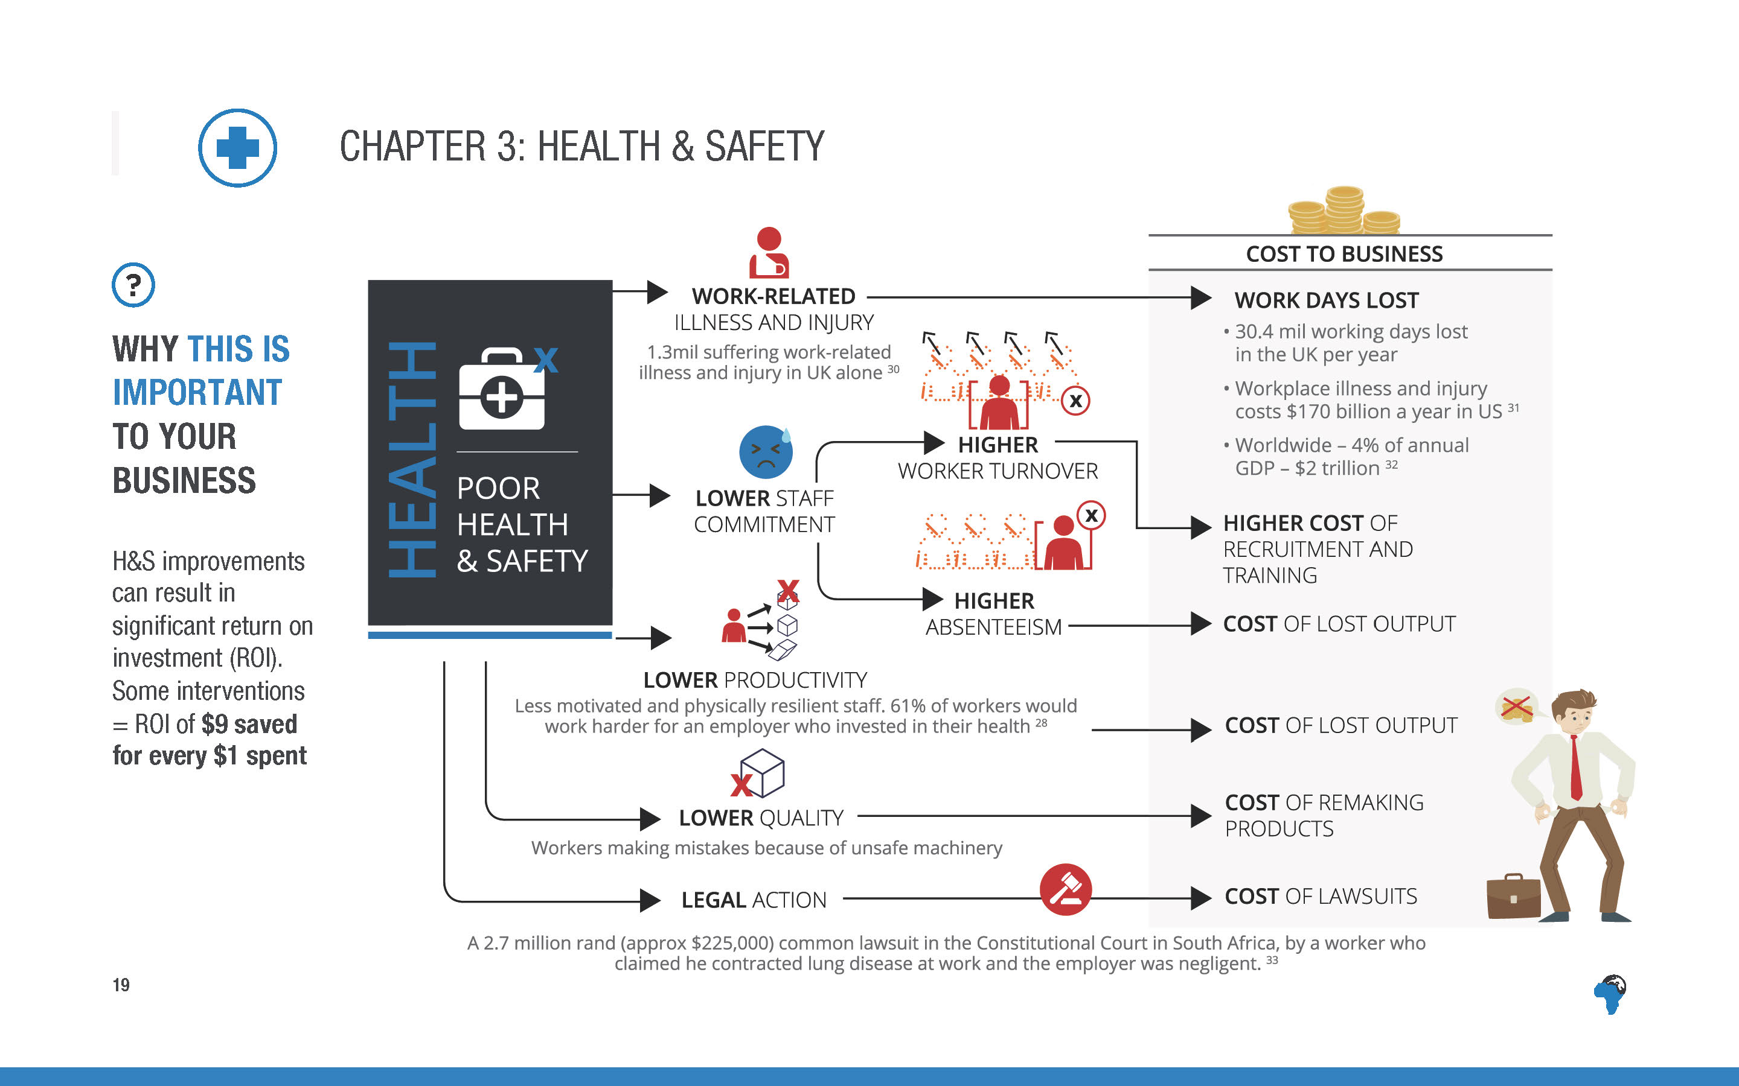
Notes:
[No need to read out the detail of the text, but just highlight the overall flow and argument of the diagram.]
Work related illness and injury costs the business in lost work days and output ($170 bill a year in the US)
If there’s poor H&S, workers are more likely to leave or be absent and are more likely to give lower productivity and quality, which costs output. (61% of workers said they would work harder for an employer who invested in their health.)
Poor H&S can also result in costly legal action if workers get sick or are injured at work.
[For more detail they can refer to the toolkit.]

Slide 22

Notes:
[No need to read this out in detail, maybe just mentioning the key words in bold,.
The H&S chapter is divided into these subsections and you can read the full expectations in the toolkit.

Slide 23
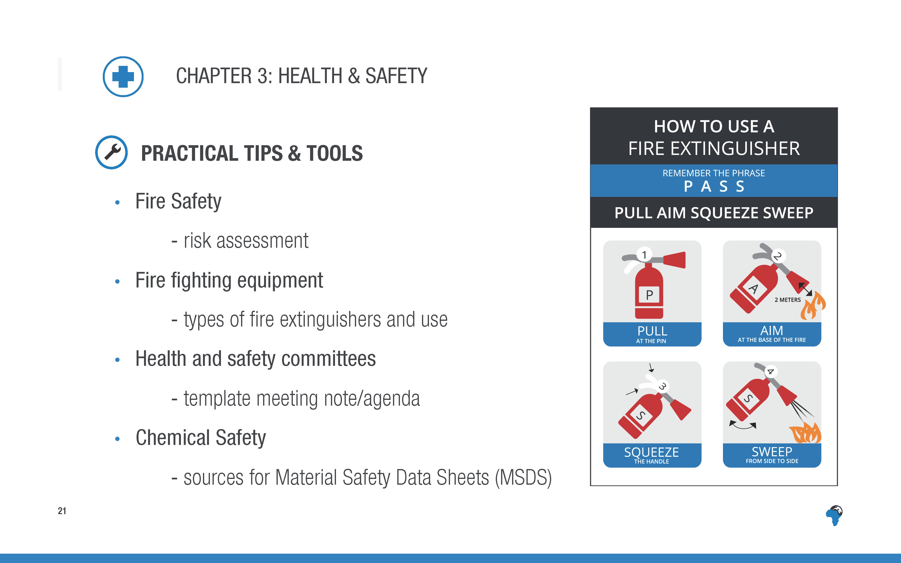
Notes:
[Just mention this briefly – a summary of what practical tools and tips are provided, they must look at the toolkit for more details. ]

Slide 24
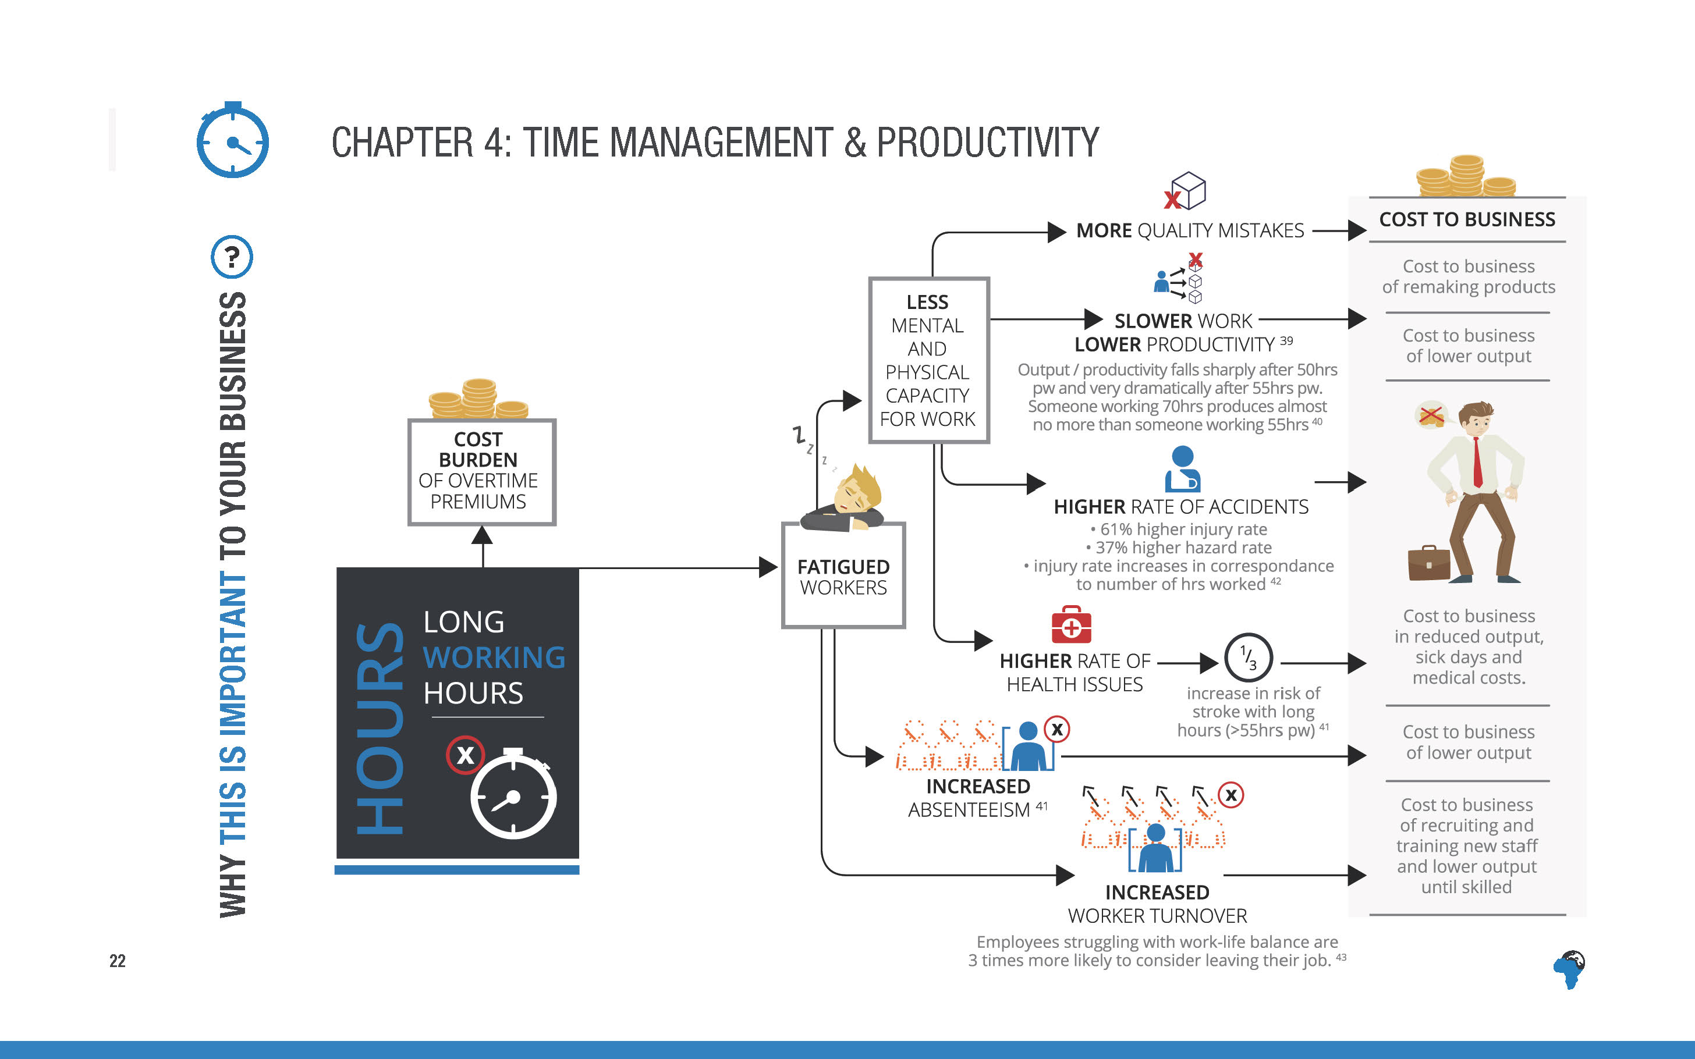
Notes:
[No need to read out the detail of the text, but just highlight the overall flow and argument of the diagram.]
In addition to the financial burden of overtime premiums, there are a number of business costs associated with long hours.
If workers are tired, they are more likely to make quality mistakes, have lower productivity and more likely to have accidents.
Long hours (over 55hrs per week) are associated with a 61% higher injury rate and one third increase in risk of strokes.
It can also lead to increased absenteeism and worker turnover.
Employees struggling with work-life balance are 3 times more likely to consider leaving their job.

Slide 25
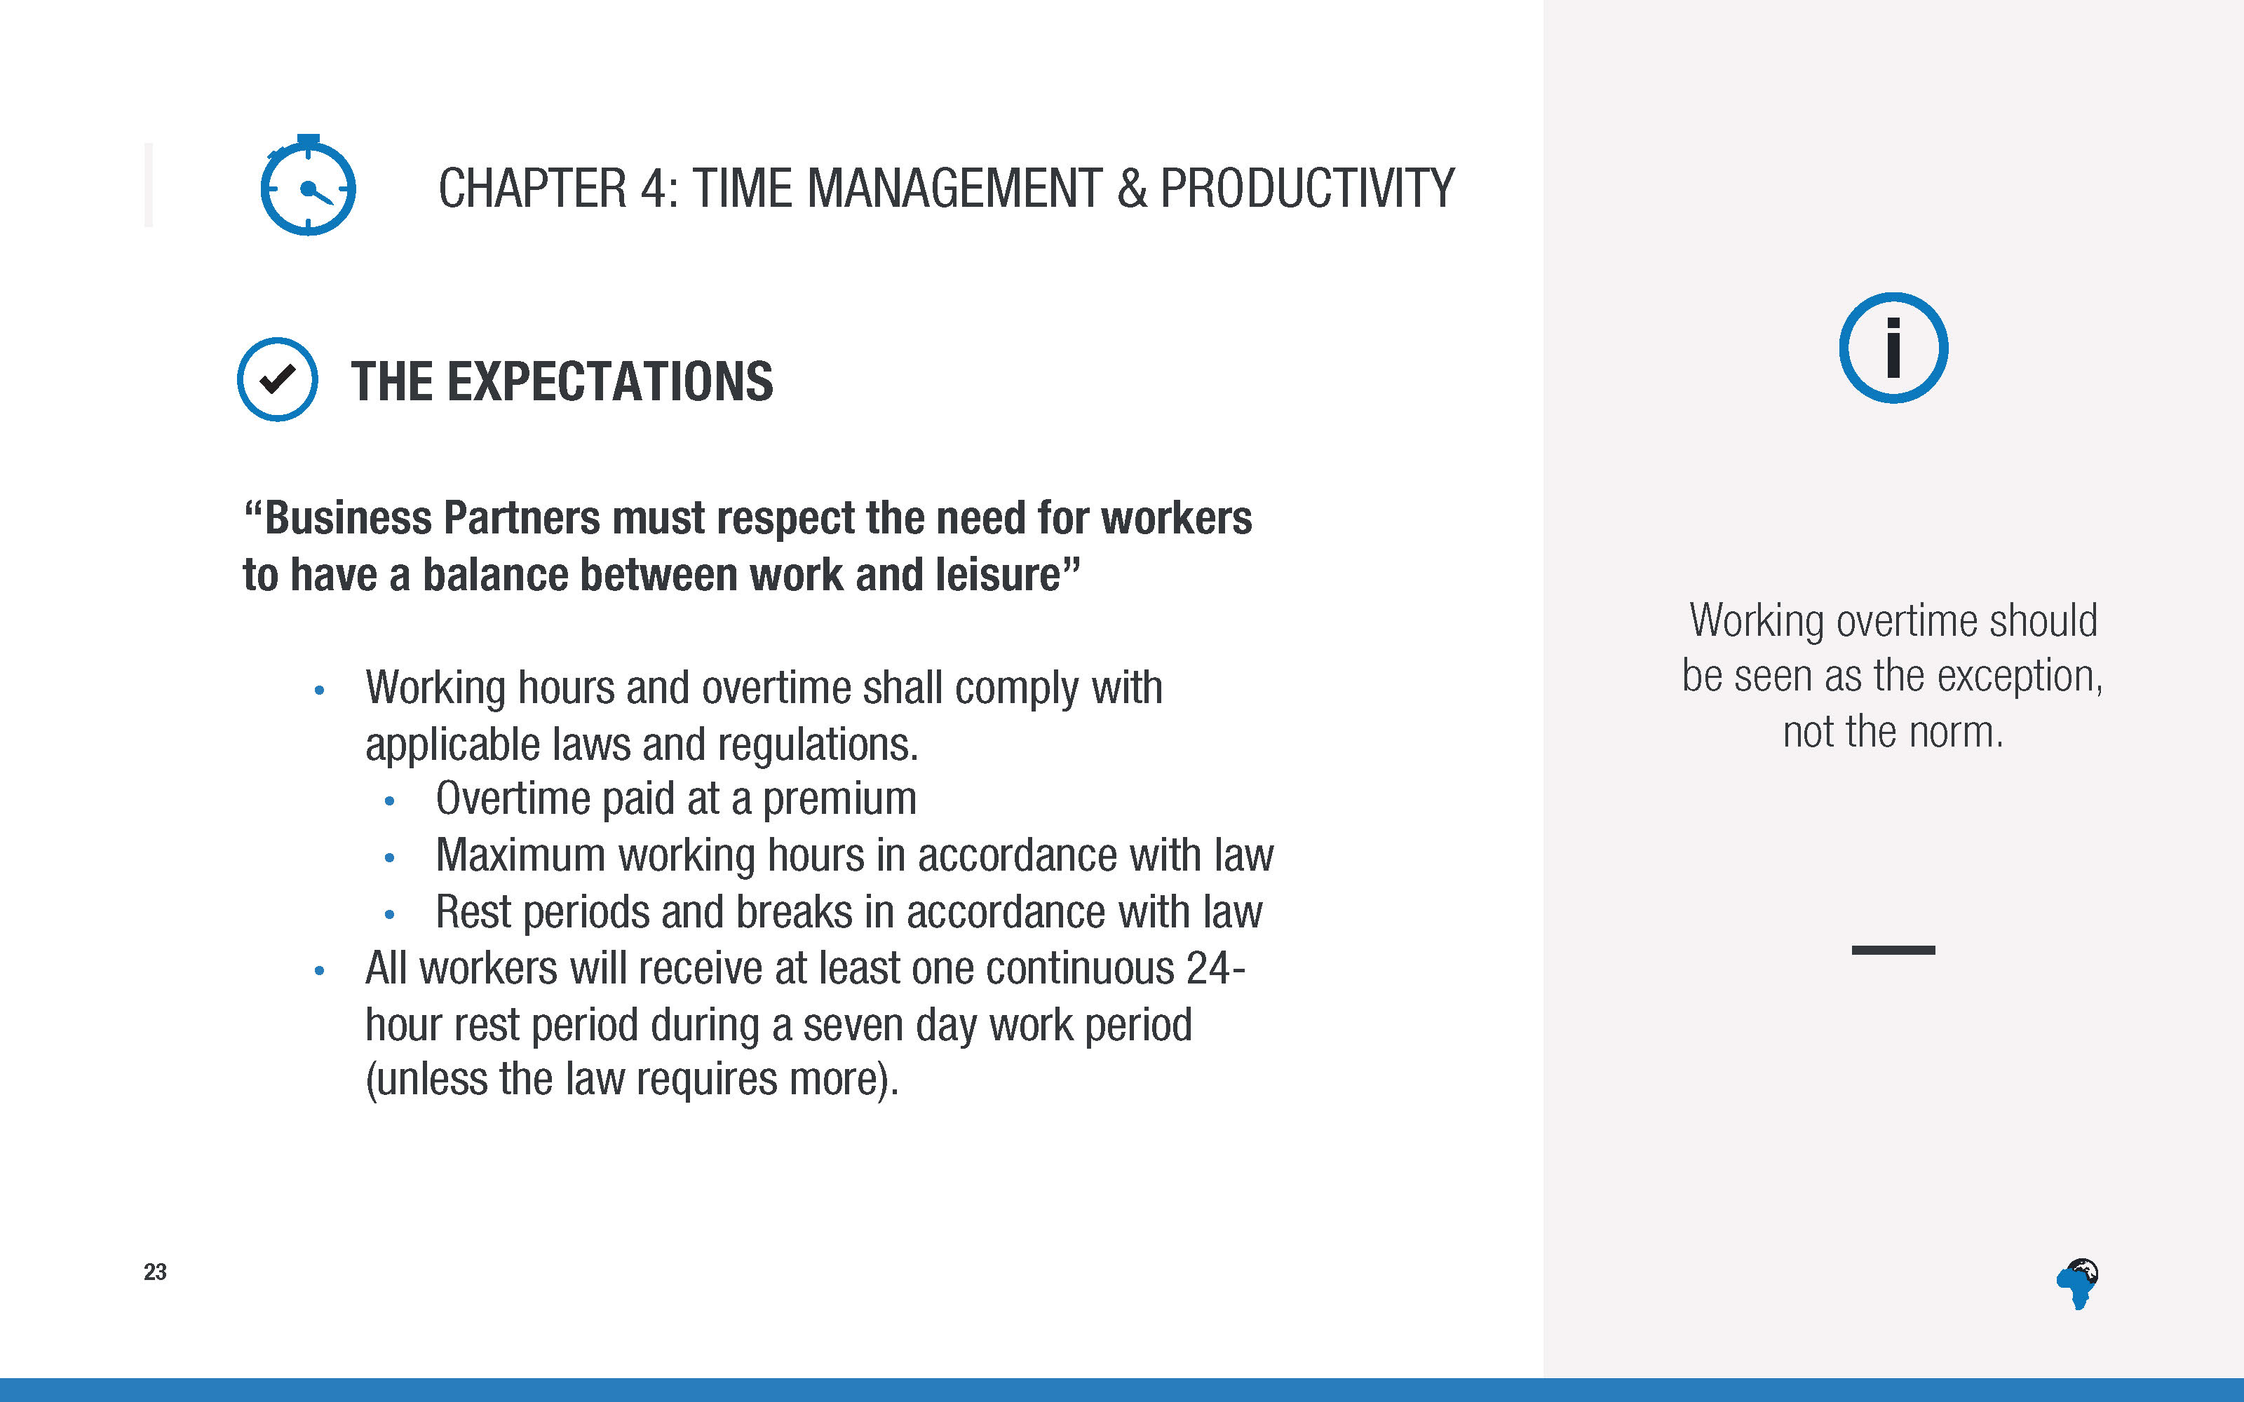
Notes:
[Again, no need to read the expectations out word for word, just topline, they can read the detail in the toolkit]

Slide 26
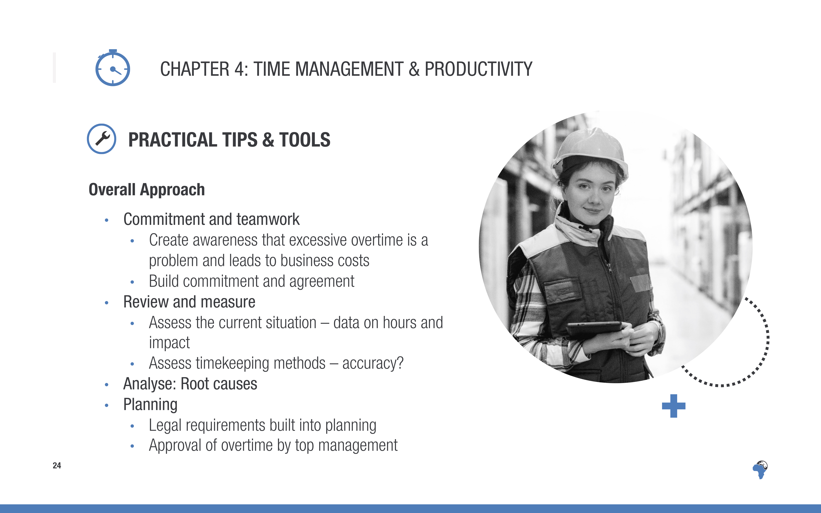
Notes:
[This needs to be run through very briefly – just topline, not much extra explanation]

Slide 27
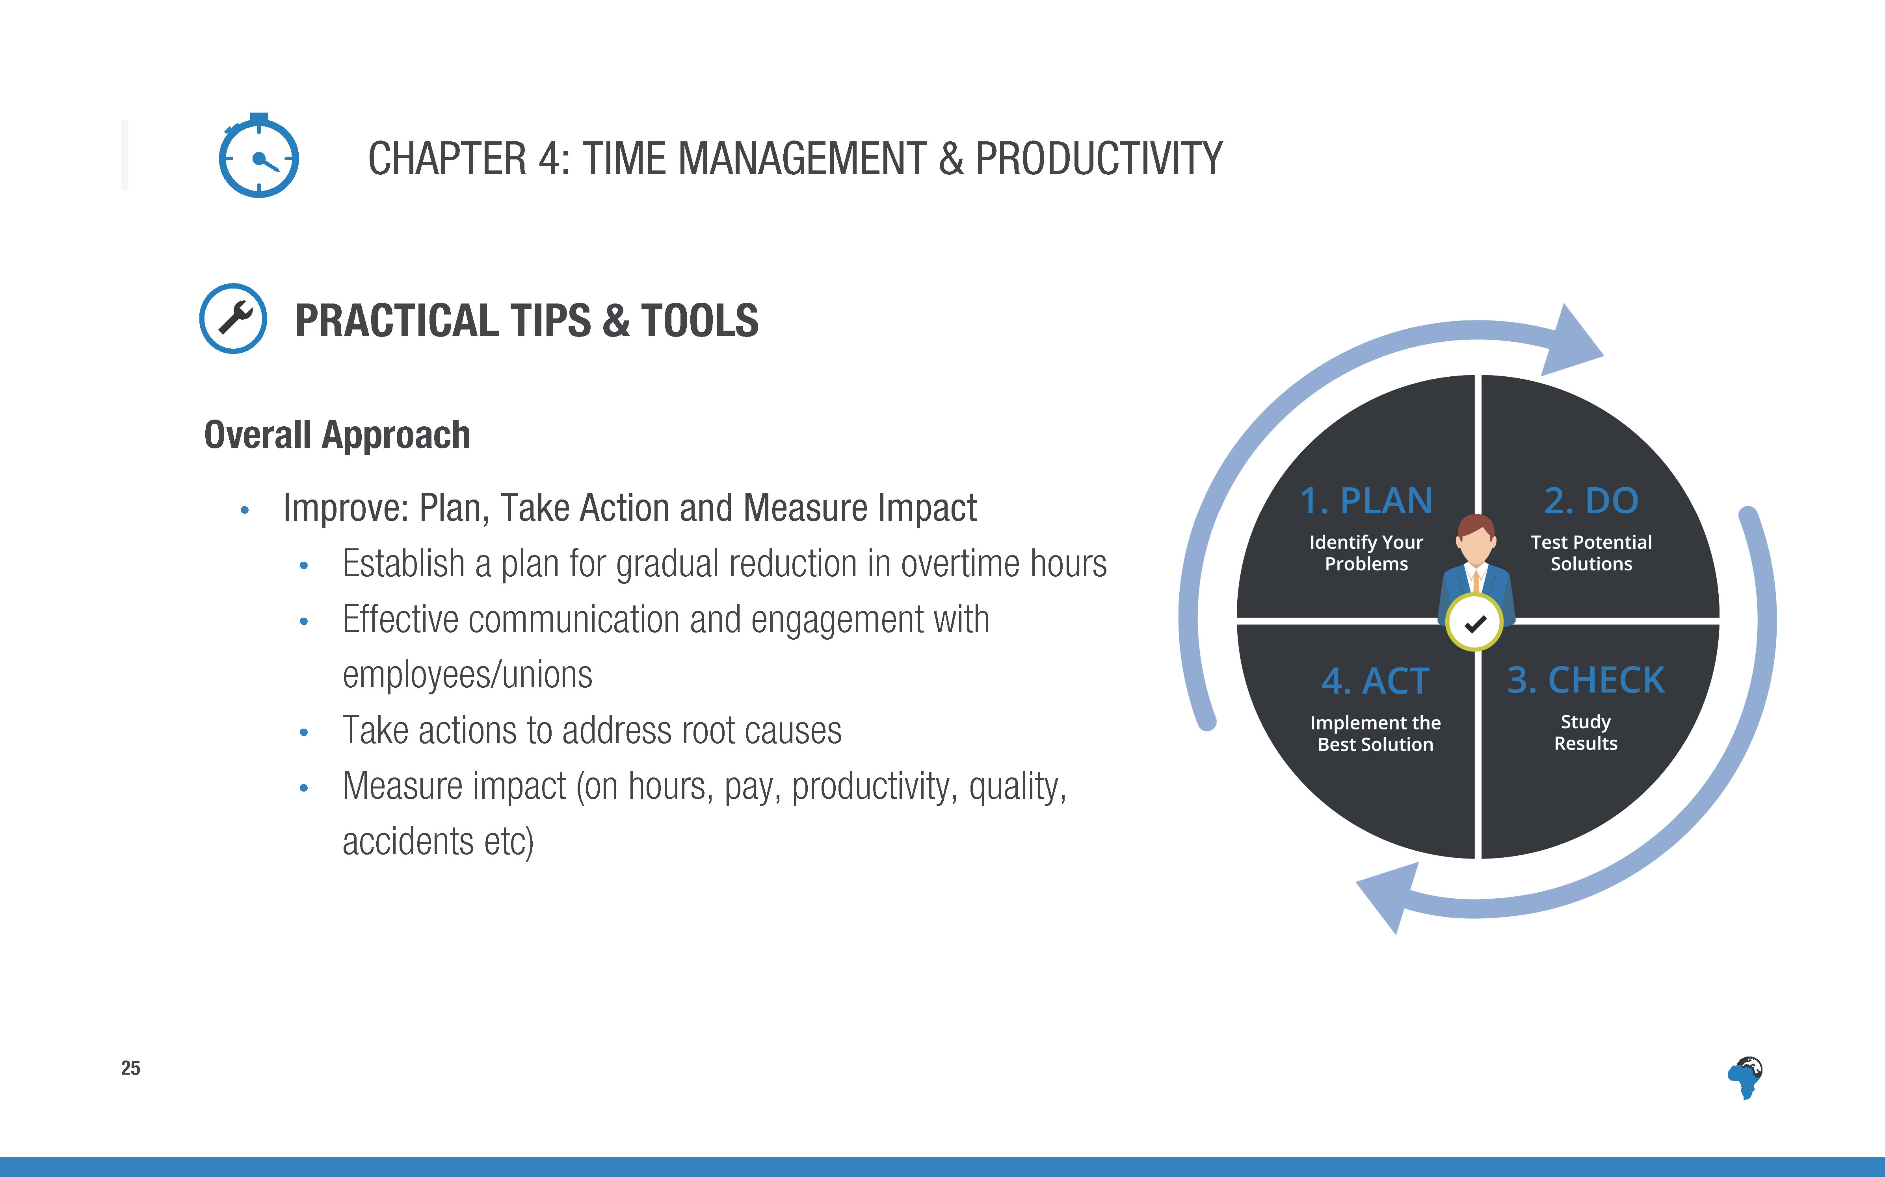
Notes:
[This needs to be run through very briefly – just topline, not much extra explanation]

Slide 28
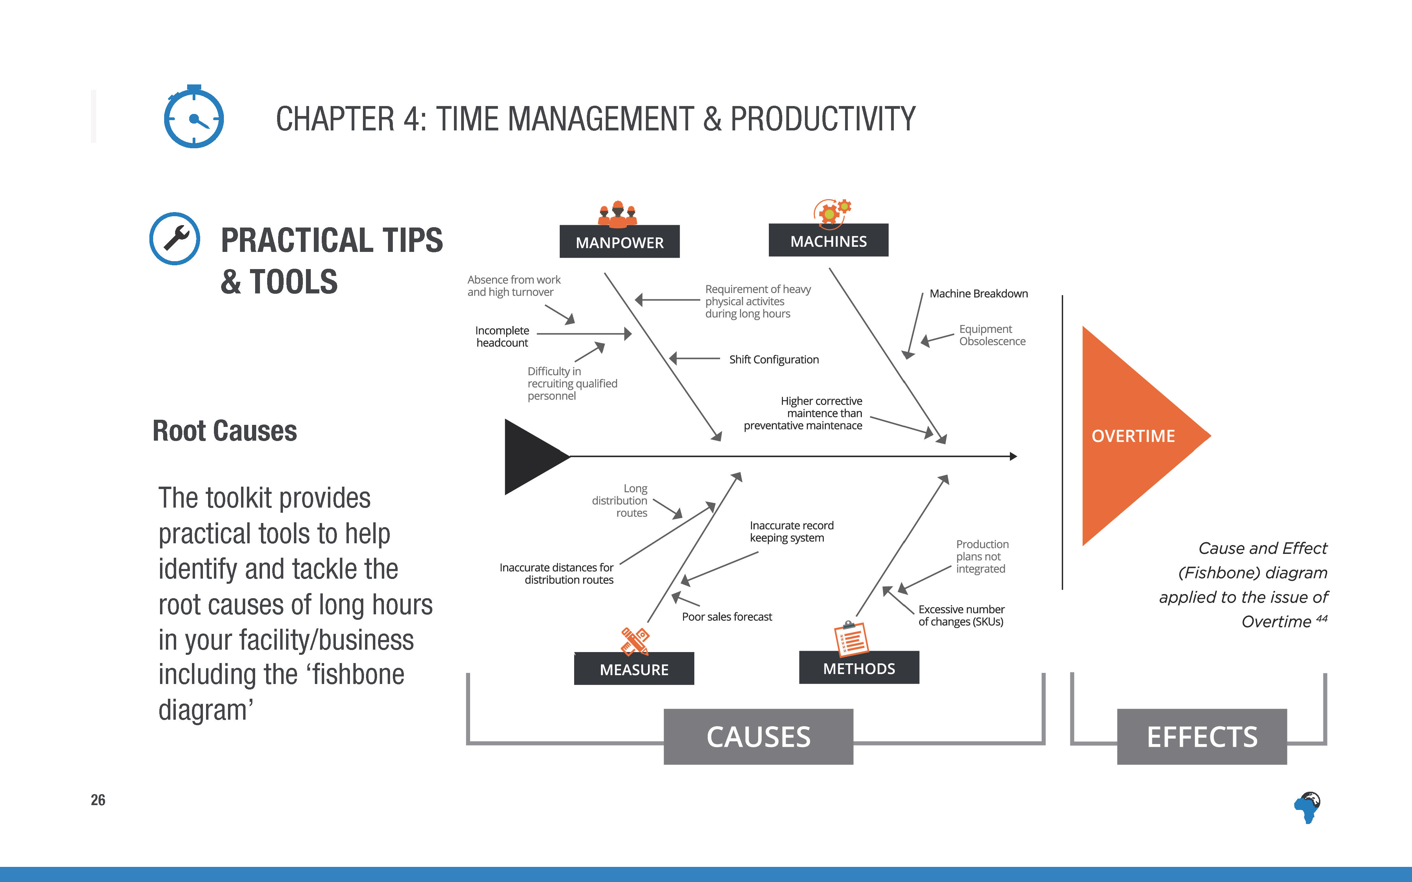

Slide 29
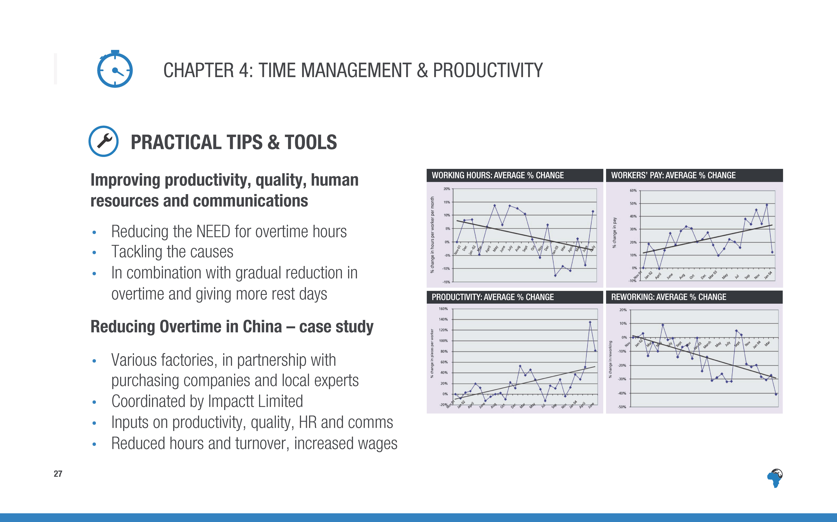
Notes:
This is a good approach to tackling excessive hours in a sustainable way – to improve productivity, quality and human resources and communication in a facility, which reduces the NEED for overtime hours and tackles the root causes.
[More detail on the case study:]
This case study in China involved a number of inputs for the factories from local organisations on improving productivity, quality, HR and communications, over a few years.
These graphs represent the overall averaged results from all the factories participating.
It was possible in a number of factories for productivity to increase (by 30% in one factory), quality to improve, hours to reduce, wages to increase (in one factory the % of workers earning the minimum wage for normal time increased from 40-50% to 95%).
There was also a greater sense of worker engagement, team work and higher motivation in the factories.
(In one of the factories worker turnover reduced from 140% to 10% during the project)
The benefits the factories achieved was variable and depended on how well the management engaged the workers and whether the management was prepared to pass on some of the benefits to the workers in reduced hours and increased wages.

Slide 30
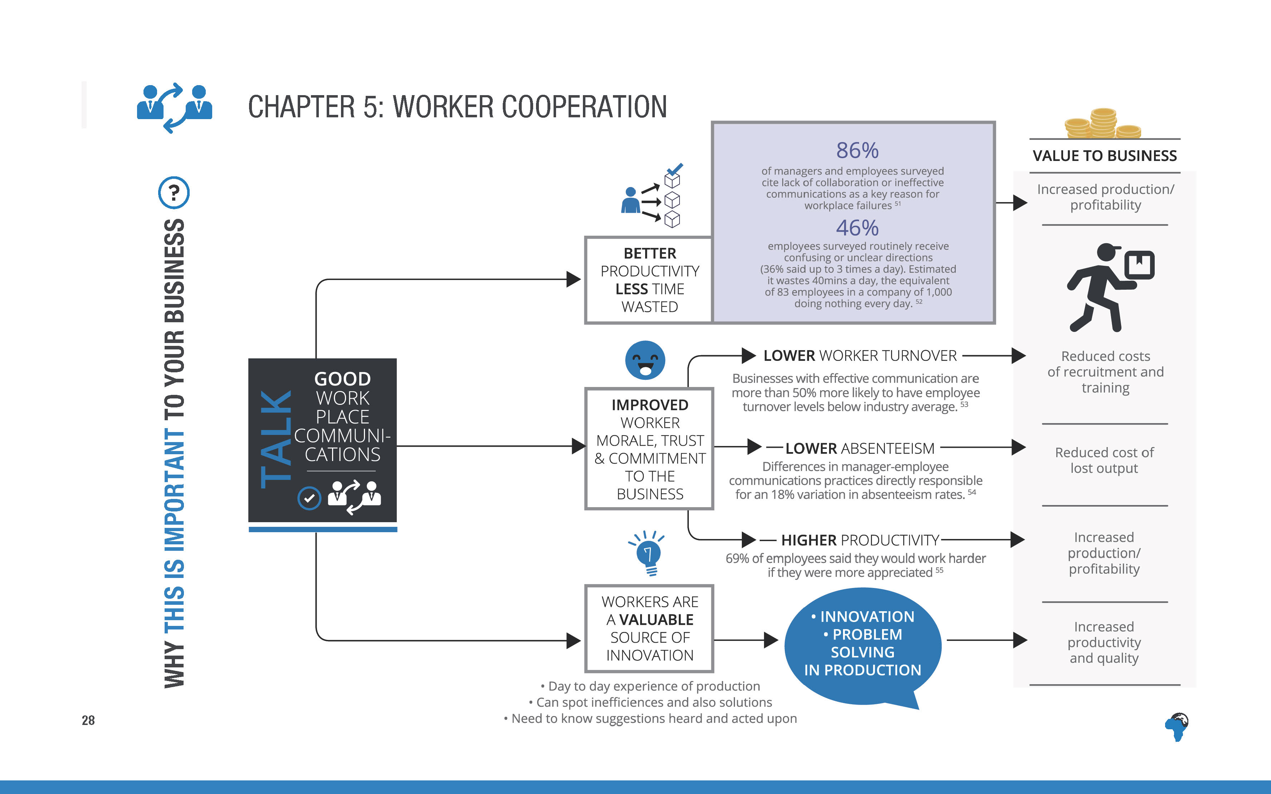
Notes:
Good workplace communications and cooperation with workers both have a positive impact on a business and can significantly impact the bottom line.
If there is good communication, workers can be more productive and waste less time.
In a survey, 46% of employees said they often receive confusing or unclear instructions, which wasted an estimate of 40 minutes per day, which is the equivalent of 83 employees in a company of 1000 doing nothing every day.
Improved communication can increase workers’ morale and commitment, resulting in lower turnover and absenteeism and higher productivity.
Workers are also a valuable source of innovation, since they have day to day experience of production and can spot inefficiencies and suggest solutions and improvements, which is why it’s important to give opportunities for workers to make suggestions and to act on them where appropriate.

Slide 31

Notes:
[If time: Allow just 2-5 minutes for discussion in pairs. No time for feedback to whole group.
If you only have one hour for the whole training, and you are running short on time (ie less than half an hour left at this stage)
You may wish to skip this discussion. If you think you do have time remember to just keep it short.
If you have more than 1 hour for the training, you can allow people 5 minutes discussion and a few minutes for feedback to the group.]

Slide 32
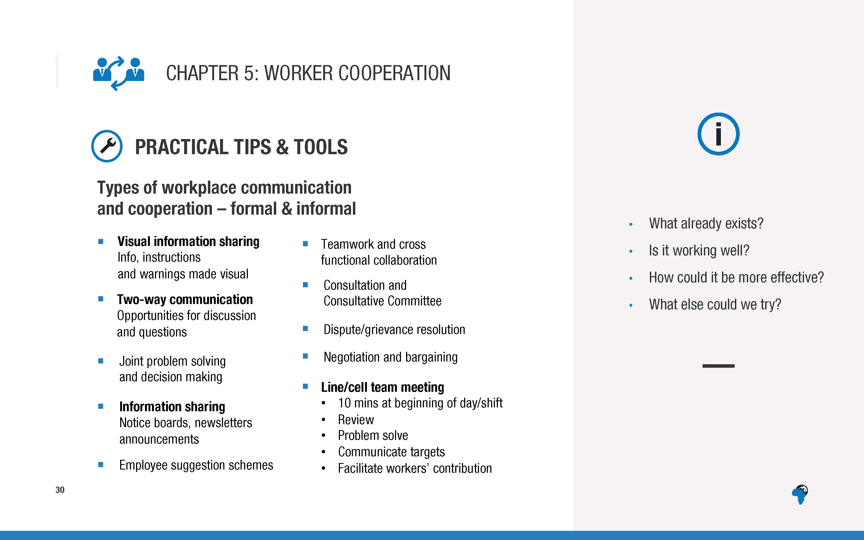
Notes:
There are lots of different types of workplace communication and cooperation. Here are a few that are explained further in the toolkit.
It is worth reviewing as a team when you return, which of these you use already, how well it’s working, whether it could be more effective and what else you could try.
[No need to read out the detail of the content of this slide, no time for discussion as a group on this, unless you have more than an hour for the training.]

Slide 33
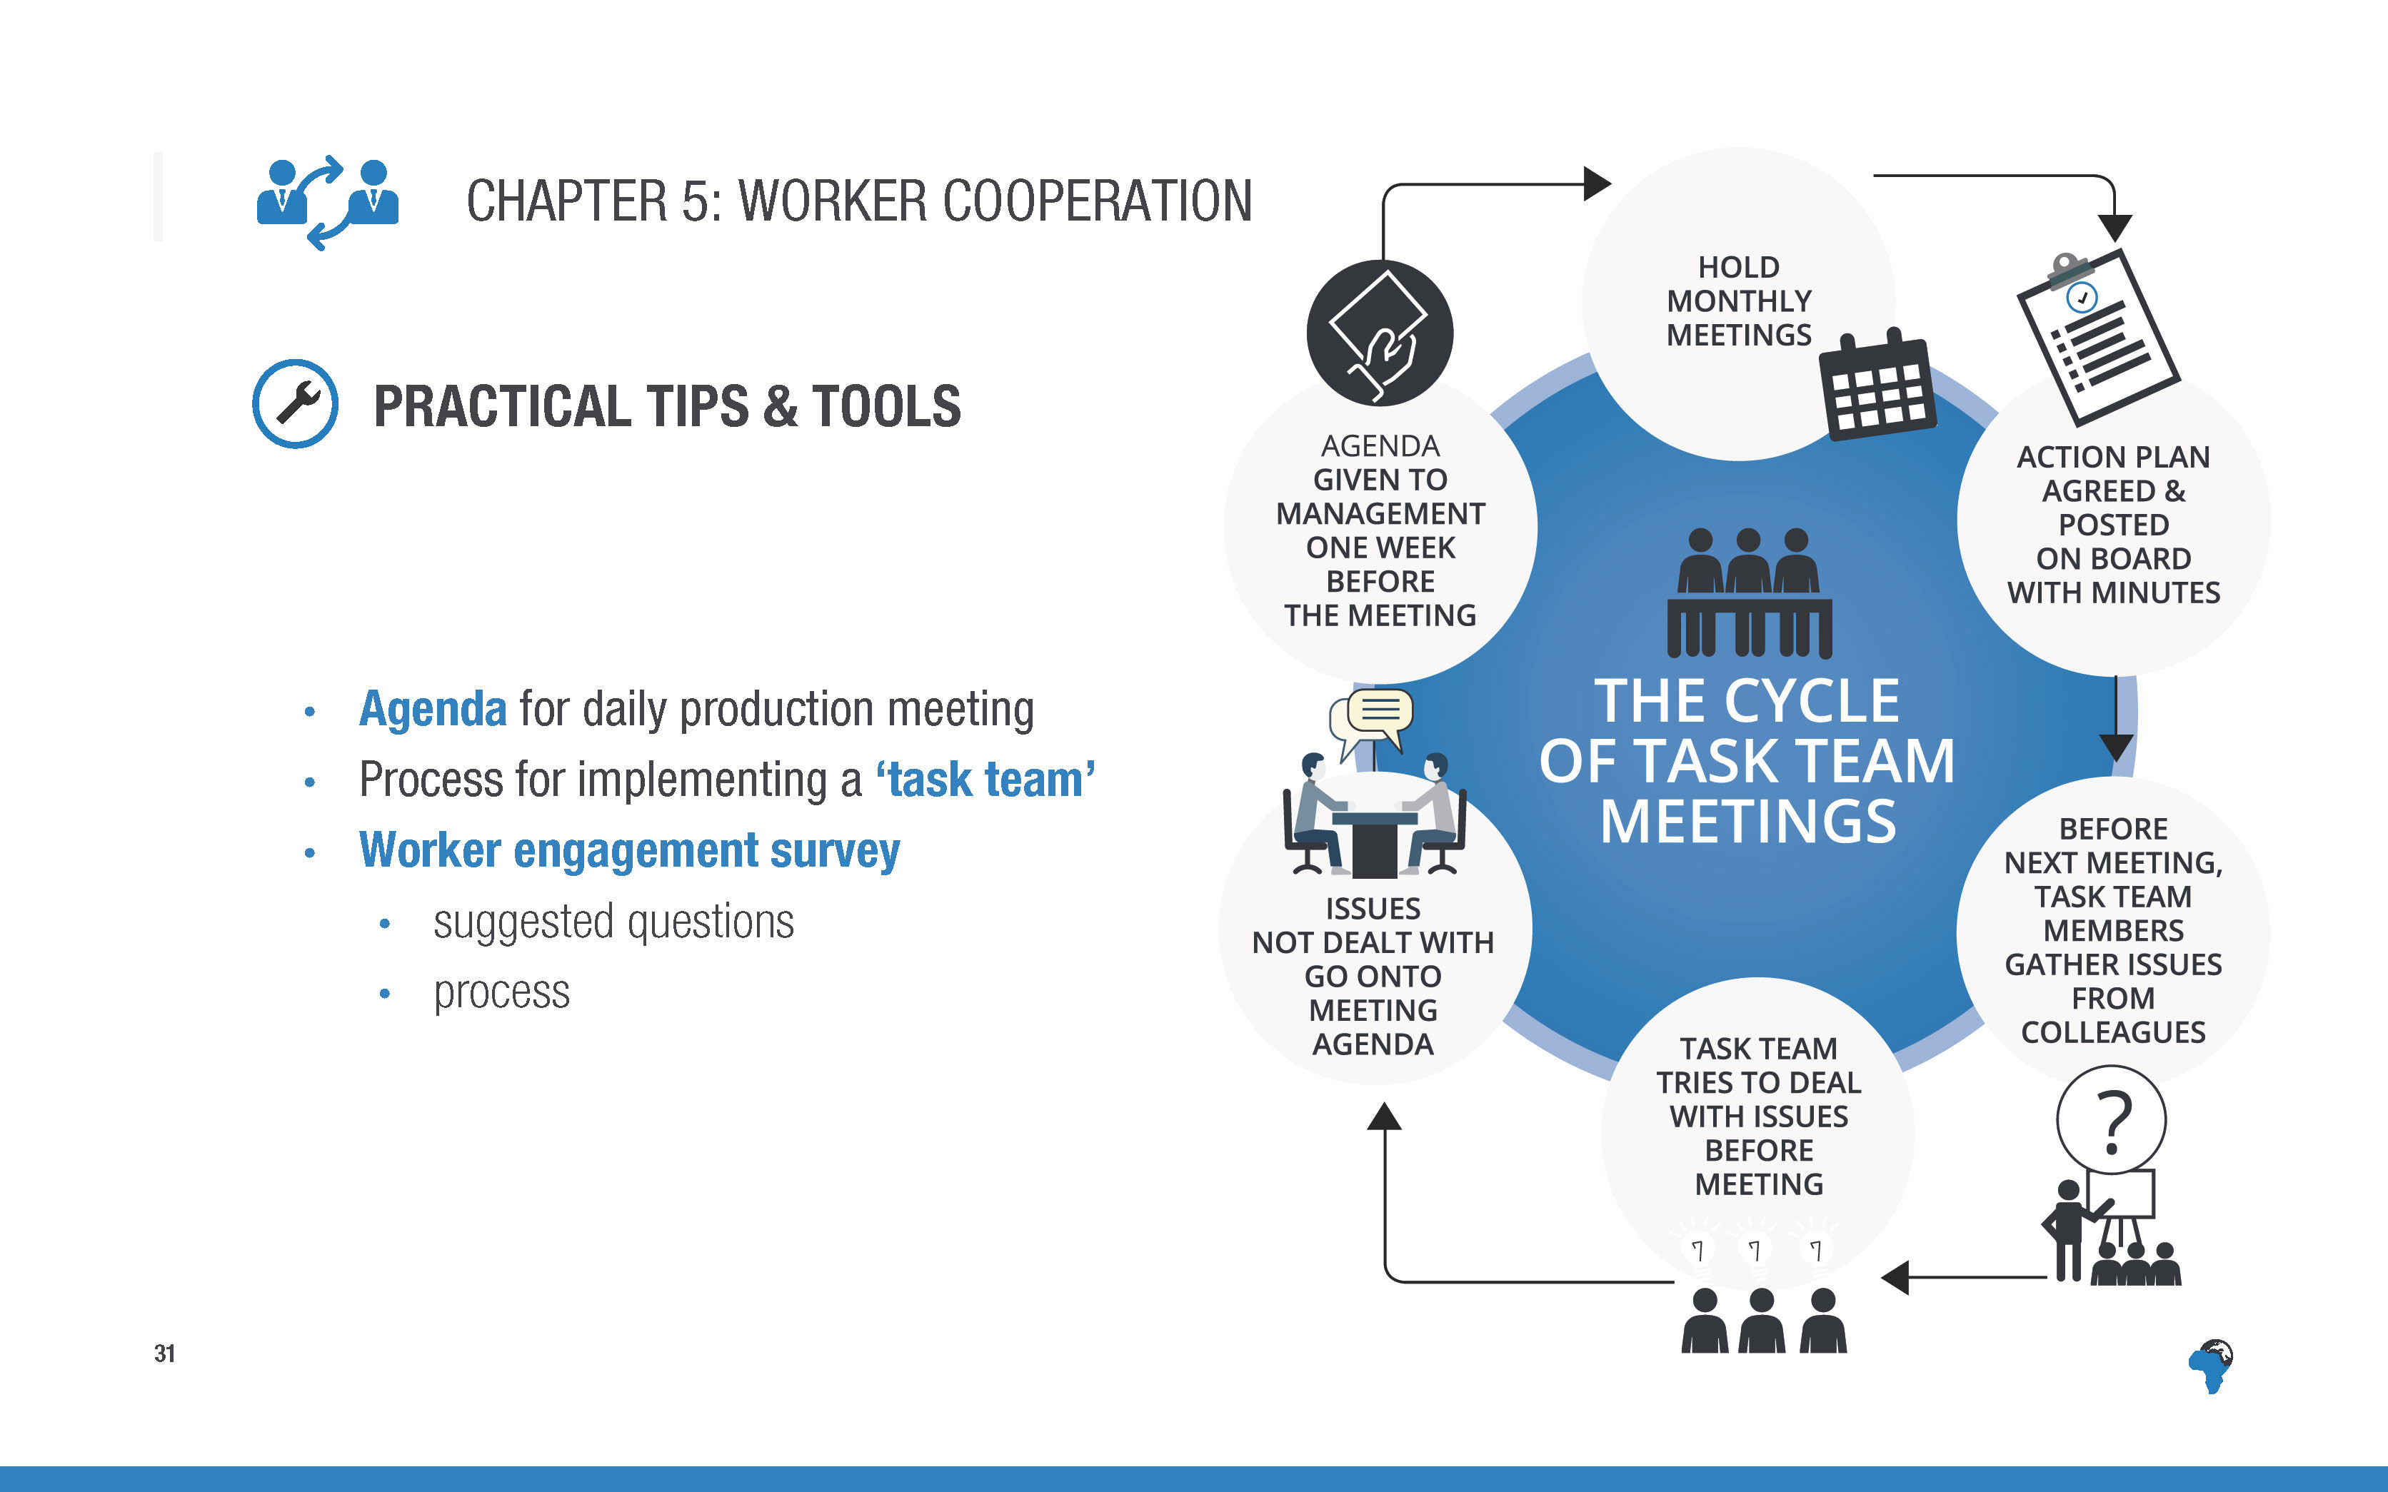
Notes:
[No need to describe in detail, just mention these as resources and tools available in the toolkit]

Slide 34
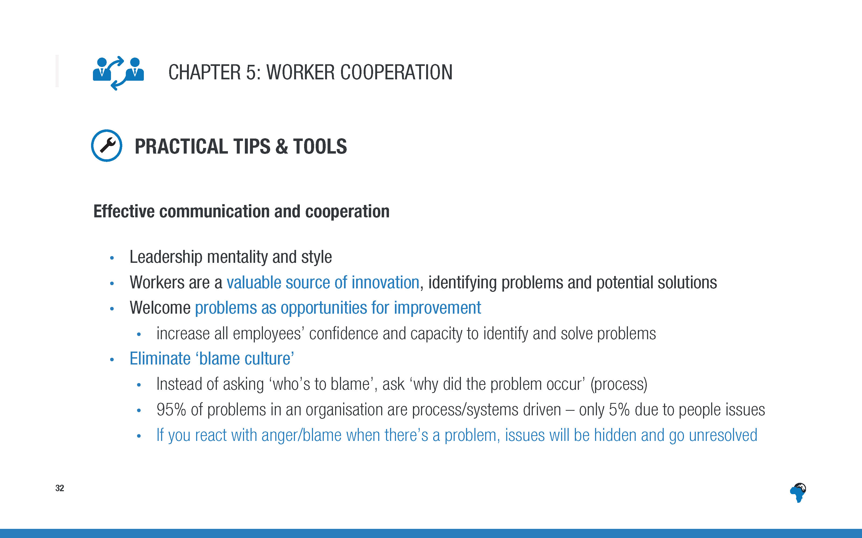
Notes:
[Worth emphasising this – it’s the essential baseline of all effective cooperation with the workforce.]

Slide 35
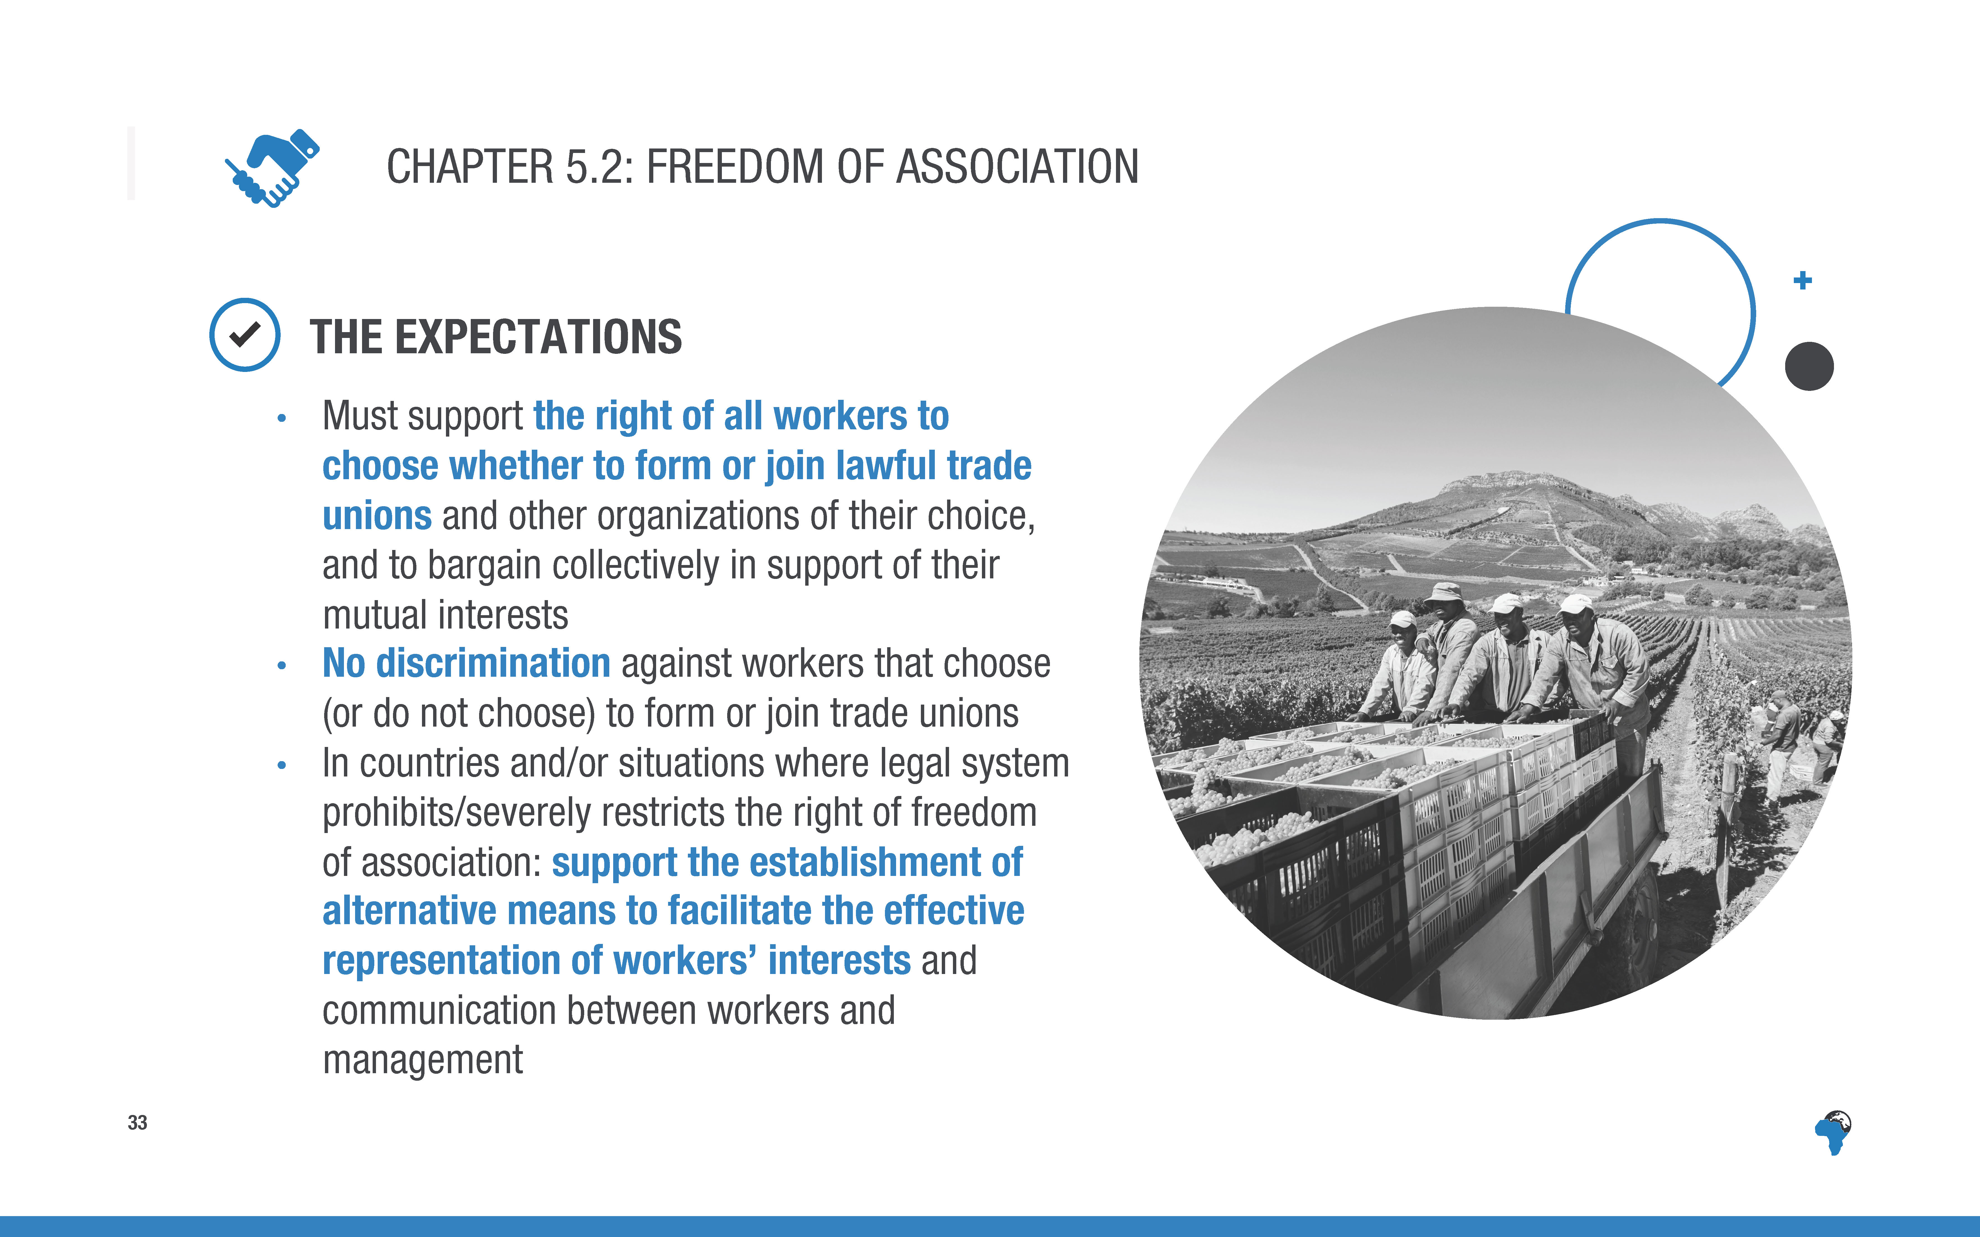
Notes:
[Again, no need to read the expectations word for word, just mention the topline elements]

Slide 36
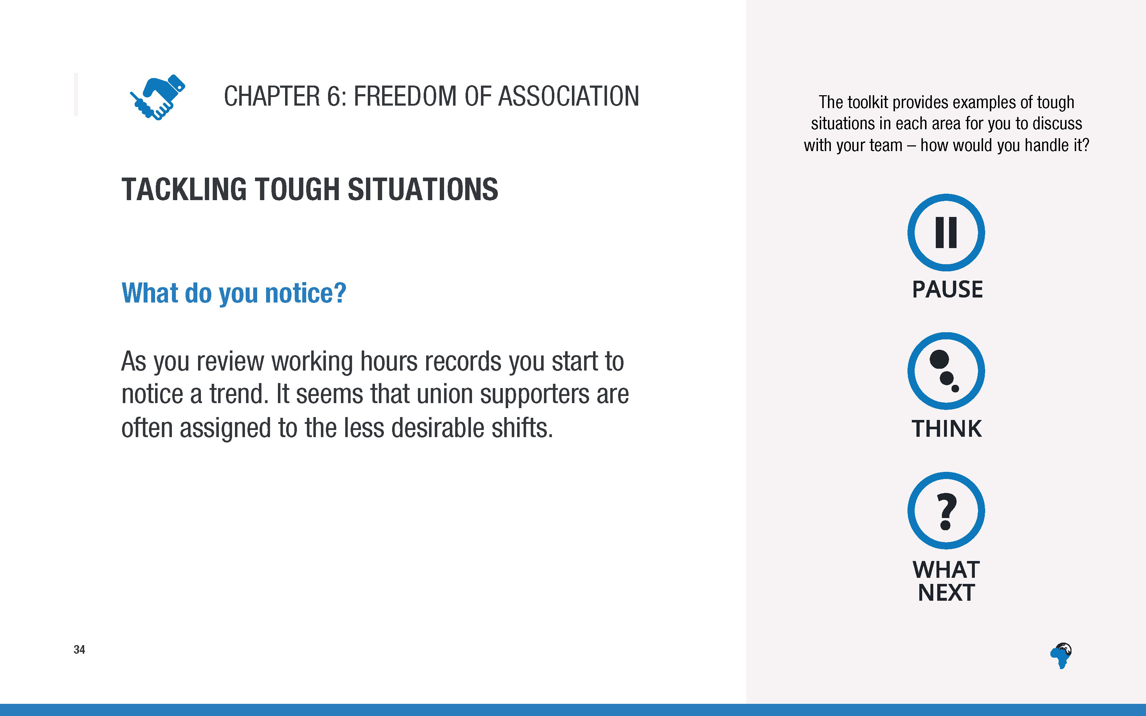
Notes:
[No need to take time to discuss the situation, just note that there are situations to think about and discuss in the toolkit]

Slide 37
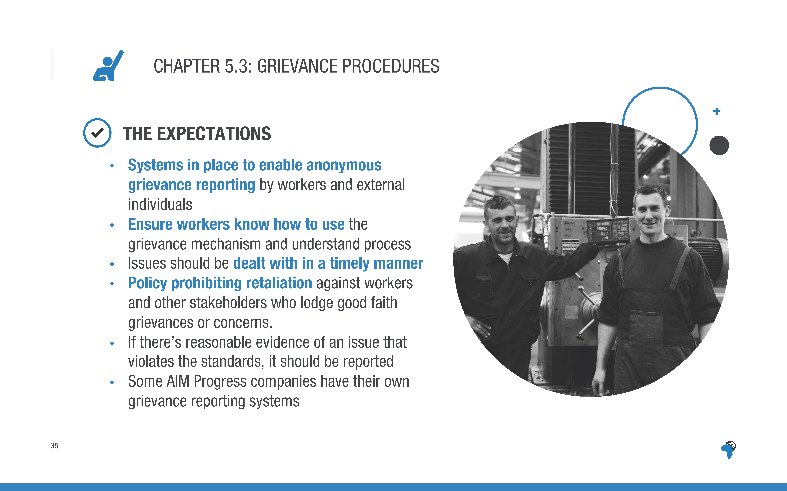
Notes:
[No need to read every word, just an overview]

Slide 38
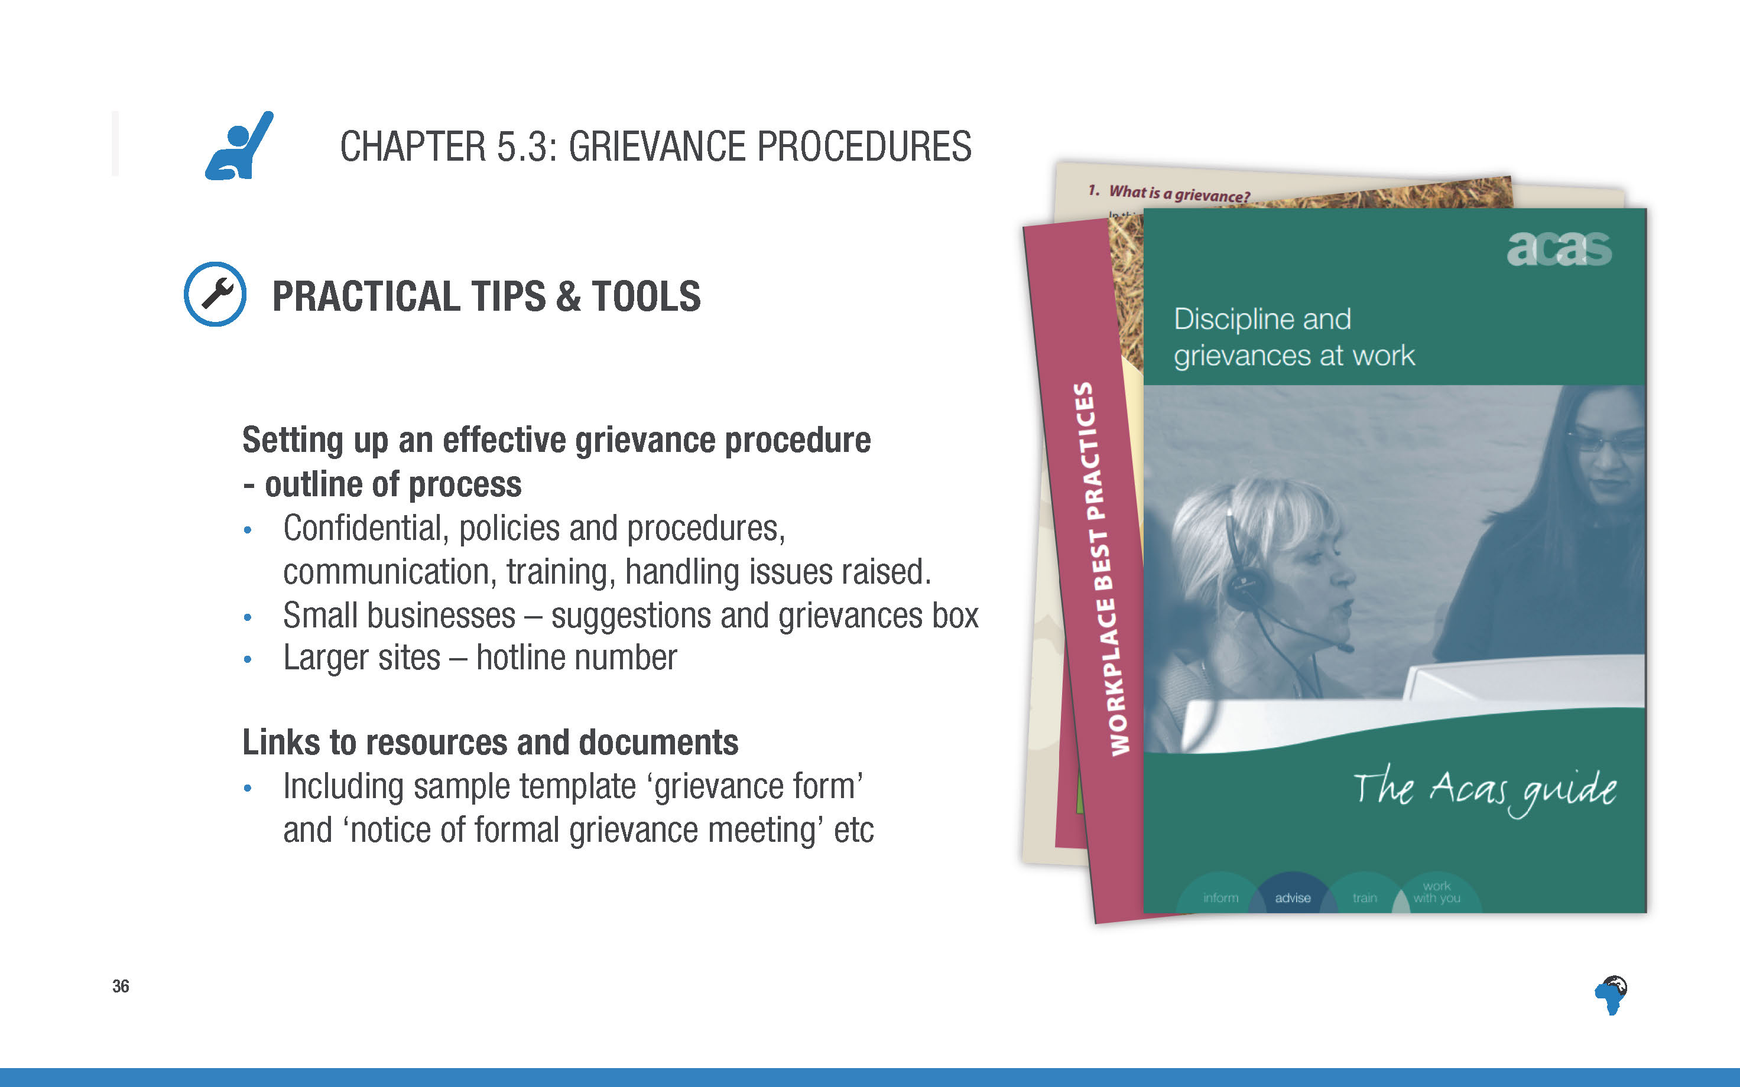
Notes:
[No need to read all the content, just signposting that there are these tools and resources in the toolkit.]

Slide 39
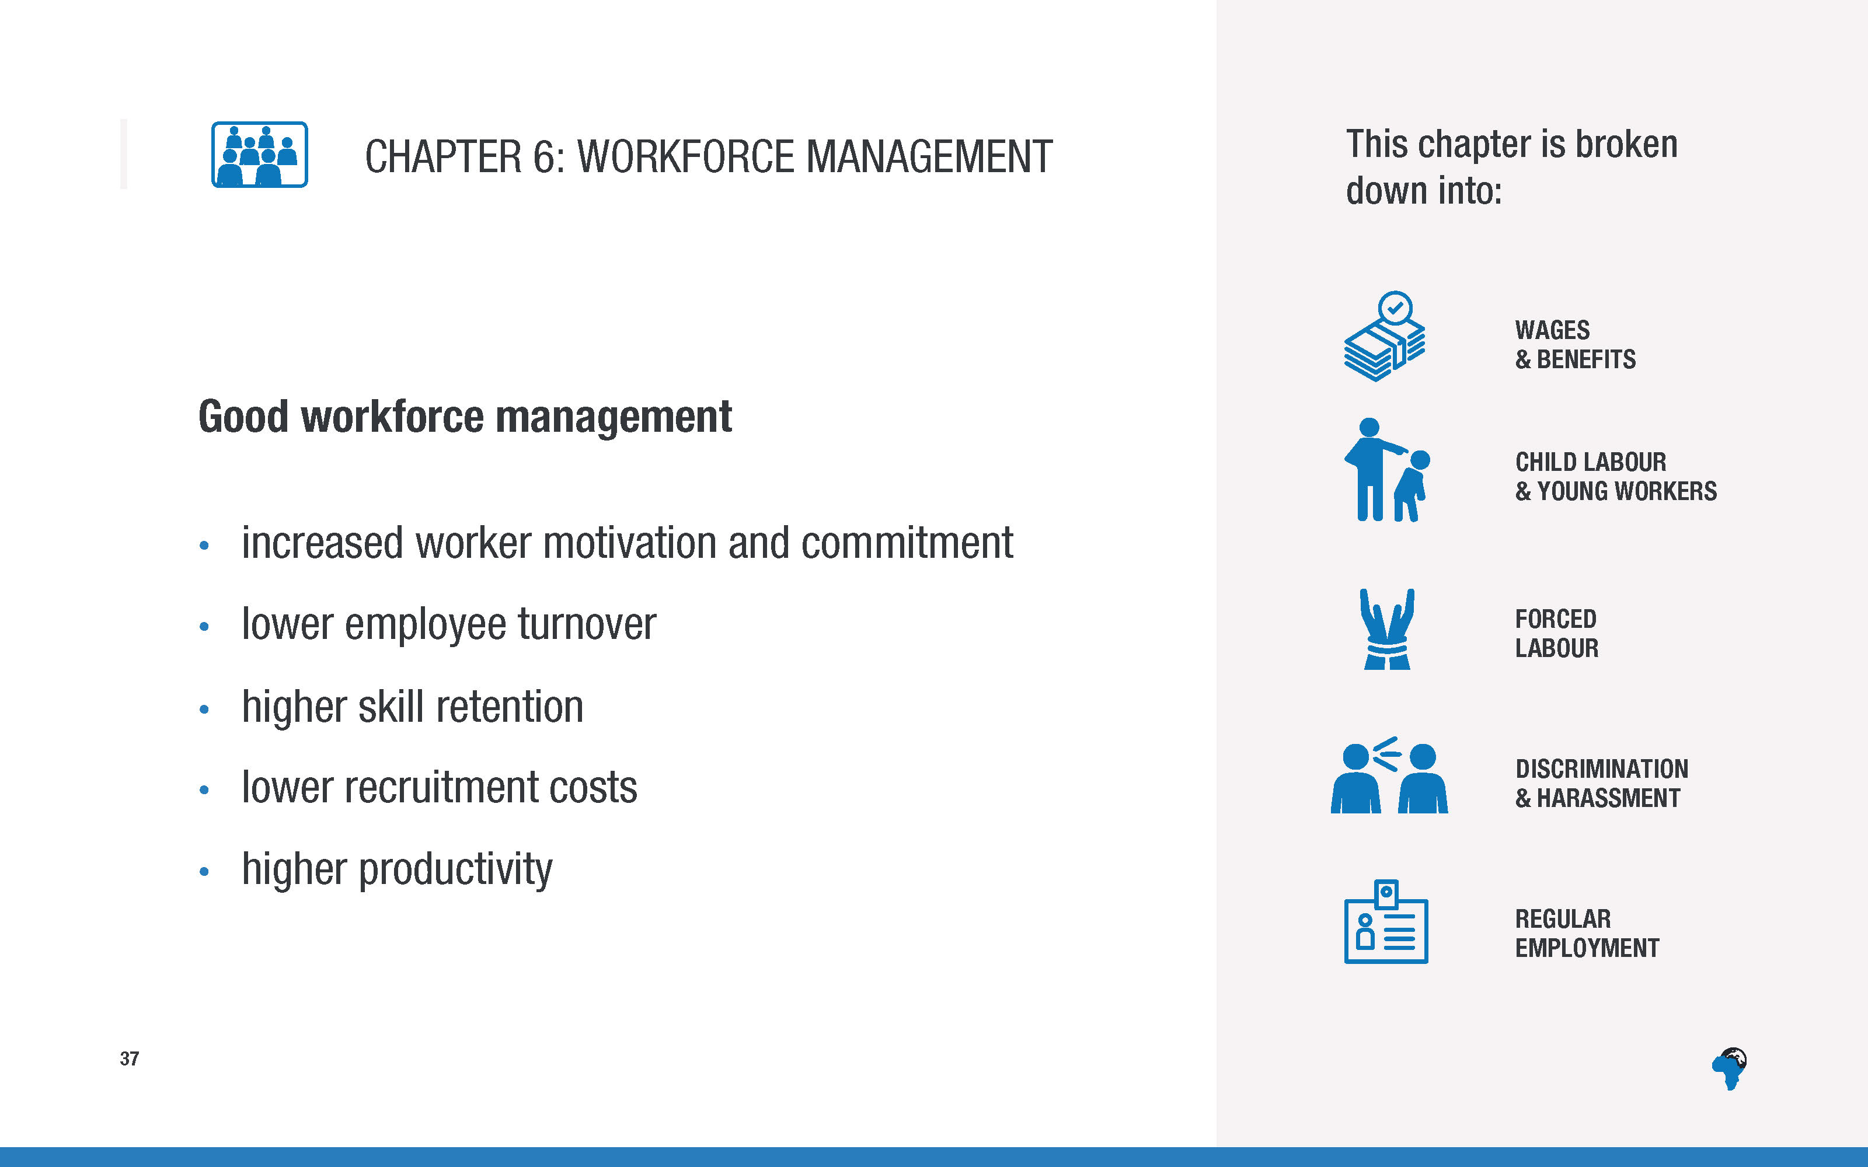
Notes:
[Overview of the sections within this chapter, no need to read them all out
Brief description of the business case for good workforce management – just a few sentences.]

Slide 40
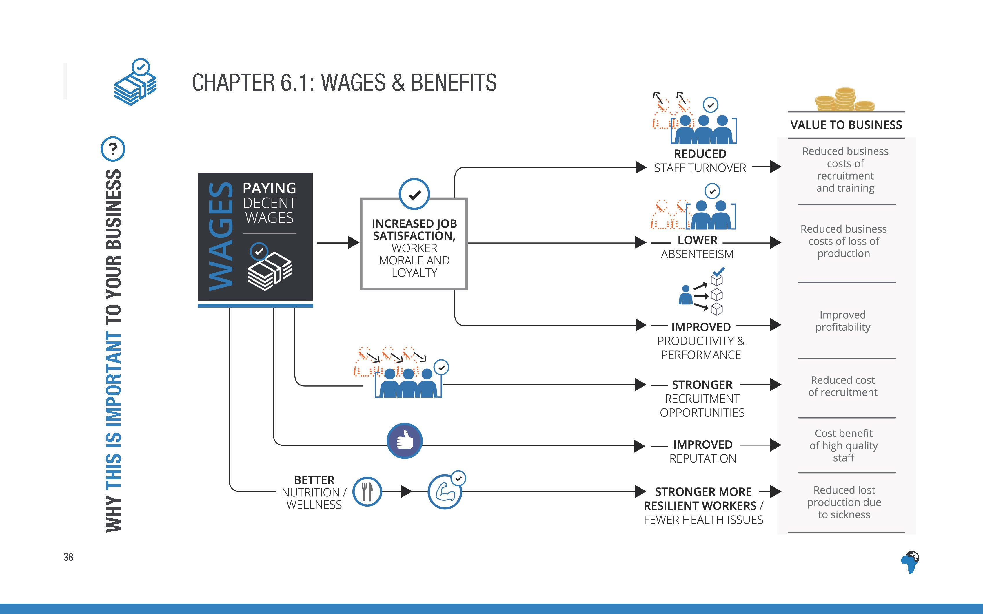
Notes:
Paying decent wages results in increased job satisfaction, worker morale and loyalty, which means reduced turnover and absenteeism and improved productivity and performance. It also improves a business’ reputation and recruitment opportunities.

Slide 41

Notes:
[again no need to read word for word, just highlight the topline points]

Slide 42
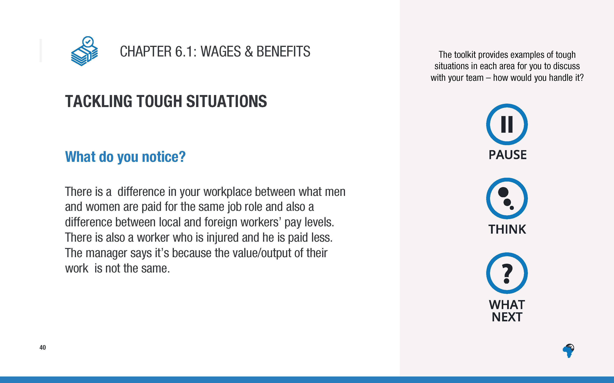
Notes:
[No need to read out or discuss in detail, just signpost to toolkit for ‘tough situations’ to be discussed with their team]

Slide 43
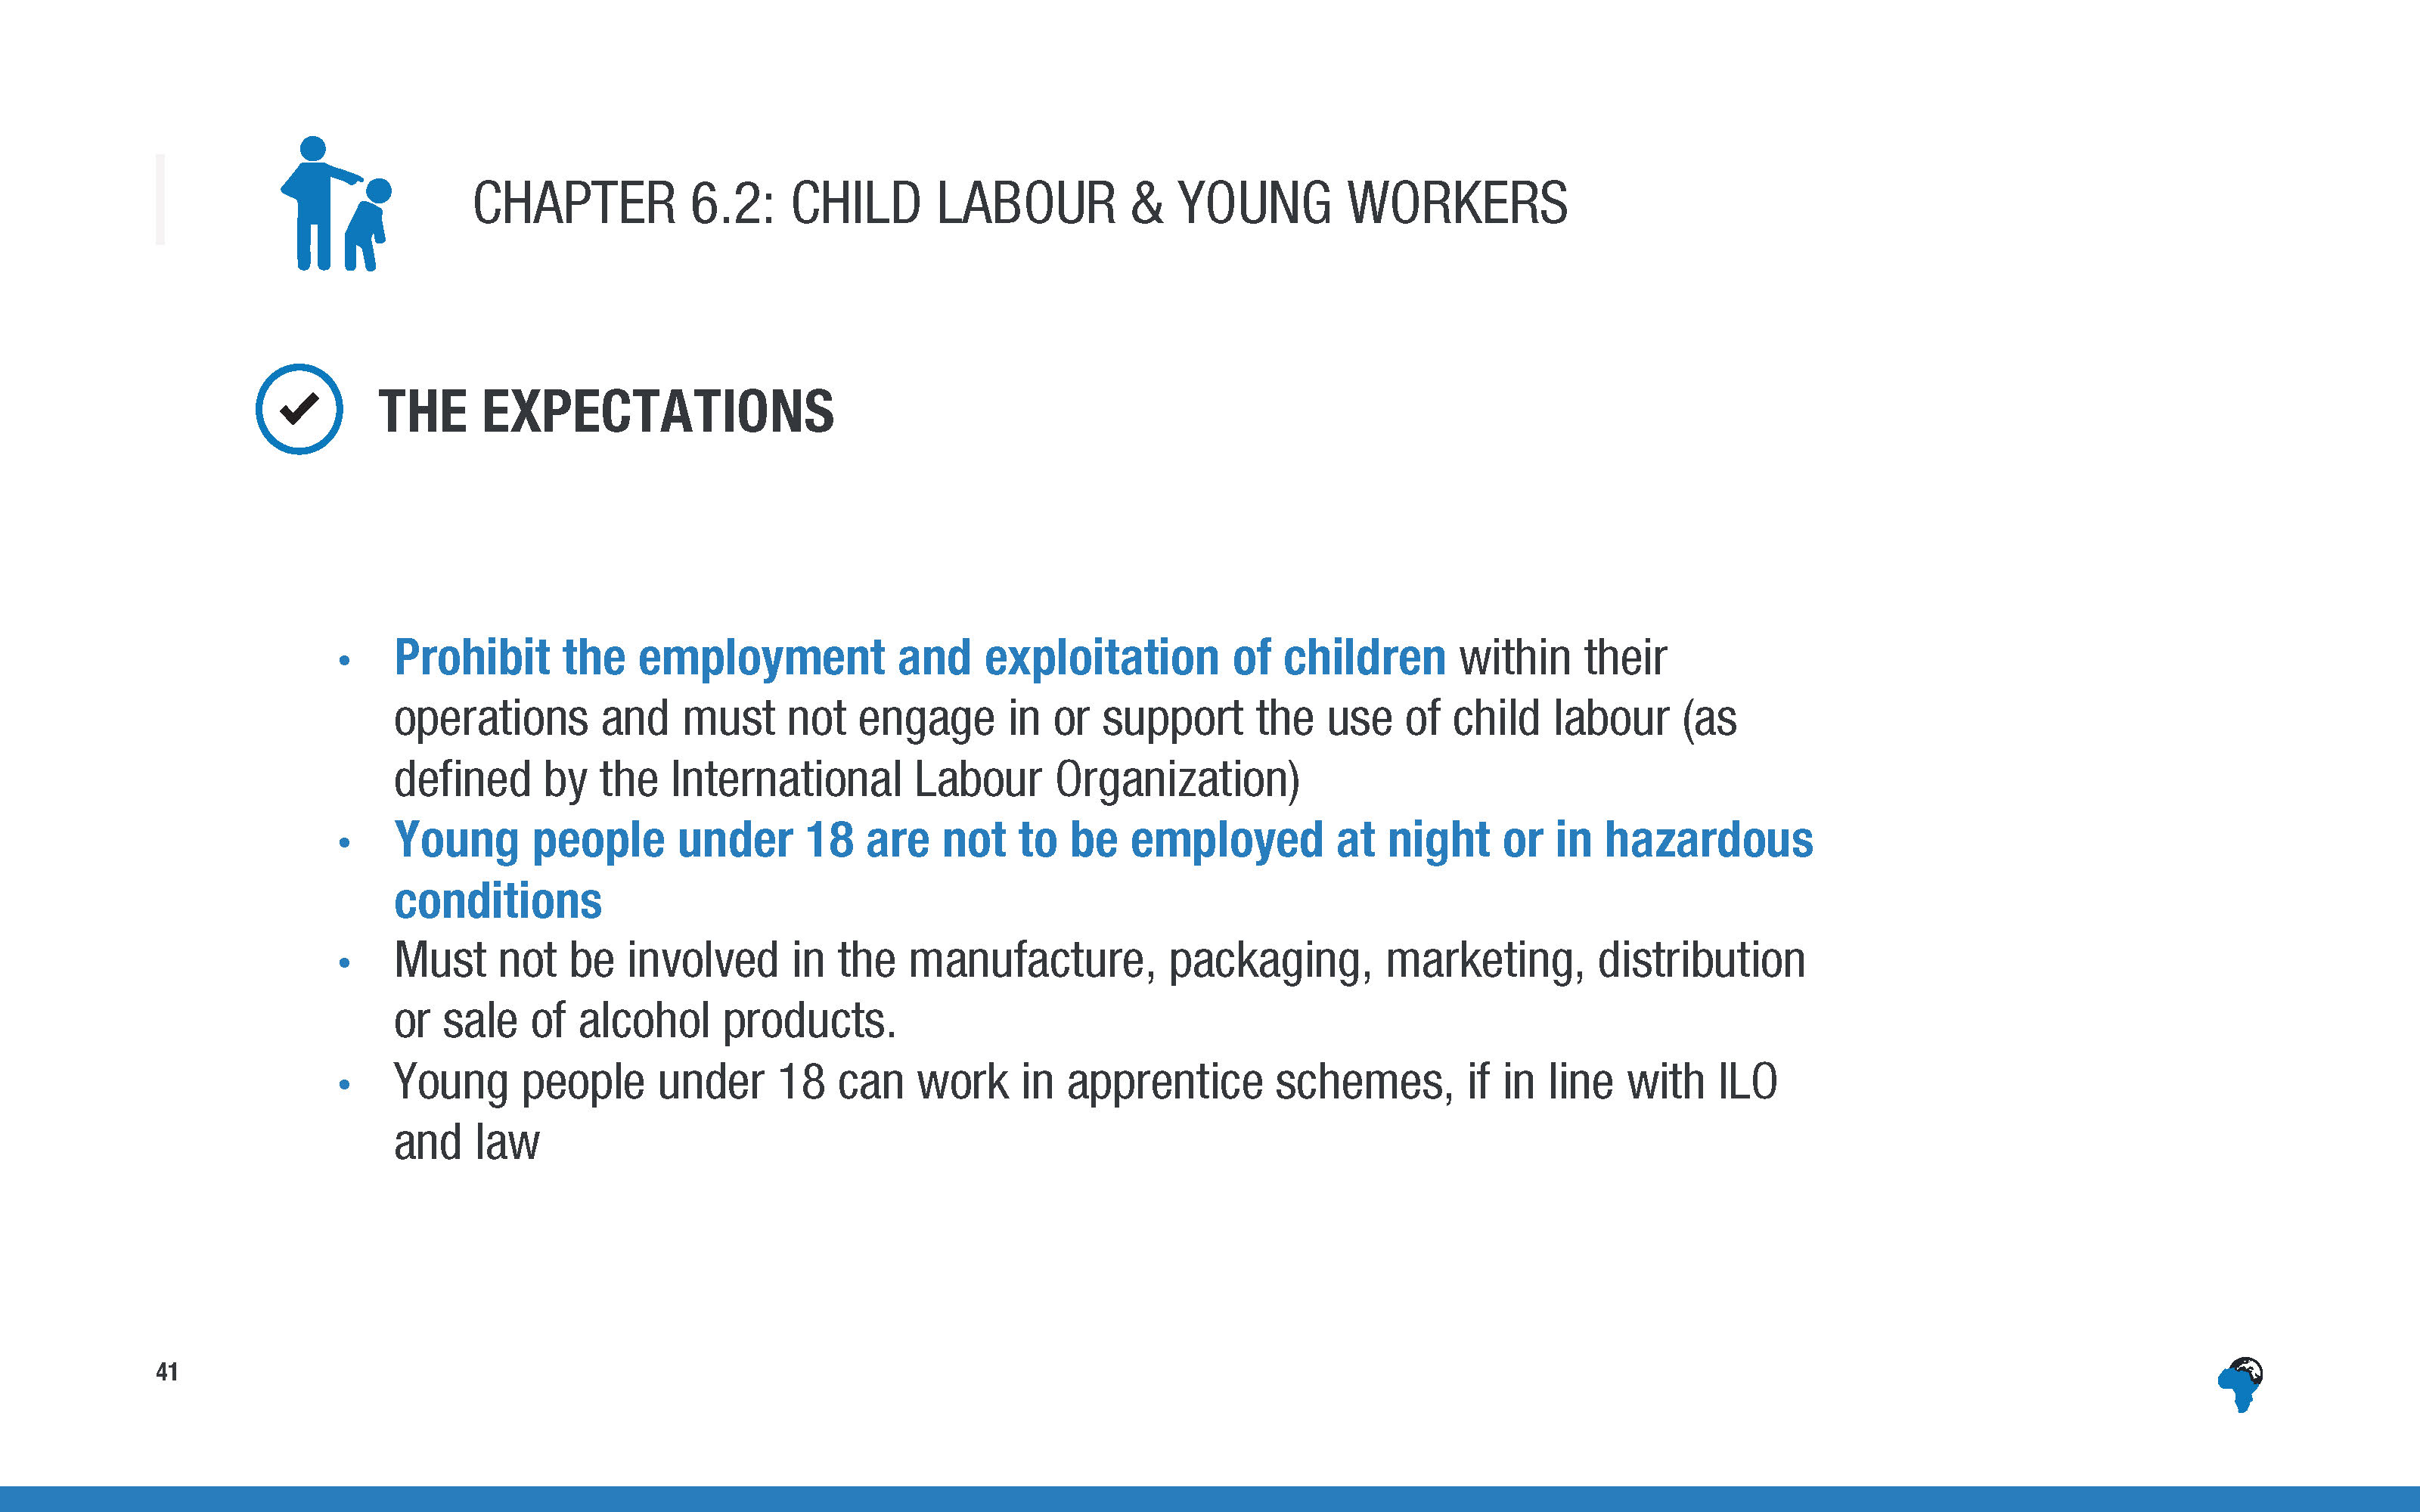

Slide 44
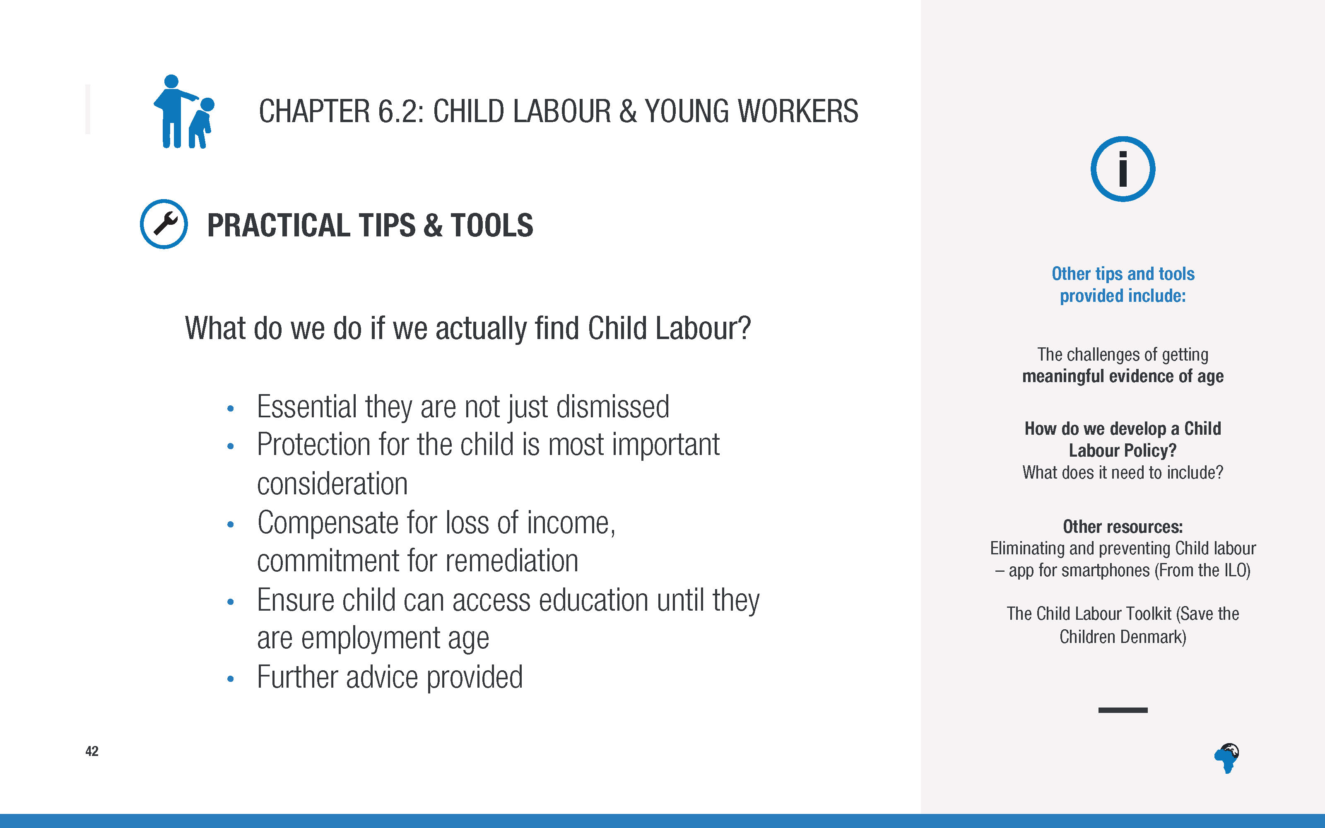
Notes:
[No need to read out the detail of the content of this slide
Just focus on mentioning the ‘what do we do if we actually find child labour’ points on the left, run through this briefly.
No need to read the text on the right, just mention this as a signpost to the sorts of tips and tools and resources that are available in the toolkit, including how to write a child labour policy.]

Slide 45
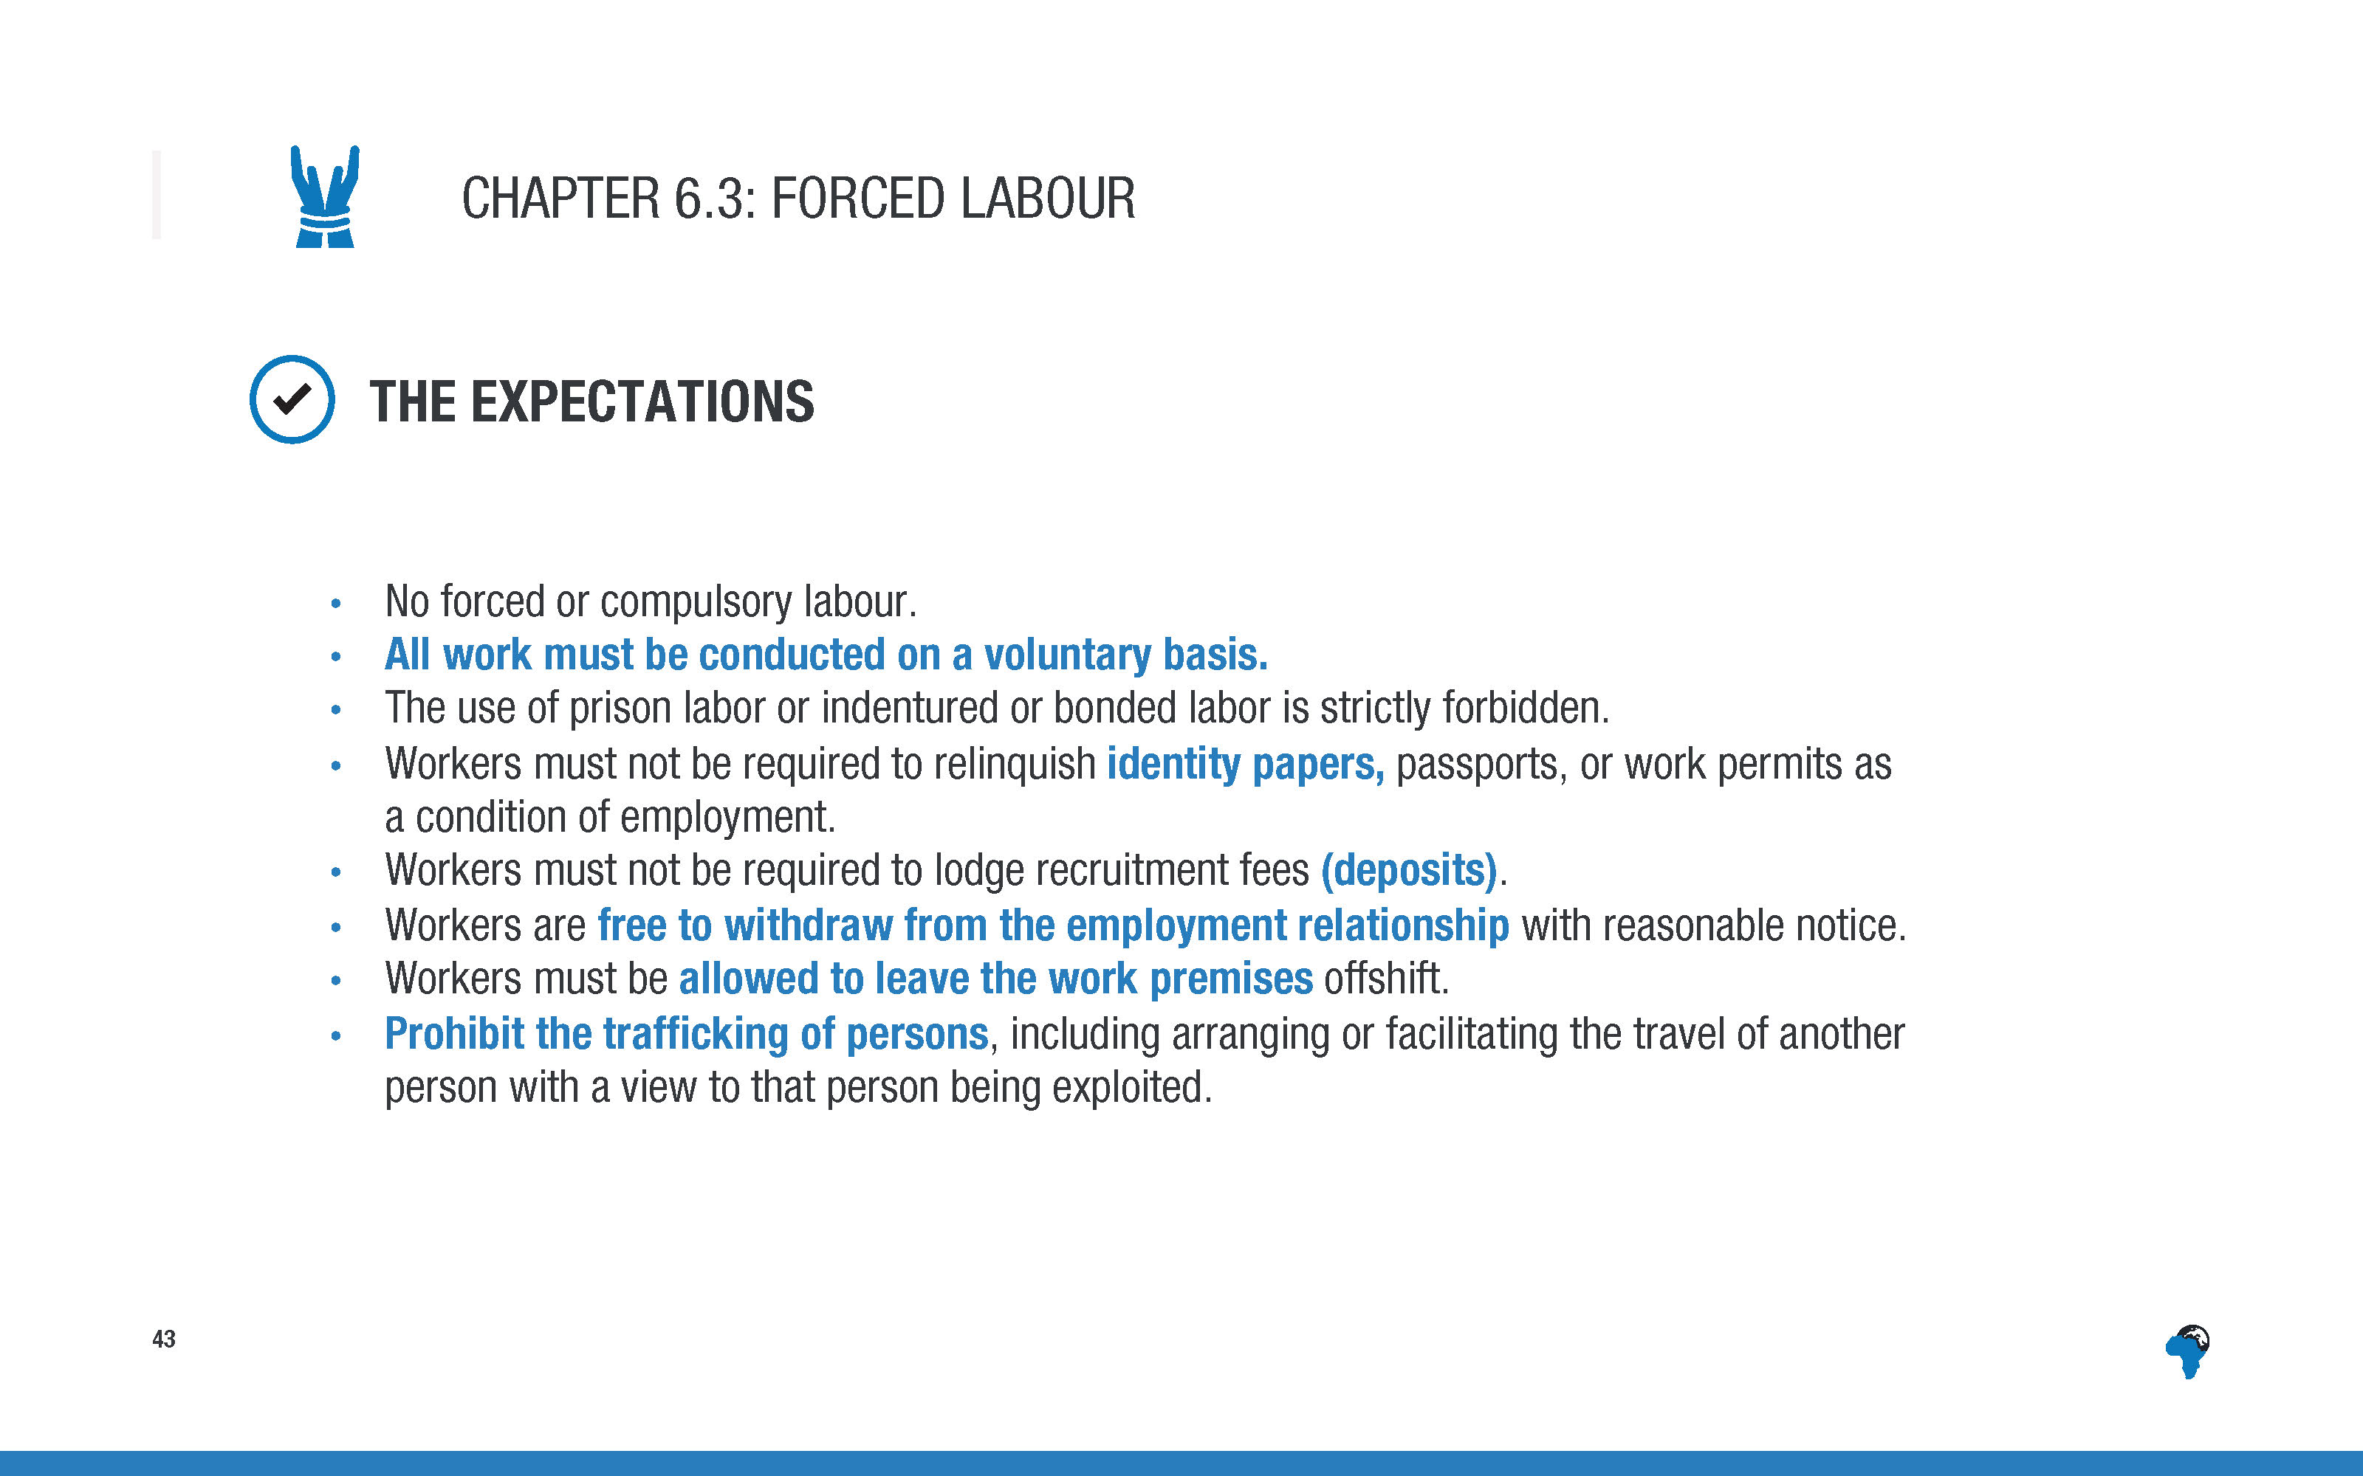
Notes:
[again no need to read word for word, just highlight the topline points]

Slide 46
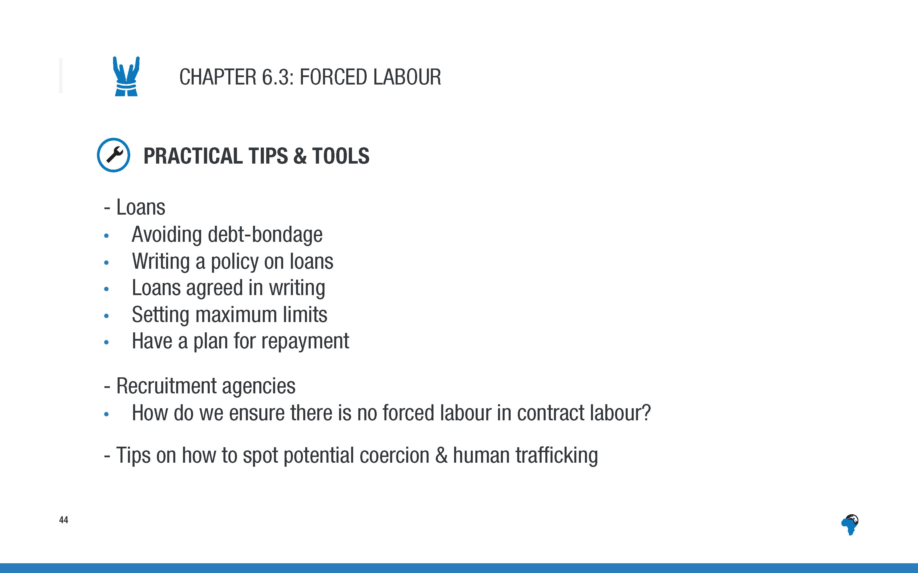
Notes:
[No need to read out the detail of the content of this slide
Just mention the main headings as a signpost to the sorts of tips and tools and resources that are available in the toolkit.]

Slide 47
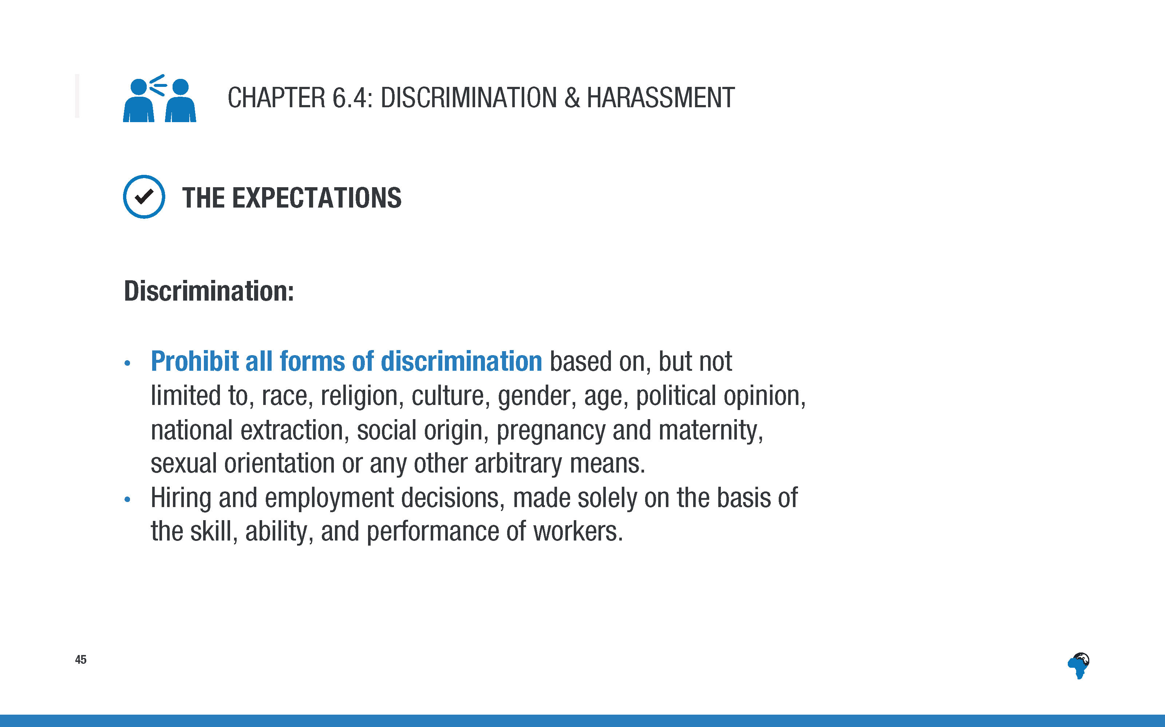
Notes:
[again no need to read word for word, just highlight the topline points]

Slide 48
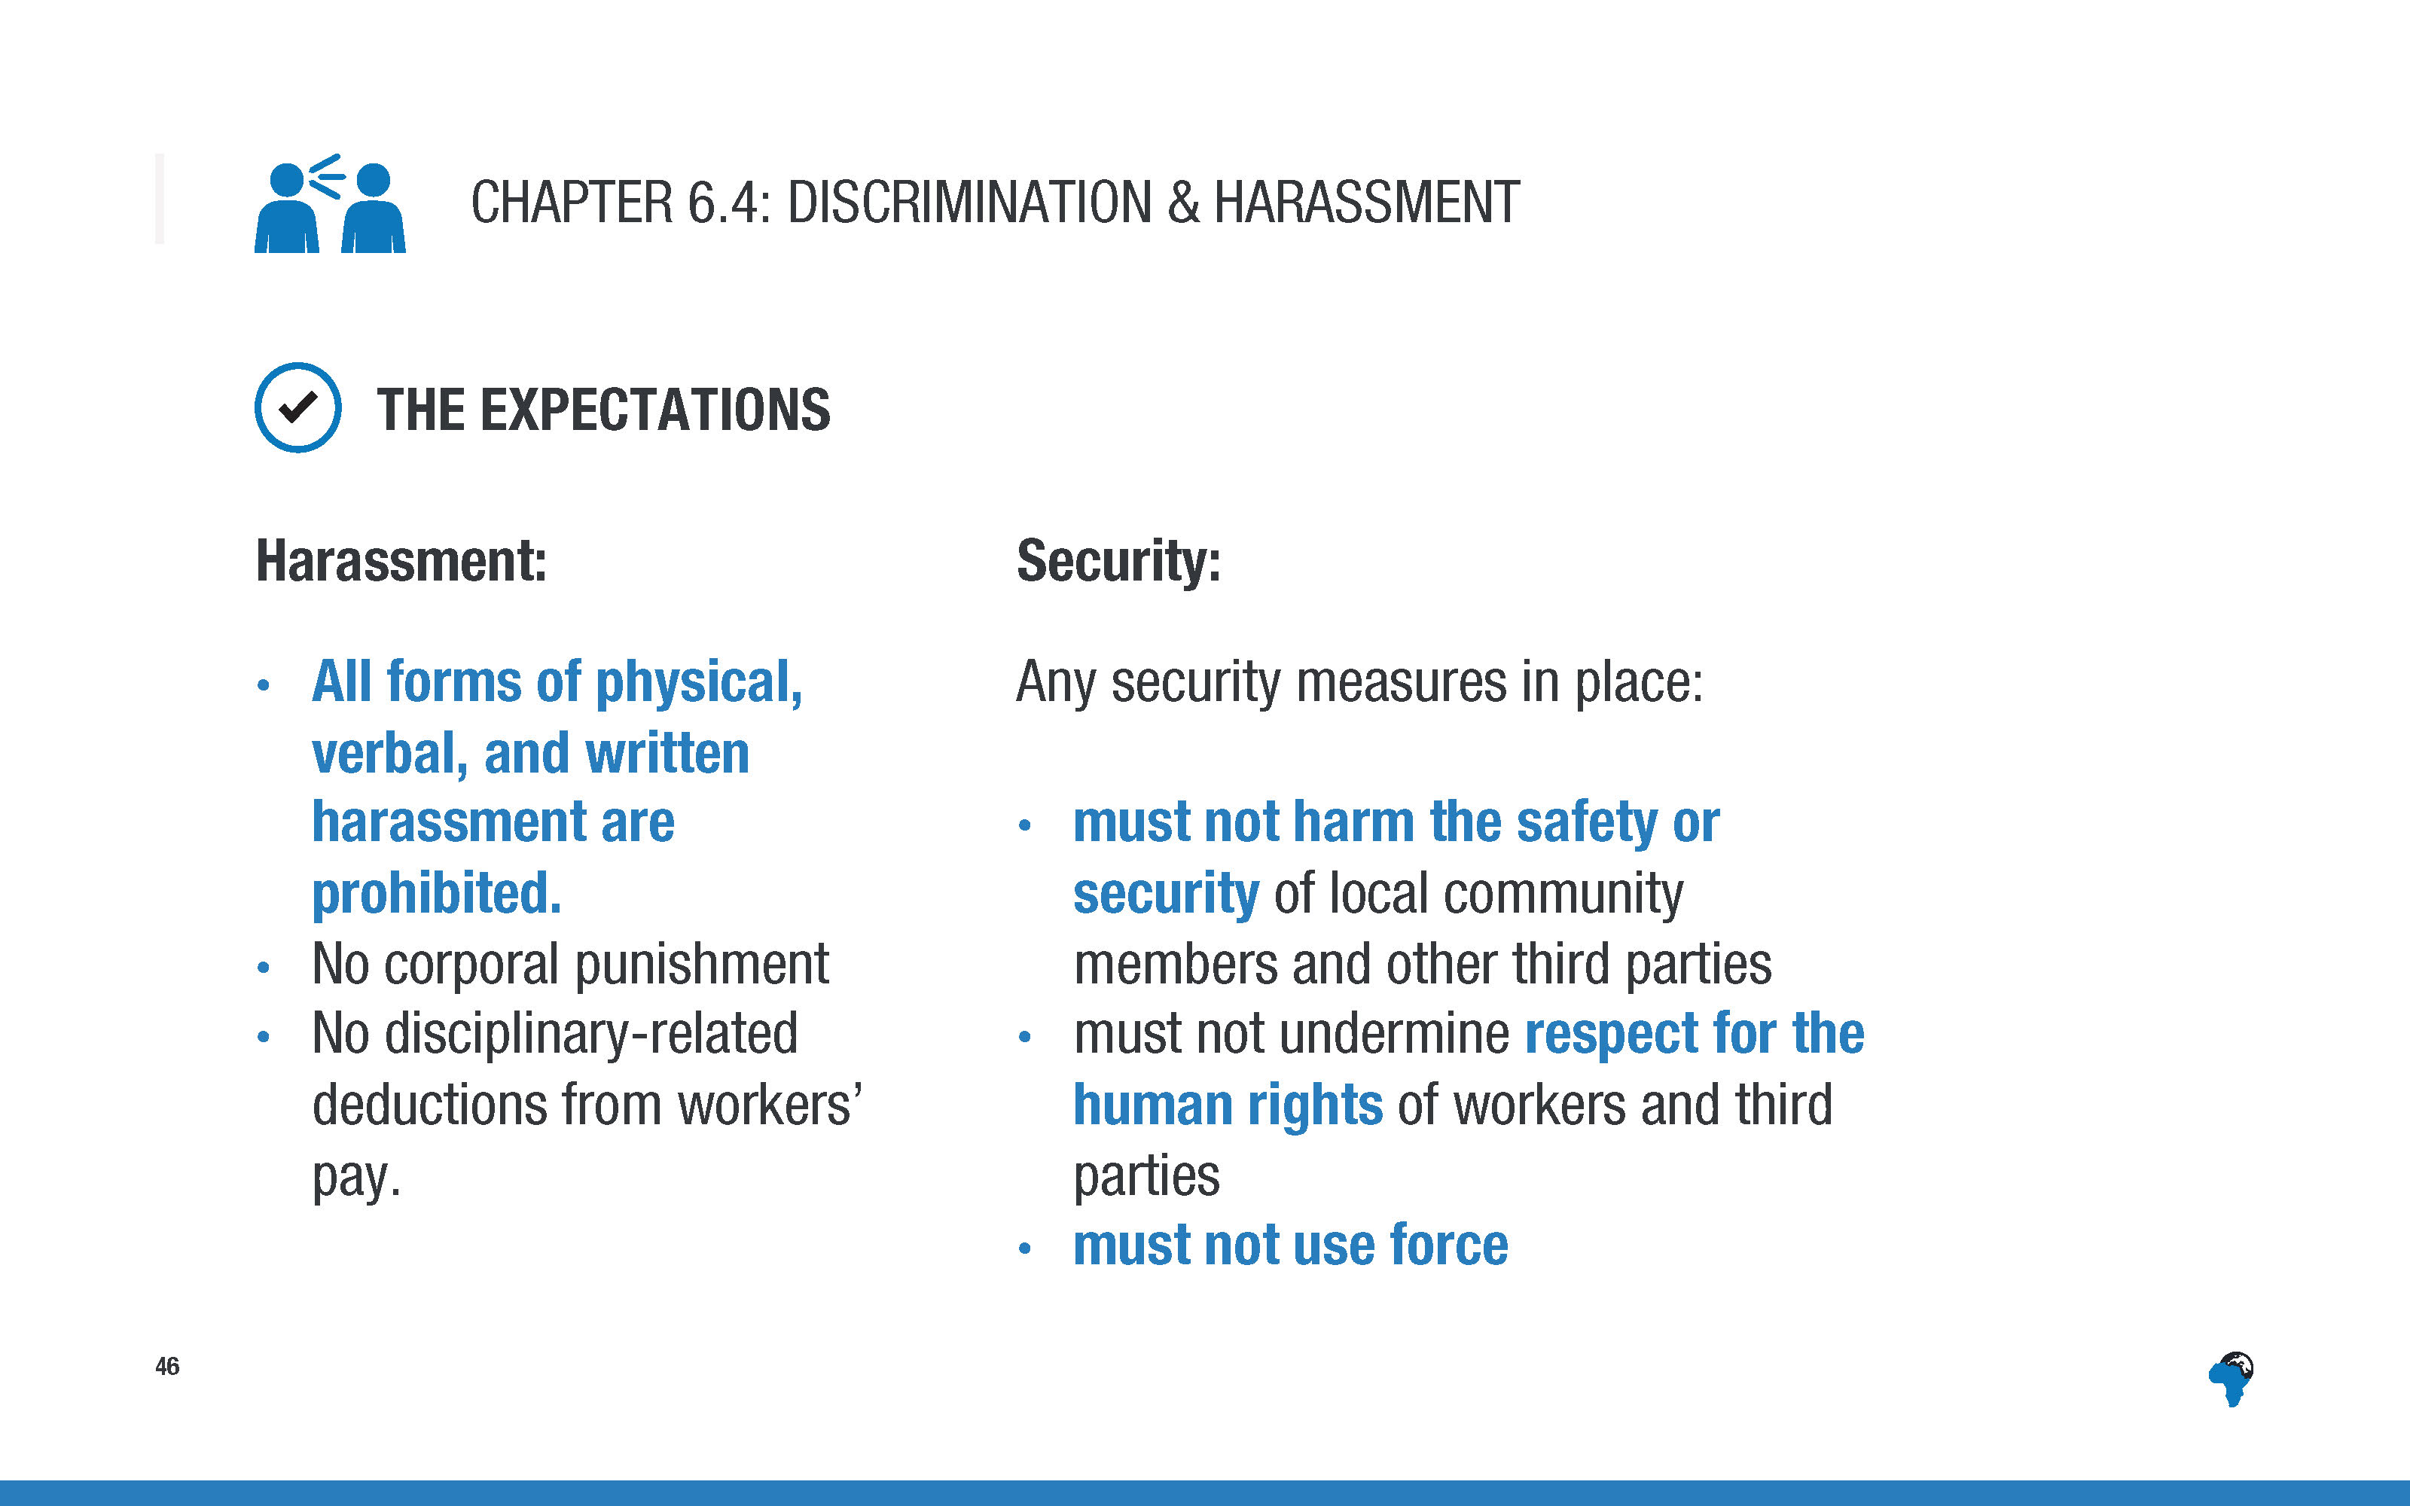
Notes:
[again no need to read word for word, just highlight the topline points]

Slide 49
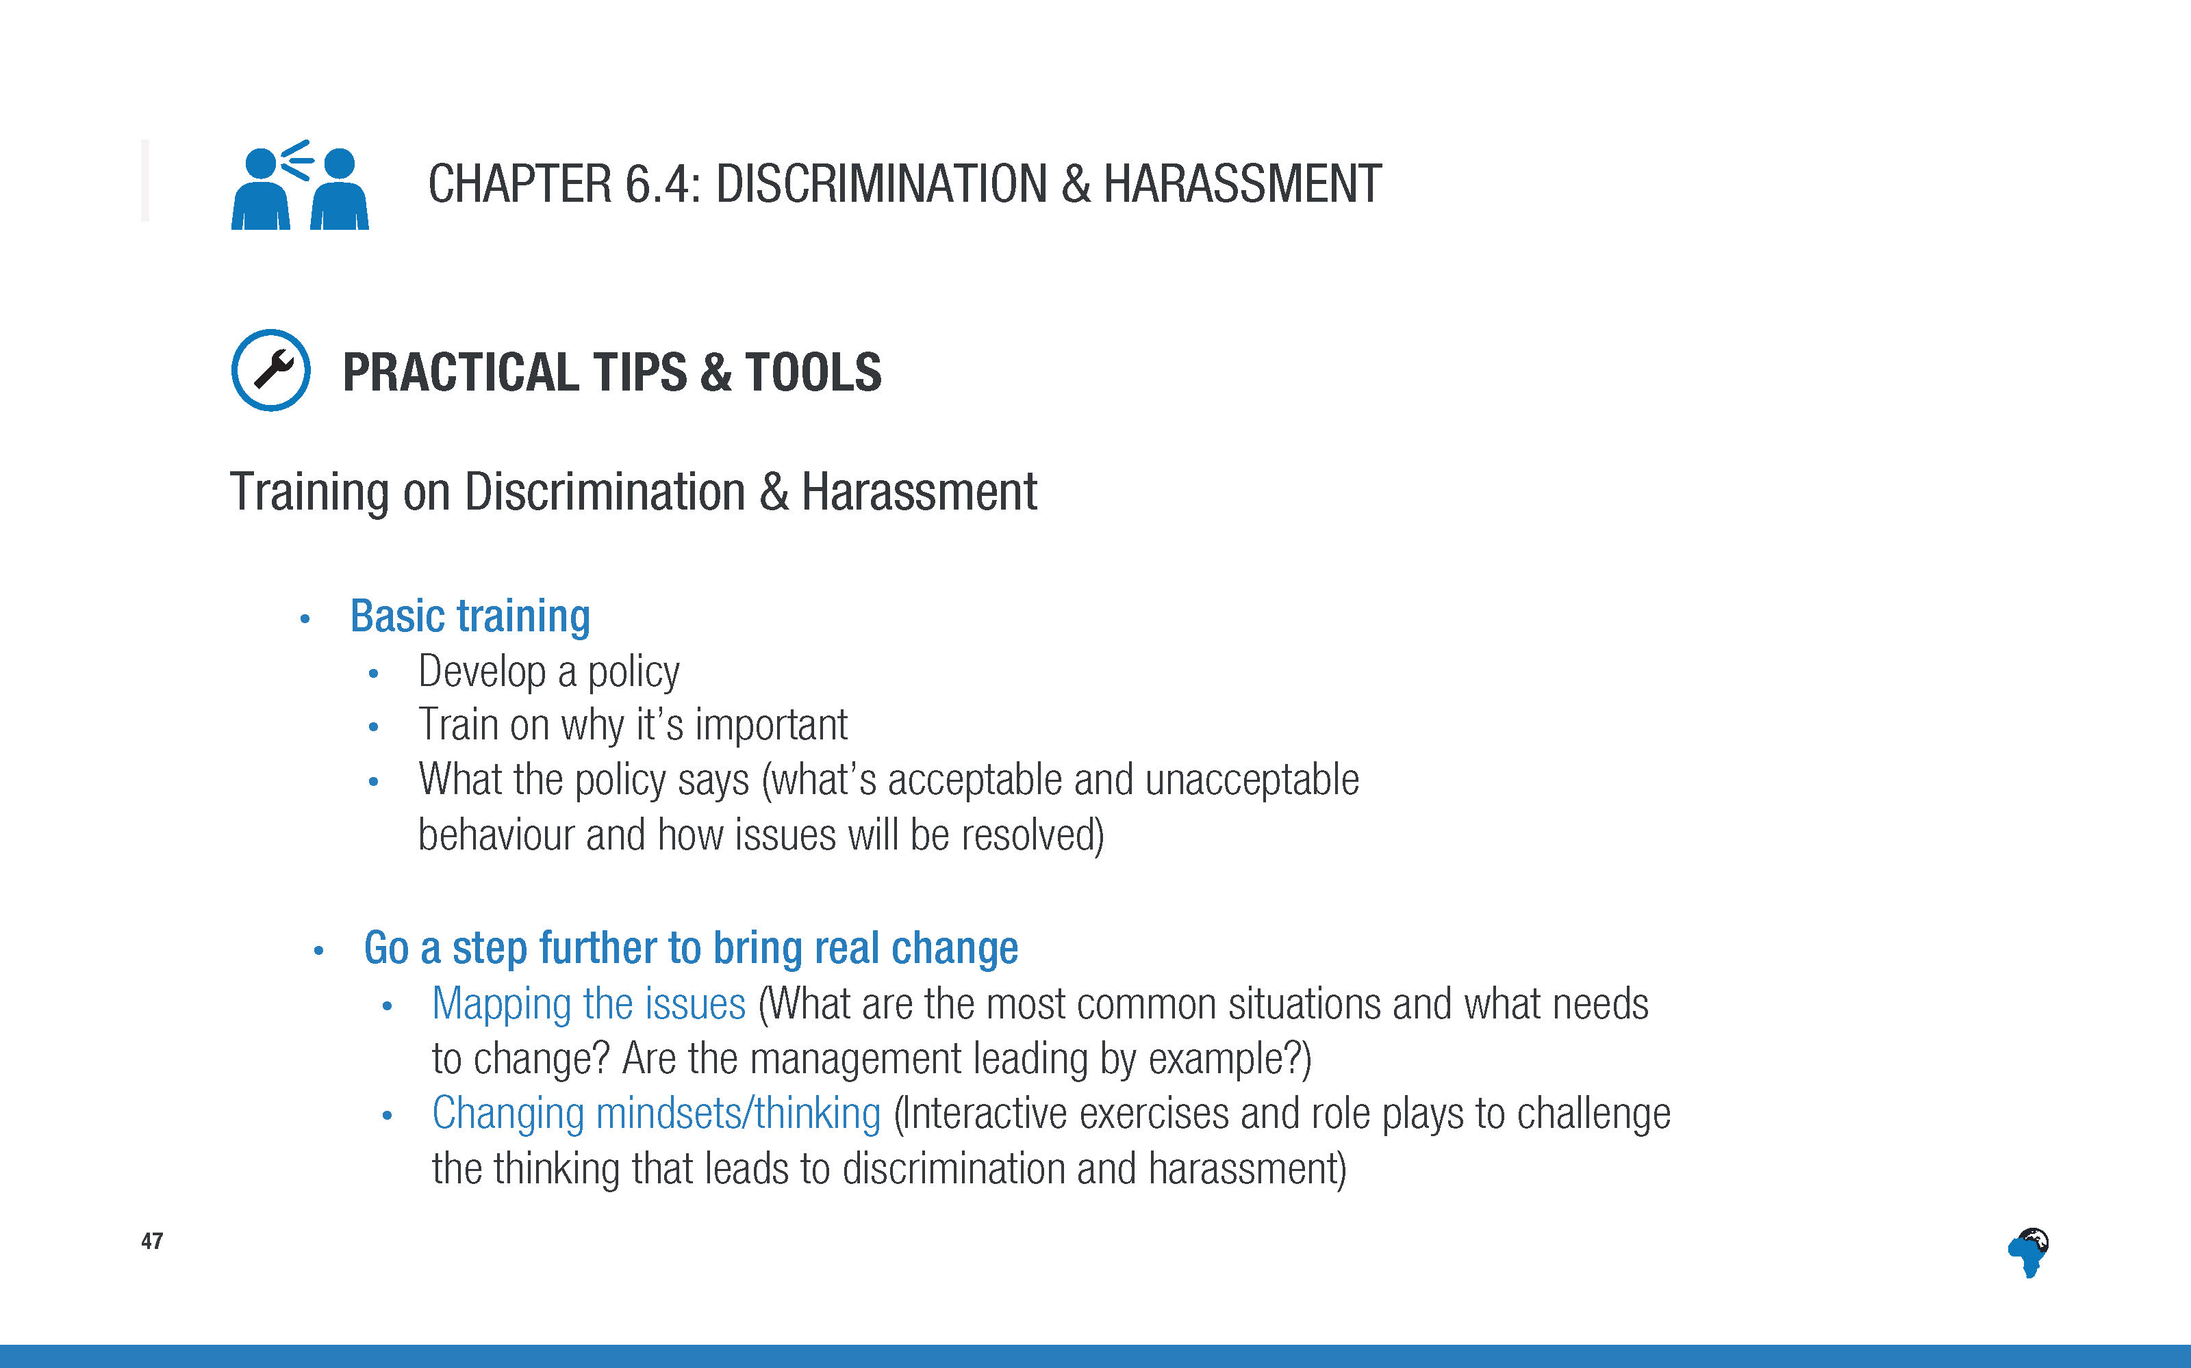
Notes:
[The level to which you talk through this slide depends on the time you have left at this stage]

Slide 50
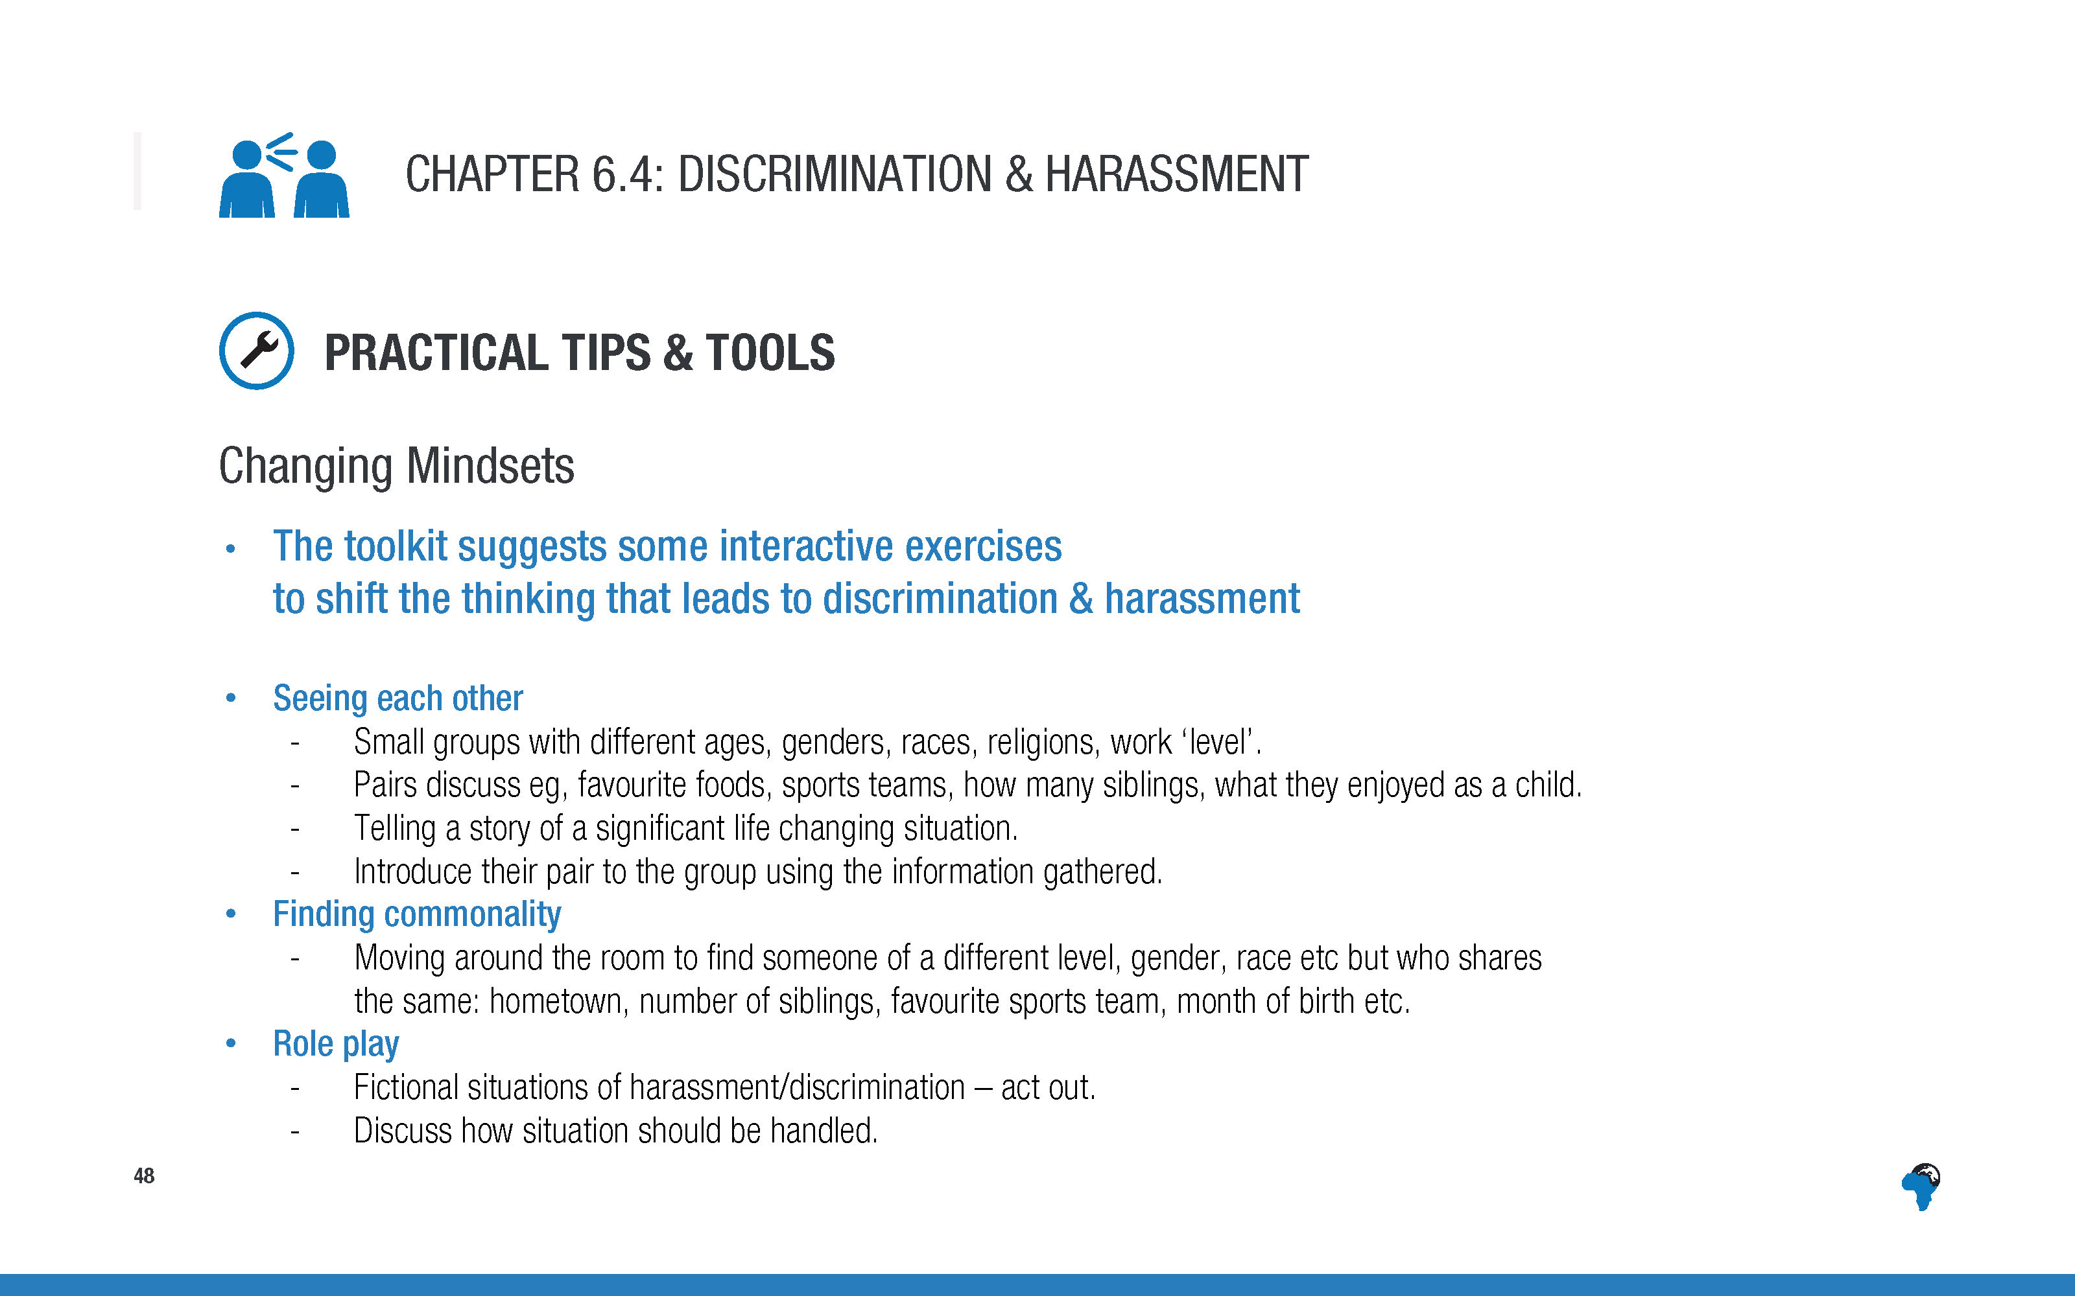
Notes:
[Run through the three ideas for activities, very briefly.
The level to which you talk through this slide depends on the time you have left at this stage]

Slide 51
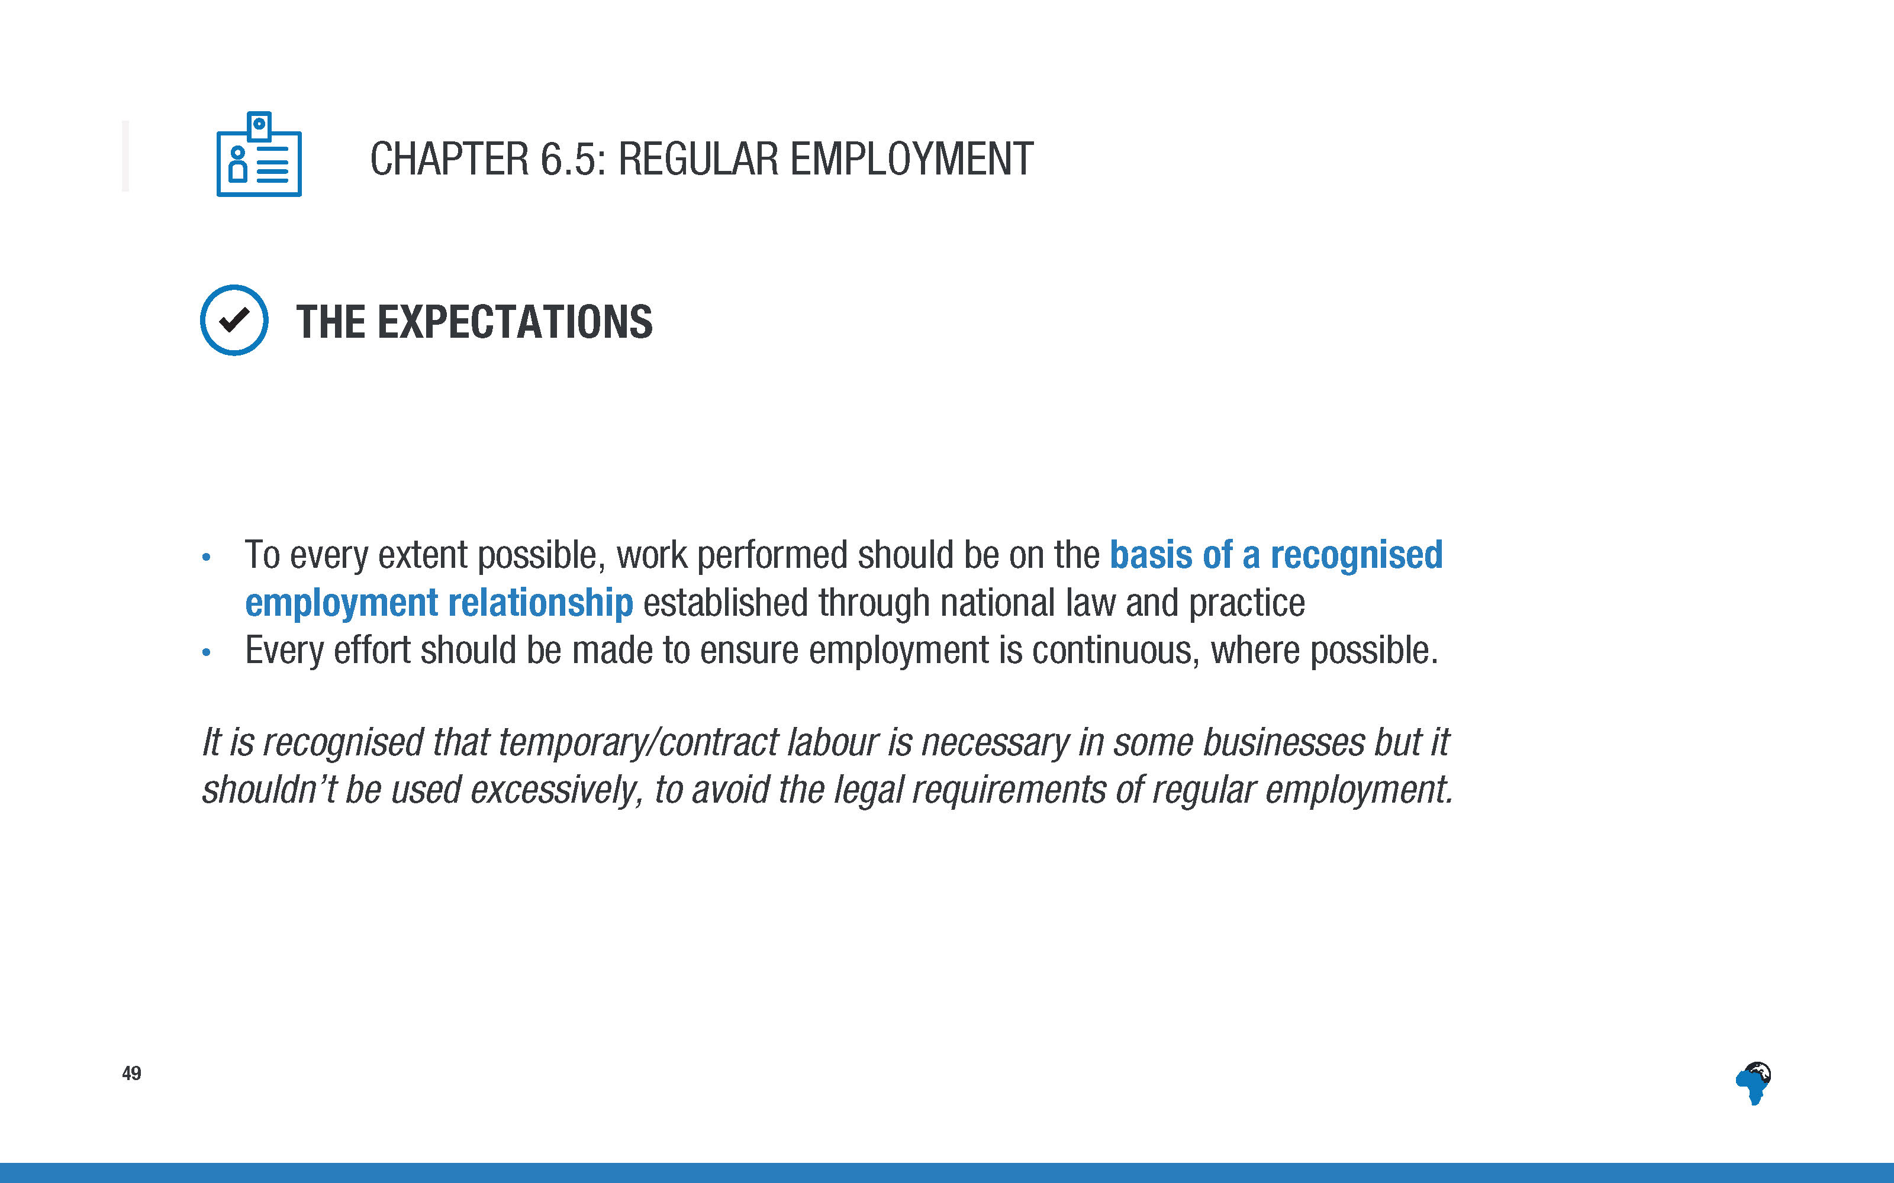

Slide 52
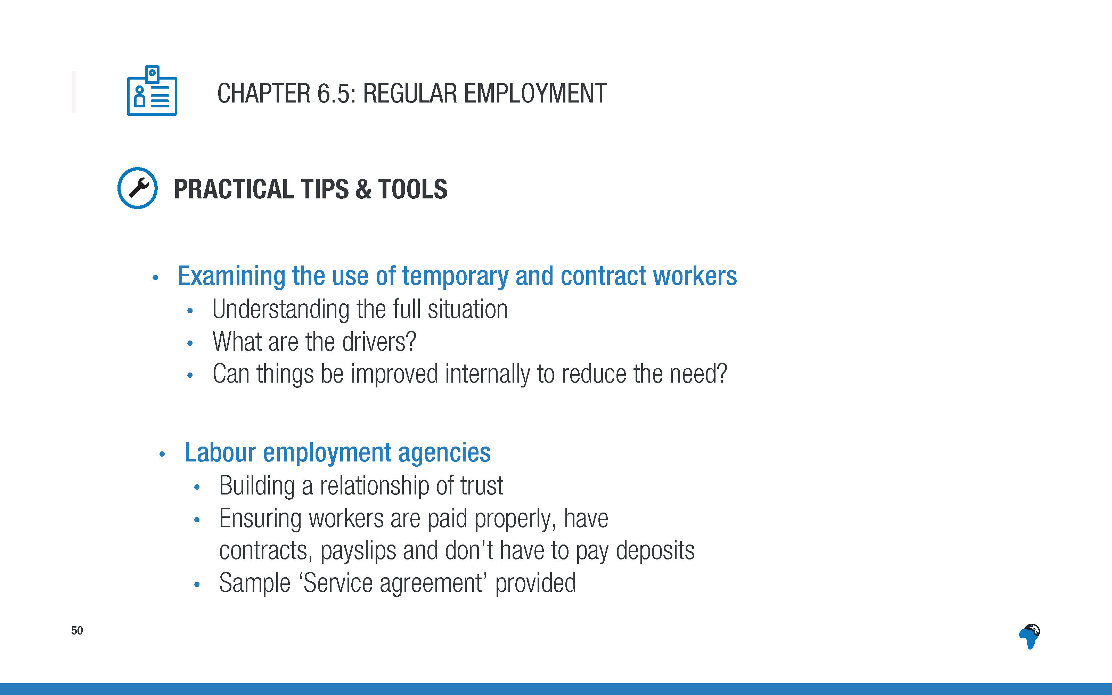
Notes:
[No need to read out the detail of the content of this slide
Just mention this as a signpost to the sorts of tips and tools and resources that are available in the toolkit.]

Slide 53
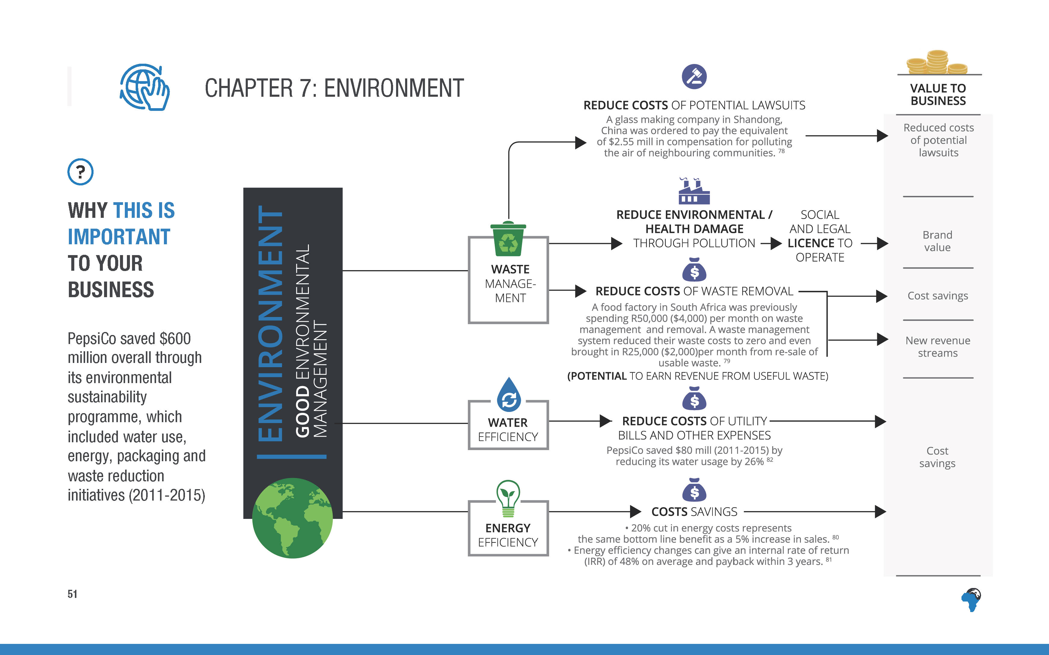
Notes:
There are some big opportunities to reduce business costs by reducing waste, water use and energy use.
PepsiCo saved $80 mill by reducing its water usage by 26%, which was part of its wider programme that saved a total of $600mill through reducing water and energy use, packaging and waste.

Slide 54
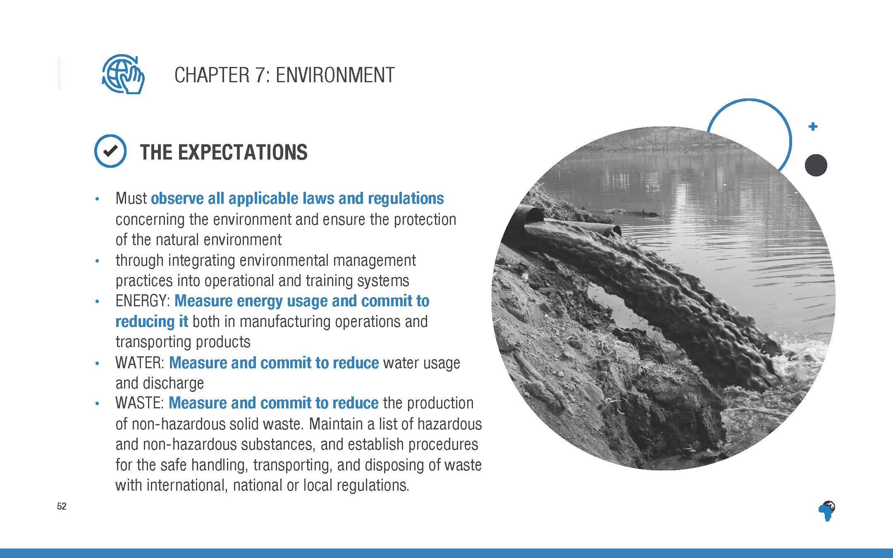
Notes:
[No need to read out every word, just highlight the 3 areas of requirements: energy, water and waste – measure and reduce each.]

Slide 55
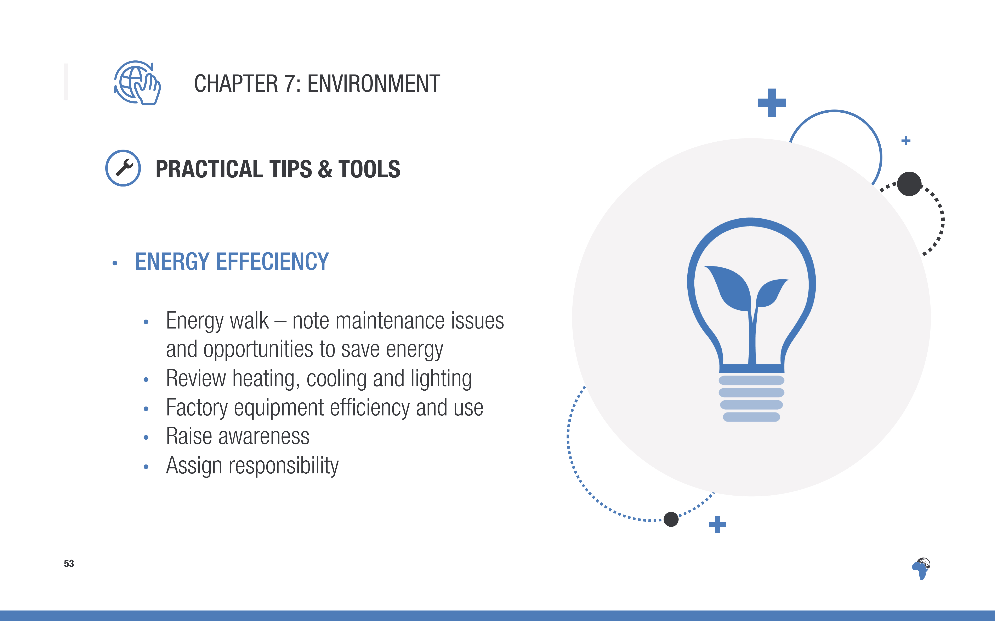
Notes:
There are detailed tools and tips for increasing energy efficiency in the toolkit, including…

Slide 56
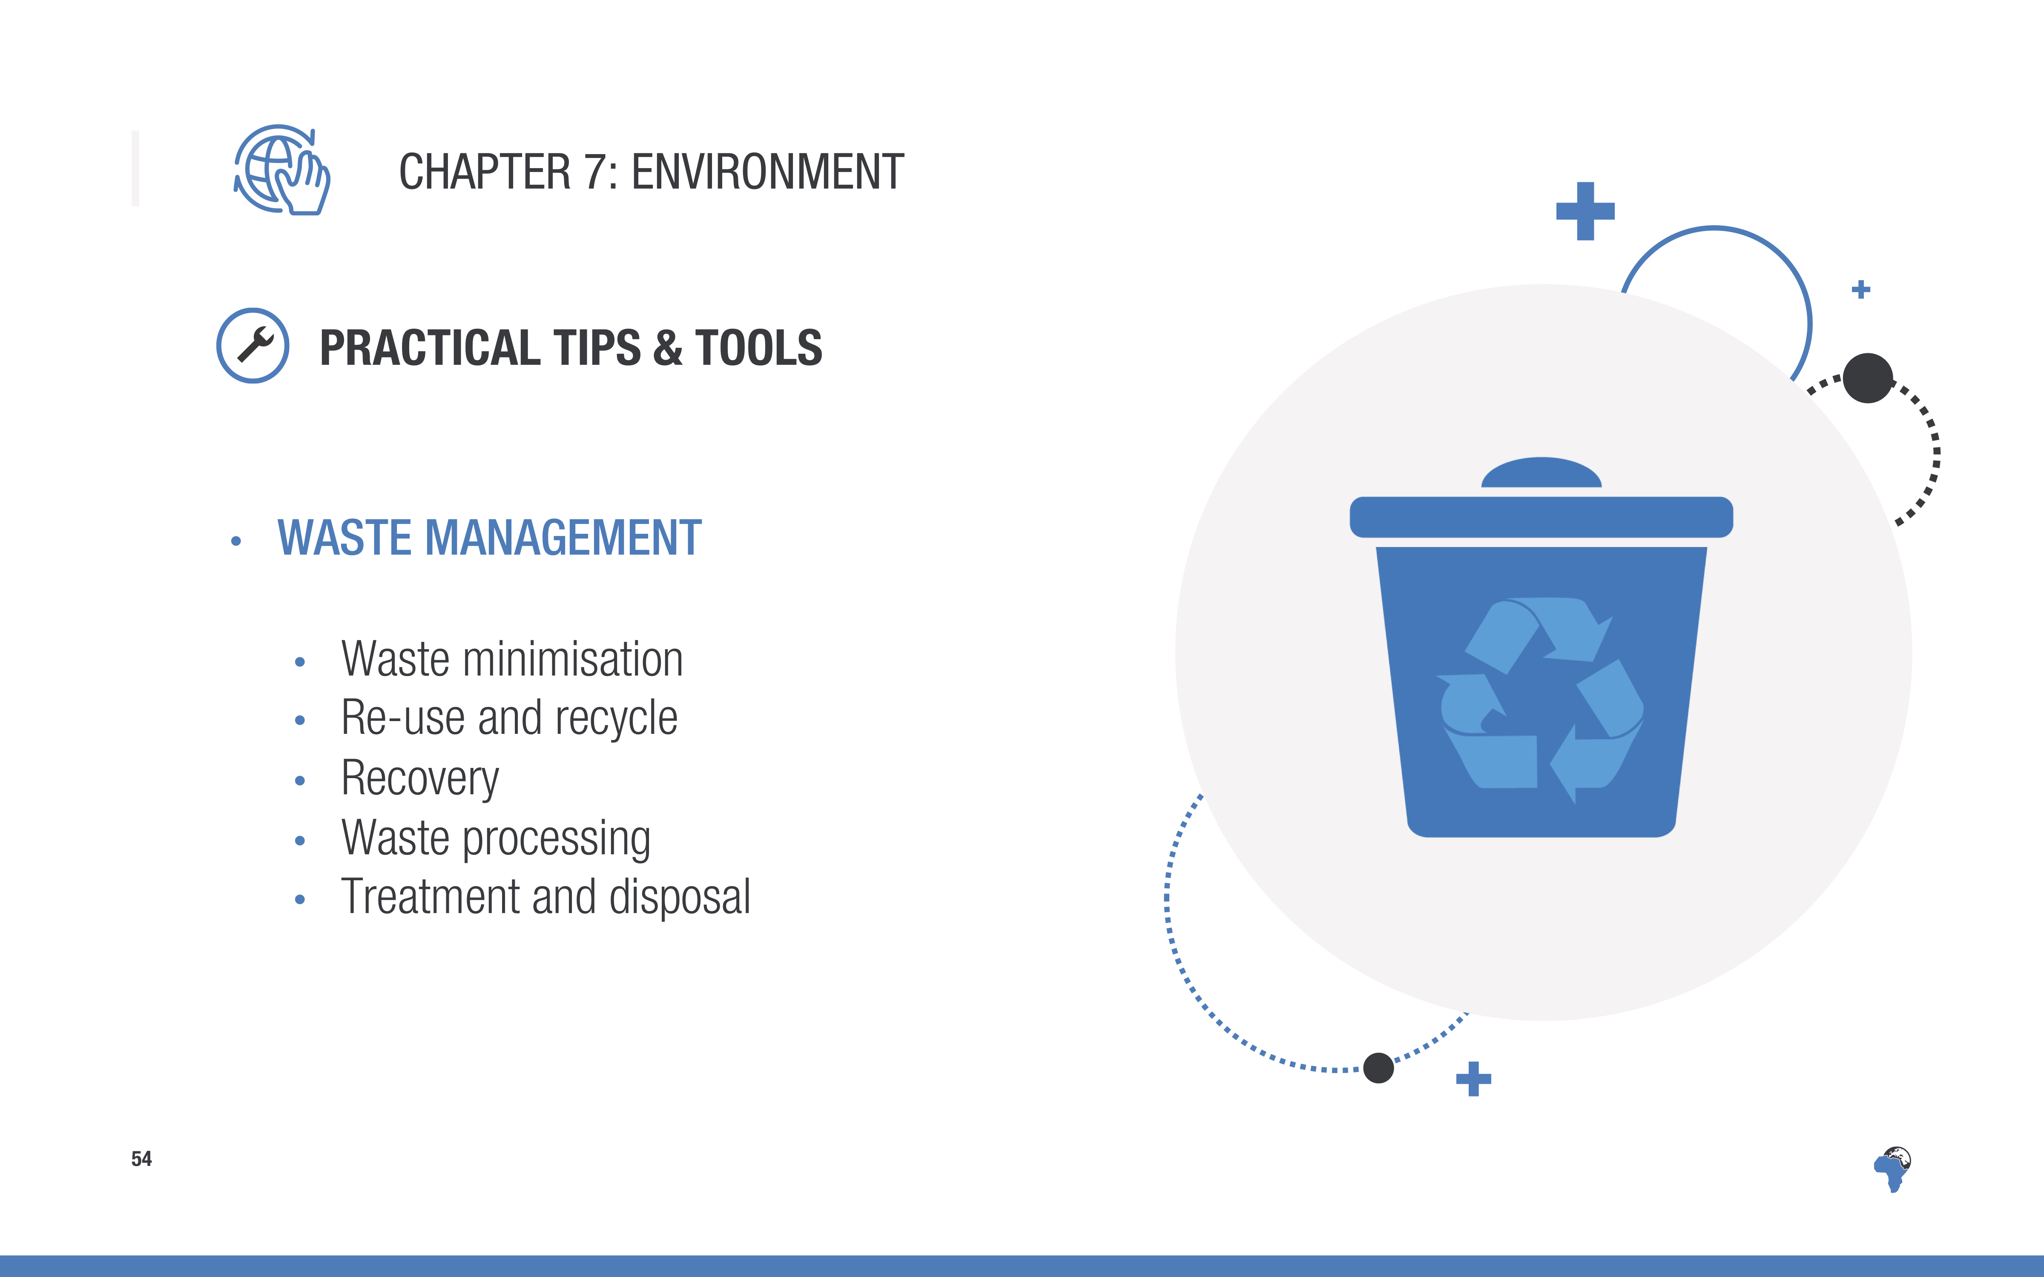

Slide 57


Slide 58

Notes:
[again no need to read word for word, just highlight the topline points]

Slide 59

Notes:
[again no need to read word for word, just highlight the topline points]

Slide 60

Notes:
[No need to read out the detail of the content of this slide
Just mention this as a signpost to the sorts of tips and tools and resources that are available in the toolkit.]

Slide 61

Notes:
If land rights issues aren’t handled adequately and appropriately, it can result in significant costs for a business including court cases, adverse media attention and production delays.

Slide 62

Notes:
[No need to read the content in detail but signpost the fact that there are tools, steps to take and advice in the toolkit. This section will be more relevant to some companies and regions than others]

Slide 63

Notes:
[No need to read the content in detail but signpost the fact that there are tools, steps to take and advice in the toolkit. This section will be more relevant to some companies and regions than others]

Slide 64

Notes:
[Ask for feedback on these questions from the whole group, if there is time.]

Slide 65


